Slide 1
Topological Network Design: Link Locations
B
Dr. Greg Bernstein
Grotto Networking
www.grotto-networking.com

Slide 2
Outline
Network Node Types
Access vs. transit
Expenses:
Capital and Operating
Link Placement Problem
With installation (capital) and operating costs
Book sections 2.7 (pg 65), 6.3 (pg. 230-234)

Slide 3
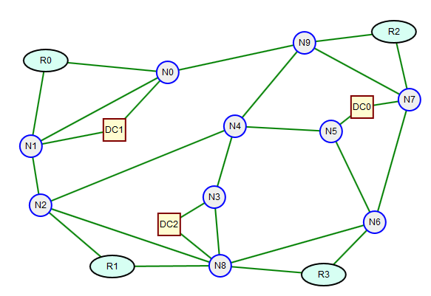
Node Types
Access Nodes
Originate and terminate traffic demand but do not switch traffic not associated with themselves
Transit Nodes
Do not originate or terminate demand traffic, but switch it for other nodes
VoD example:
User Regions R0-R3
Data Centers DC0-DC2
Core Switches N0-N8
Which are access and which are transit?

Slide 4
Node Type Caveats I
Management/Control Plane Traffic
All nodes must, in some way, be involved with the management or control planes and hence transit nodes originate and terminate some traffic.
In general demand traffic is much, much greater than management or control traffic. Why?
Additional Access Switching and/or De-multiplexing
Access nodes may represent entire networks themselves with some internal nodes acting as transit nodes
Even end systems perform de-multiplexing. Can you think of examples?

Slide 5
Node Type Caveats II
Hybrid Nodes
IXP’s with co-location services for CDNs
Internet Exchange Points (https://en.wikipedia.org/wiki/Internet_exchange_point )
Netflix co-locating at ISPs
http://www.networkworld.com/community/blog/netflix-goes-edge-internet
Sometime node definitions depend on the “granularity” of our view.
In network design we tend to start with coarser grained models and then refine them if warranted.

Slide 6
Types of Expenses
Capital Expenses (CapEx)
Costs to “build it”
Installation and acquisition of infrastructure, cables, and equipment
Examples: digging trenches, laying conduit, acquiring cables, laying cables, cable trays, equipment racks, switches, etc…
Operational Expense (OpEx)
Costs to “run it”
Power, network administrators, repair, maintenance, depreciation

Slide 7
Link Placement Design IA
Problem
Select links and their capacity to design a minimal OpEx network subject to a CapEx budget.
Constants (link path based formulation)
B upper bound for capital budget
$h_{d}$ volume of demand d
$δ_{edp}$ 1 if link e is in demand path d,p; 0 otherwise
$ξ_{e}$ unit maintenance cost (OpEx) of link e
$κ_{e}$ capital cost (CapEx) of link e
$M_{e}$ upper bound for the capacity of link e. Note that even if this is extremely large we need it for our formulation.

Slide 8
Link Placement Design IB
Givens
List of candidate paths for each demand
Variables
$x_{dp}$ flow for demand d on its path p ($≥0$)
$y_{e}$ capacity of link e ($≥0$)
$u_{e}$ provisioning indicator 1 if used, 0 otherwise. Used in CapEx bounds and capacity bounds.

Slide 9
Link Placement Design IC
Objective
Minimize OpEx network costs
Minimize: $\sum_{e}{ξ_{e}}y_{e}$
CapEx budget Constraint
$\sum_{e}{κ_{e}u_{e}}≤B$
Demand satisfaction Constraints
$\sum_{p}{x_{dp}}=h_{d}$ for $d=1,…D$

Slide 10
Link Placement Design ID
Bandwidth Capacity Constraints
$$\sum_{d}{\sum_{p}{δ_{edp}x_{dp}≤y_{e}}}$$
for $e=1,…,E$
“Can’t use it if its not installed” Constraint
$y_{e}≤M_{e}u_{e}$ for $e=1,…,E$
What does this do?
Remember that $u_{e}$ is 1 if the link is installed and zero otherwise.

Slide 11
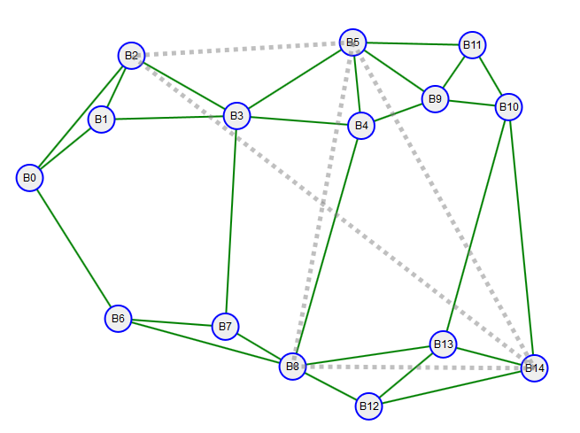
Example 1
Demands
('B14', 'B2'): 26.4, ('B5', 'B14'): 17.9, ('B5', 'B2'): 25.1, ('B5', 'B8'): 18.4, ('B8', 'B14'): 26.7

Slide 12
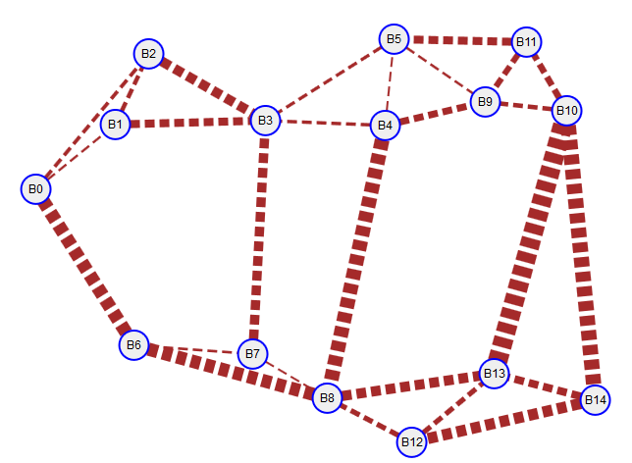
Example 1 CapEx Visualization
CapEx based on length and a random multiplying integer
CapEx shown as width of dashed lines
(B7, B8): 264.97
(B4, B5): 265.38
(B0, B1): 313.45
(B5, B9): 338.68
(B6, B7): 364.00
(B3, B5): 465.24
(B3, B4): 488.41
(B2, B0): 538.91
(B2, B1): 636.99
(B10, B9): 667.89
(B12, B13): 765.40
(B12, B8): 776.49
(B11, B9): 888.73
(B10, B11): 973.48
(B4, B9): 1047.85
(B14, B13): 1171.28
(B5, B11): 1215.30
(B3, B1): 1224.42
(B3, B7): 1430.13
(B2, B3): 1507.64
(B8, B13): 1546.46
(B8, B13): 1546.46
(B14, B12): 1726.92
(B6, B8): 2042.67
(B6, B0): 2066.16
(B4, B8): 2273.53
(B14, B10): 2371.38
(B10, B13): 3058.32

Slide 13
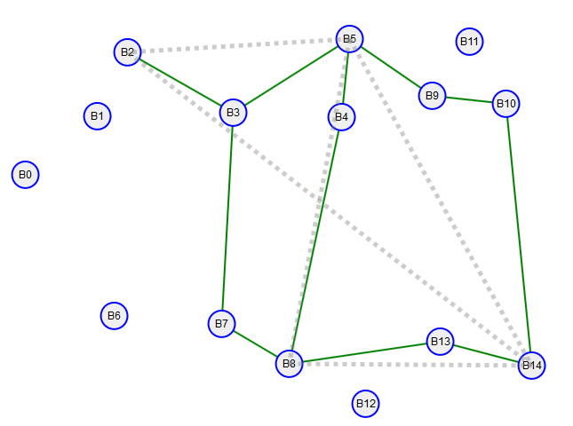
Example 1: Results A
With a CapEx bound of 18,566.66
Optimum OpEx value of 50,116.57

Slide 14
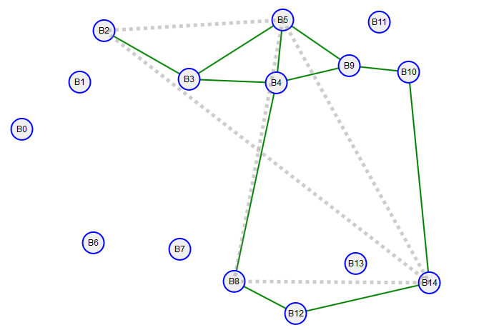
Example 1: Results B
With a CapEx bound of 12,068.33 (lower)
Optimum OpEx value of 50,448.92 (bigger)

Slide 15
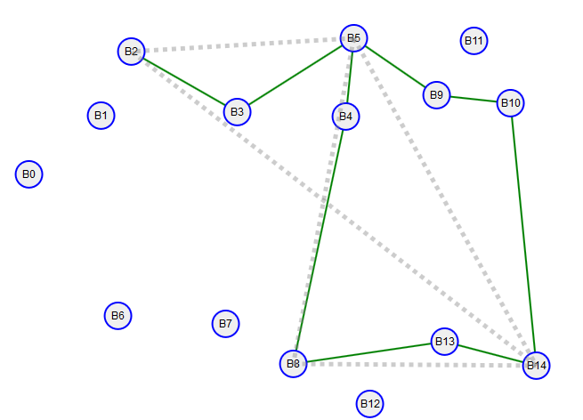
Example 1: Results C
With a CapEx bound of 11,140.00 (lower)
Optimum OpEx value of 51,250.81 (bigger)

Slide 16
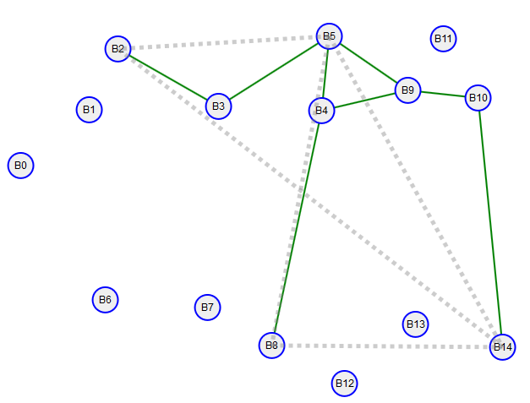
Example 1: Results D
With a CapEx bound of 9,283.33 (lower)
Optimum OpEx value of 64,375.67 (bigger)

Slide 17
Optimizing both CapEx and OpEx
What if we…
Want to optimize on CapEx?
Optimize on a combination of CapEx and OpEx
Find the minimum CapEx to produce a viable network?
Can we reuse some of what we have?

Slide 18
Optimizing CapEx and OpEx
Constants (link path based formulation)
B upper bound for capital budget
$h_{d}$ volume of demand d
$δ_{edp}$ 1 if link e is in demand path d,p; 0 otherwise
$ξ_{e}$ unit maintenance cost (OpEx) of link e
$κ_{e}$ capital cost (CapEx) of link e
$M_{e}$ upper bound for the capacity of link e. Note that even if this is extremely large we need it for our formulation.

Slide 19
Optimizing CapEx and OpEx
Variables
$x_{dp}$ flow for demand d on its path p ($≥0$)
$y_{e}$ capacity of link e ($≥0$)
$u_{e}$ provisioning indicator 1 if used, 0 otherwise. Used in CapEx bounds and capacity bounds.

Slide 20
Optimizing CapEx and OpEx
Objective
Minimize OpEx network costs
Minimize: $\sum_{e}{ξ_{e}}y_{e}+\sum_{e}{κ_{e}u_{e}}$
CapEx budget Constraint
$\sum_{e}{κ_{e}u_{e}}≤B$
Demand satisfaction Constraints
$\sum_{p}{x_{dp}}=h_{d}$ for $d=1,…D$

Slide 21
Optimizing CapEx and OpEx
Bandwidth Capacity Constraints
$$\sum_{d}{\sum_{p}{δ_{edp}x_{dp}≤y_{e}}}$$
for $e=1,…,E$
“Can’t use it if its not installed” Constraint
$y_{e}≤M_{e}u_{e}$ for $e=1,…,E$
What does this do?
Remember that $u_{e}$ is 1 if the link is installed and zero otherwise.

Slide 22
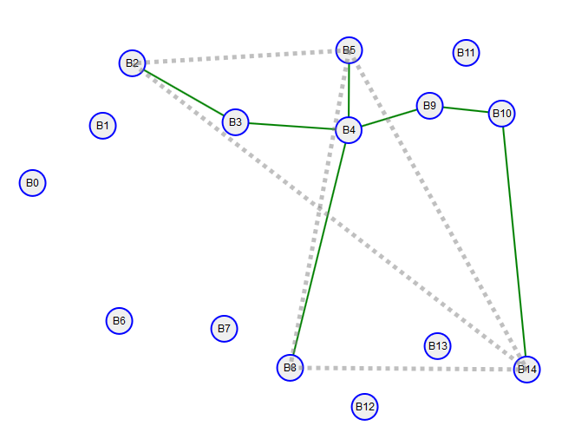
Example
Result from minimization with previous CapEx values and OpEx values scalled down by 0.01
Objective value = 9,283.33, used this as a basis for the CapEx bounds in the previous formulation examples.

