Slide 1
Topological Network Design: Access Networks
B
Dr. Greg Bernstein
Grotto Networking
www.grotto-networking.com

Slide 2
Outline
Topological Design Problem Types
Location and installation costs
Node Placement Problems
chapter 6 (intro information), 6.1 (but not 6.1.1) access, but not proof of proposition 6.1.
Link Installation Costs
Book sections 2.7 (pg 65), 6.3 (pg. 230-234)

Slide 3
Node Placement Problems
Network Access/Edge
Where to put points of presence (PoPs).
Where to put core network edge nodes
Servers and Content
Where to locate web or application servers for a given customer base
Where to locate content replicas in a CDN

Slide 4
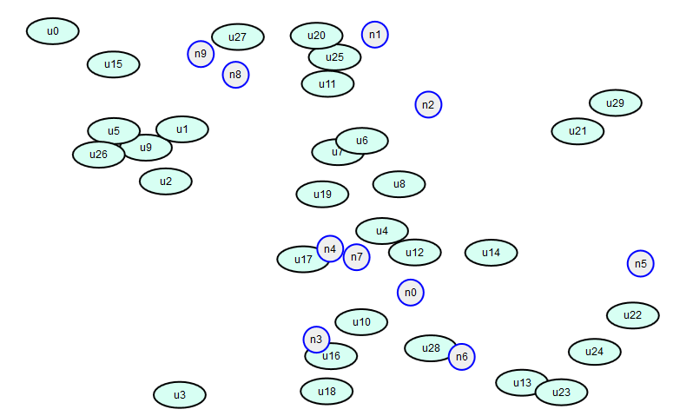
Access network design problem
Figure out where to install “access nodes” how to connect to “user areas”
Possible access node locations
Fixed user area locations

Slide 5
Requirements & Costs
N user regions (areas) all must have network access
Each region must map to one and only one access node
The cost of connecting user region i to access node j is $ξ_{ij}$
Why might these vary? How might you set these?
M possible access node locations
Each node location, j, has a cost $η_{j}$
Why might these vary?
Each node location j can support $K_{j}$ user regions
Why might these vary?

Slide 6
Variable Selection
Where to put the nodes?
Use a binary variable to indicate if a particular access node is used
$r_{j}=1$ if node j is used in the design, 0 otherwise.
How to connect regions to nodes?
Use a binary variable to indicate if area i is to connect to access node j in the design

Slide 7
Requirements as Constraints
User region service requirement
A user region must connect to one and only one node
$\sum_{j}{u_{ij}=1}$ for all user regions $i=1,…,N$
Capacity limits of an access node location j
If a node location is used then the total number of user regions connected to it must be less than its capacity
$\sum_{i}{u_{ij}≤K_{j}r_{j}}$ for access node $j=1,2,…, M$

Slide 8
Objective
Minimize Cost
Cost of each node location
Cost of connecting each user region to an access node
$$\sum_{i}{\sum_{j}{ξ_{ij}u_{ij}}+\sum_{j}{η_{j}}r_{j}}$$
Total connectivity cost
Total location cost

Slide 9
Generating Test Problems
Use geometric distance for connectivity cost between users and nodes.
Generate two types of nodes and place into a graph (n_users, n_nodes)
Give nodes random locations within prescribed limits.
Try different values of node capacity and location costs to see how these influence the problem.

Slide 10
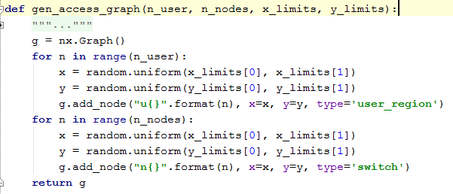
Python Problem Generator
Example usage:

Slide 11
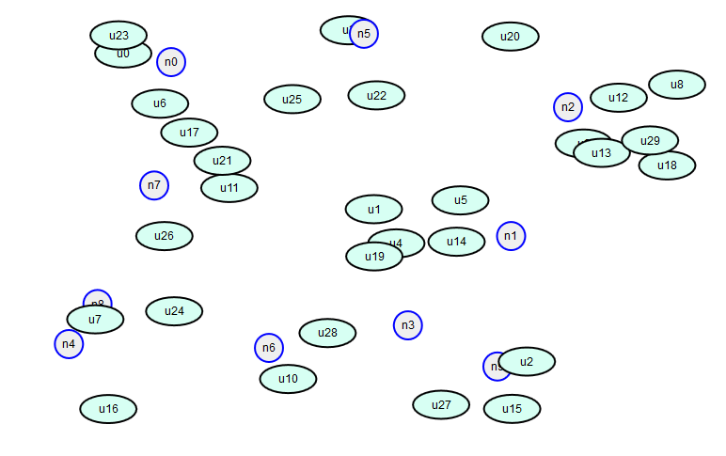
Example Network 2
Access node locations modified from purely random

Slide 12
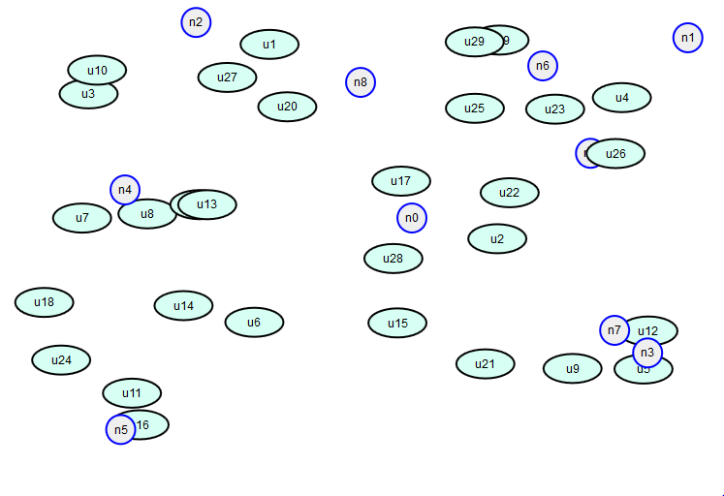
Example Network 3
Access node locations modified from purely random

Slide 13
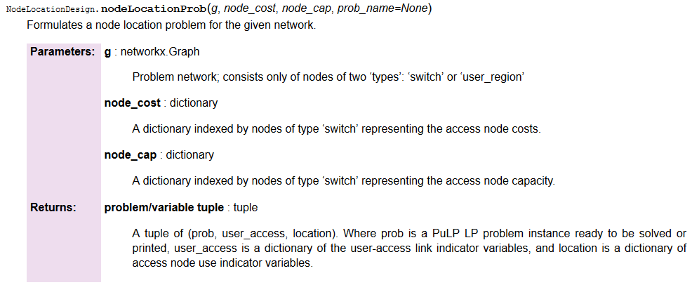
Python MIP Formulation
Problem formulation function:

Slide 14
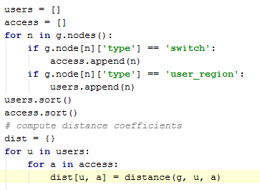
Python Formulation Setup
User and access type node lists
Need these to generate variables
Distances
Put in a dictionary for generality, but could have directly used the distance() function.

Slide 15
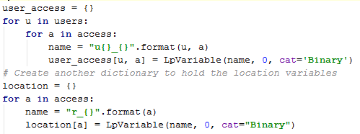
Python Formulation: Variables & Objective
User-Access link like variables,
Access node use variables
Objective function in terms of link and node costs

Slide 16
Python Formulation: Constraints
Node capacity
Node a indicator
Node capacity constraints
User connectivity constraints

Slide 17
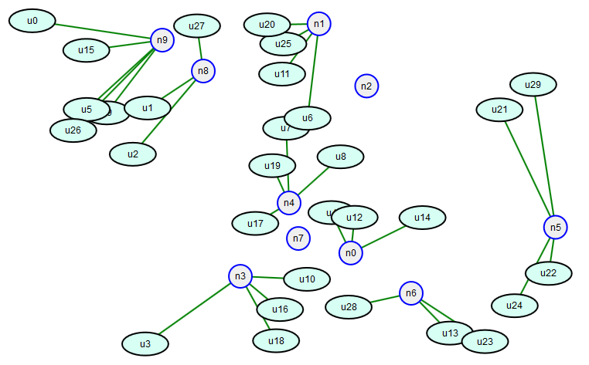
Example 1A
K = 6, Cost = 50 per node, Average distance from user to access node 268.8.
Note 8 out of 10 access nodes used. Why aren’t the access nodes being used to capacity?

Slide 18
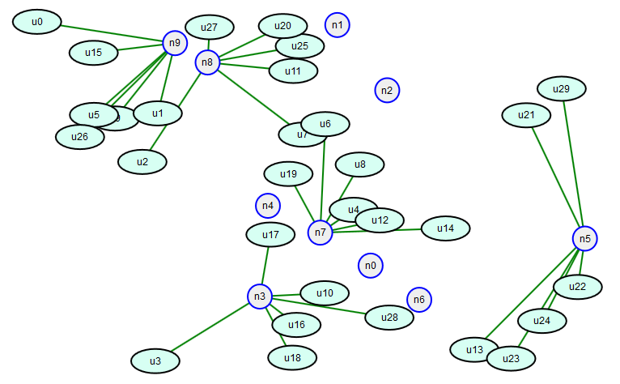
Example 1B
K = 6, Cost = 500 per node, Average distance from user to access node 268.8.
Note 5 out of 10 access nodes used. Why are the access nodes running at full capacity?

