Slide 1
Technologies from the point of view of Network Design
Dr. Greg Bernstein
Grotto Networking
www.grotto-networking.com

Slide 2
Outline
Network Layers and Partitions
  Not just the OSI/TCP layer models!
  Breaking the network into manageable chunks
Network technologies
  Fundamental limits: How far? How fast? How much?
  Switching properties: Granularity, Speed, Power, Cost
  Control Plane Limits: “The paths not taken?”
Readings:
  P. Molinero-Fernández, N. McKeown, and H. Zhang, “Is IP Going to Take over the World (of Communications)?,” SIGCOMM Comput. Commun. Rev., vol. 33, no. 1, pp. 113–118, Jan. 2003.

Slide 3
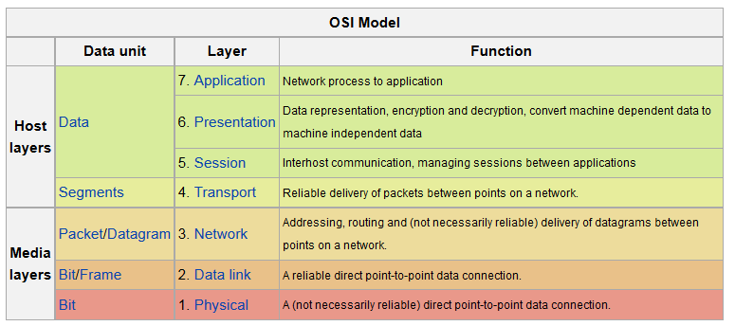
OSI Layer Models
  Useful for understanding data communication protocol relationships
  Not so great for network design (particularly layer 1-3)
  https://en.wikipedia.org/wiki/OSI_layer

Slide 4
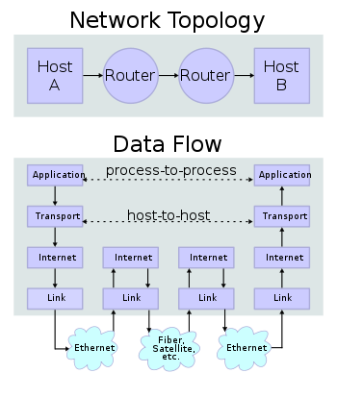
TCP/IP Layer Model
Application
Transport
  TCP, UDP
Internet
  IPv4, IPv6
Link
No physical?
  Flexibility to use different phy layers
https://en.wikipedia.org/wiki/TCP/IP_model

Slide 5
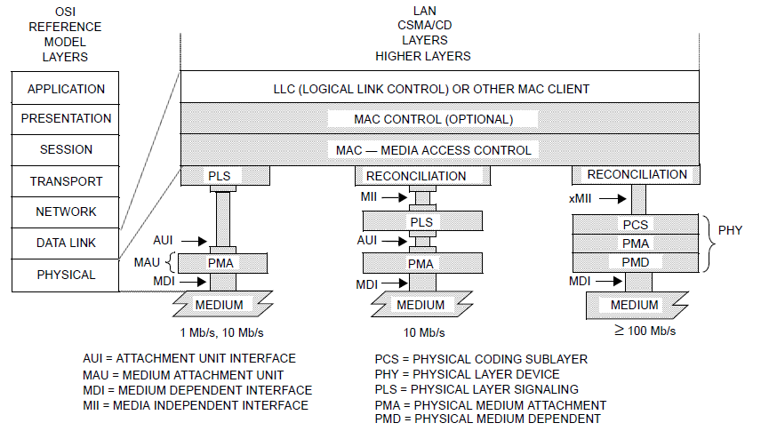
Ethernet Layer Model
From IEEE 802.3 (2012) Section 1
Available from http://standards.ieee.org/about/get/
Why the extra layers/sublayers? PCS, PMD, Medium…

Slide 6
SDH/SONET Layers
ITU-T G.707 “Network node interface for the synchronous digital hierarchy (SDH)”
Available from http://www.itu.int/ITU-T/recommendations/rec.aspx?rec=8981
Why all these layers?
  Multiplexing/Switching and Management!

Slide 7
Layers in TDM Networks
TDM = Time Division Multiplexing like SONET, SDH, PDH, G.709, etc…

Slide 8
Layers in WDM Networks

Slide 9
Uses of Layers in Networks
Interoperability points
  Physical and logical
Management
  Fault isolation, Performance monitoring (where did the errors occur)
Multiplexing and Switching
  How signals/bits/bytes/packets get combined and forwarded
  Not just one switching layer!!!

Slide 10
“Domains” – partitions of networks
General Internet
  Autonomous Systems
Intra-Domain Routing
  OSPF Areas
Ethernet “LANs”
  Broadcast domains for Ethernet switches

Slide 11
Subnetwork Terminology
C3
C9
Node or
Network Element (NE)
C2
C4
C10
C1
End system A
C6
C8
C7
B3
Subnetwork C
B2
B1
B4
End system Z
B6
B8
Link
B7
Network
Subnetwork B

Slide 12
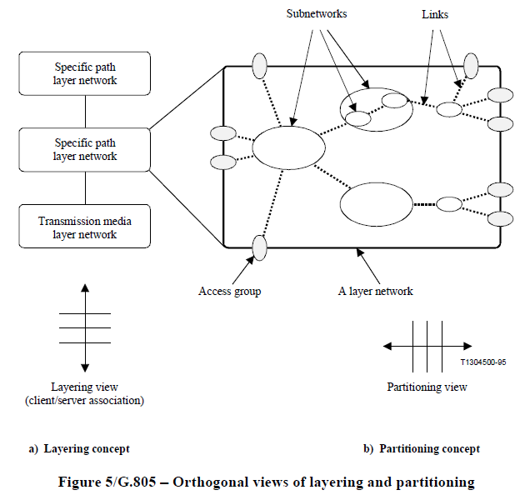
Layers and Partitions
Formal Models
  ITU-T
    G.805
    G.800
    http://www.itu.int/ITU-T/recommendations/index.aspx?ser=G
  Open Grid Forum
    Network Markup Language
    http://www.ogf.org/documents/GFD.206.pdf

Slide 13
Technology Limits: Distance
Distance (How far?)
  100BaseT over UTP5 100m (328 feet)
    https://en.wikipedia.org/wiki/Fast_Ethernet
  10GBASE-LR “long reach) has a specified reach of 10 kilometres (6.2 mi)
    https://en.wikipedia.org/wiki/10-gigabit_Ethernet
  Commercial WDH ULH (ultra long haul)
    http://www.huawei.com/en/products/transport-network/wdm-otn/bws1600G/index.htm
    “The Ultra Long Haul (ULH) incorporates certain technologies such as SuperWDM+, realizing 10G transmission over 5000km without regeneration. The Long Hop (LHP) technology incorporates SuperWDM+ and ROPA, which realizes extra long transmission with a single hop of 410km. In addition, DRZ and xDQPSK technologies are adopted to realize 40G transmission over 1500km without regeneration.”
    Marine systems…

Slide 14
Technology Limits: Capacity
Per medium capacity limits
10GBase-T
  10Gbps, Cat 6 UTP 55meters; Cat 6a, 7 100 meters
40 Gigabit Ethernet, 100 Gigabit Ethernet
  https://en.wikipedia.org/wiki/40GbE
Ultra High Capacity WDM
  Products 80 wavelengths of 40Gbps each (3.2Tbps per fiber)
  “Hero” demonstrations 40Tbps per fiber (http://www.prnewswire.com/news-releases/huawei-unveils-ultra-high-capacity-40t-wdm-prototype-199143681.html)

Slide 15
Switching Technologies I
Packet
  Connectionless (IP, Ethernet)
  Connection oriented (MPLS, some SDN)
Circuits
  Time division multiplexing (SONET, SDH, G.709)
  WDM (wave length division multiplex), i.e. wavelength switched optical networks (WSON)
Why not IP everywhere?
  “Is IP going to take over the world (of communications)?”
  Pablo Molinero-Fernandez, Nick McKeown, Hui Zhang
  ACM Computer Communications Review, Vol. 33, No. 1, January 2003
    http://yuba.stanford.edu/~nickm/papers/HotNets02-IP_conquest_of_the_world_with_authors.pdf

Slide 16
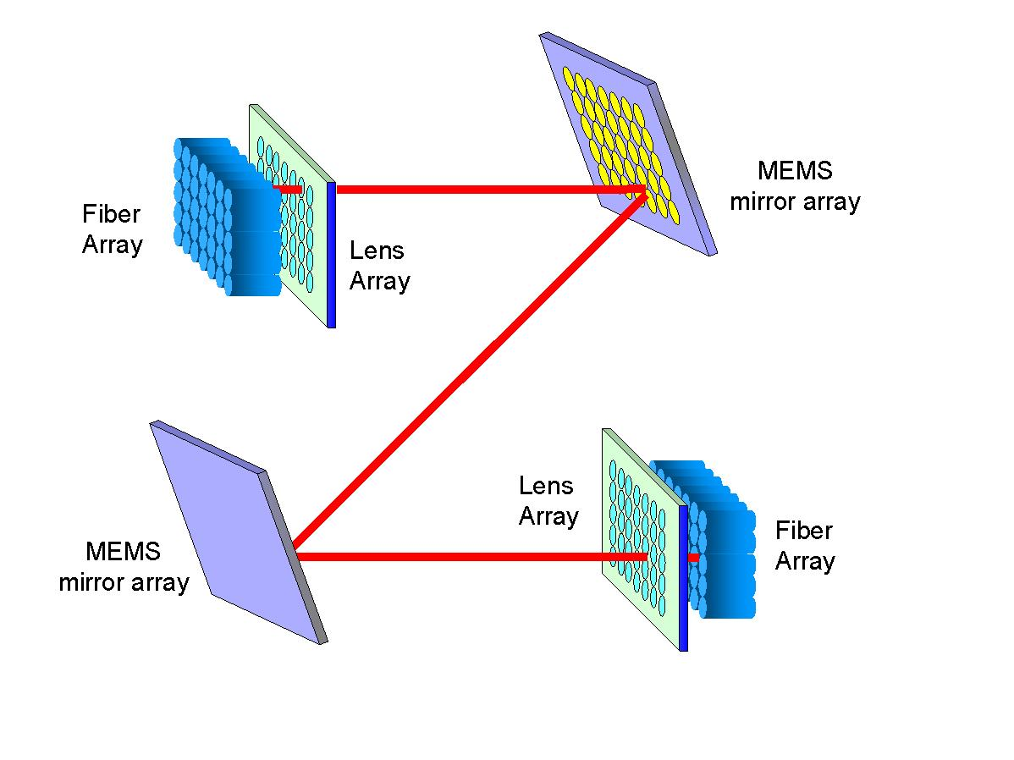
Switching Technologies II
Throughput (fast to slow)
  Patch panel, fiber switch
  Wavelength switch
  TDM switch
  Packet switch
Granularity (finer to coarse)
  Packet Switch
  TDM switch
  Wavelength switch
  Patch panel
Cost & Power per Bit
  Patch panel, fiber switch
  Wavelength switch
  TDM switch
  Packet switch
Time to Switch/Change (slowest fastest)
  Patch panel, fiber switch
  Wavelength switch
  TDM switch
  Packet switch

Slide 17
Three Fundamental Switching Types
Forwarding at each switch
Datagram (e.g., IP, Ethernet)
  Based on complete destination address within the packet. Any valid destination must be forwarded correctly.
Virtual Circuits (e.g., MPLS, ATM, Frame Relay)
  Based only on a label with the packet header. Only packets whose “virtual circuit” has been set up ahead of time must be forwarded correctly.
Circuits (not packets)
  Based implicitly on either time slot or wavelength. No forwarding information needed in data. Only those circuits whose path has been set up ahead of time must be forwarded correctly.

Slide 18
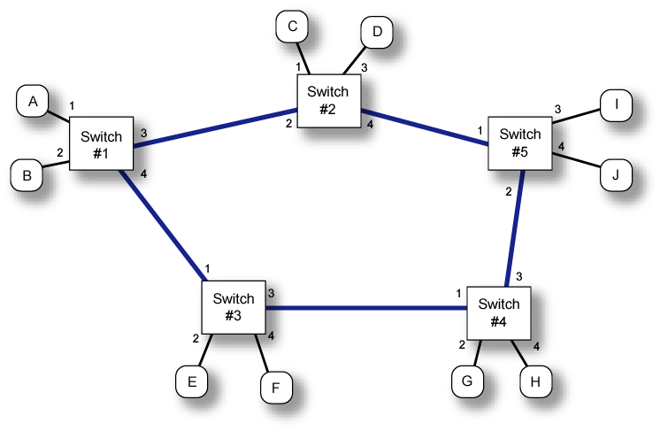
Example Network
  Datagram, Virtual Circuits, or Circuits
  Switches 1-5, Hosts A-J

Slide 19
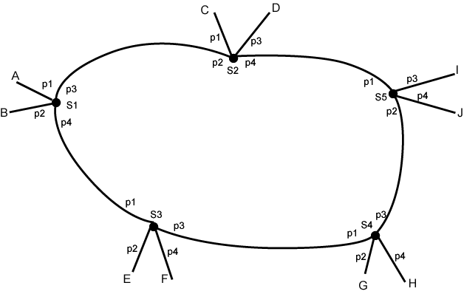
Datagram Forwarding Example
Graph of our example network with switch ports and hosts shown
I
I
I
I
I
I

Slide 20
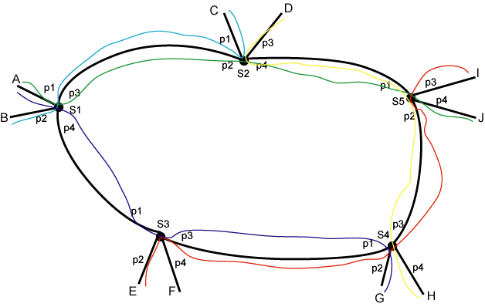
Virtual Circuit forwarding Example
Connections
  Host A to Host J, Host B to Host C, Host E to Host I, Host D to Host H, and Host A to Host G

Slide 21
Virtual Circuit Forwarding
  Packets are forwarded based on a label in the header
  Labels are not destination addresses, usually much shorter
  Labels need to be unique on a link but not in a network, i.e., we can reuse labels on each link.
  Switch forwarding tables consist of a map between (input port, packet label) to (output port, new packet label). Each entry is known as a cross-connect.
  Table entry (cross-connect) for each virtual circuit rather than for each destination (the datagram case)
  Technologies: MPLS, Frame Relay, ATM, X.25

Slide 22
VC Forwarding Table Example
6
3
3
1
Each row in these switch tables is a cross connect
1
1

Slide 23
“Real” Circuit Forwarding
No more packets
Bit streams are distinguished by port and
  Time slots in the TDM case
  Wavelength in the WDM case
  Frequency in the FDM case
Switching independent of bit stream contents
TDM example (same connections as VC case)
  Host A to Host J, Host B to Host C, Host E to Host I, Host D to Host H, and Host A to Host G

Slide 24
“Real” Circuit Tables Example
Note similarity to virtual circuit case!

Slide 25

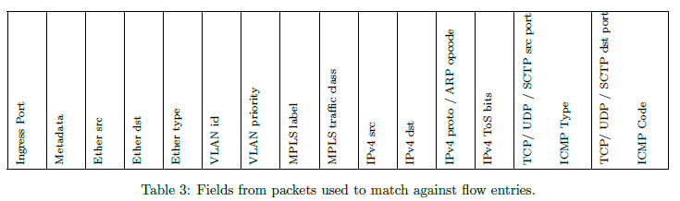
SDN Forwarding (OpenFlow 1.1)
Flow tables
  Like a forwarding table
  Can match on much more than a label or destination address
  For example matching on source and destination address permits VC like forwarding
  Instructions include output port and possibly other processing (TTL, label push/pop)

Slide 26
Differences in Switching Types
Virtual Circuits
  Connection set up is required.
  Resource reservation is explicit & optional (best effort service is allowed)
“Real” Circuits
  Connection set up is required
  Resource reservation is implicit and required
Datagram (connectionless)
  No connection setup is used or needed
  Resource reservation is explicit & optional (best effort service is common)

Slide 27
Implications of the Control Plane Ia
Ethernet Bridge (IEEE 802.1D-2004)
  See chapter 7 “Principles of Bridge Operation”
  Forwarding, Filtering, and Learning
    By default “frames are flooded”
    As destination addresses are “learned” the bridge applies “filtering” to avoid flooding
    “flooding” and “loops” are a show stopper so…
  Port States and the Active Topology
    Ports are disabled so that network topology forms a tree ➔ “Spanning Tree” protocol (STP).

Slide 28
Implications of the Control Plane Ib
Ethernet Bridge with Rapid Spanning Tree Protocol
  Only one possible path between each source and destination, tree choice dictated by protocol with relatively small amount of management control
  This graph has 79 different trees. See (https://en.wikipedia.org/wiki/Kirchhoff%27s_theorem) and my trees.py code.
  What if we have a lot of traffic between N4 and N7? N1 and N2? N2 and N3?
L6
N7
N7
L4
N4
L4
N4
N3
N3
L2
L9
L11
L9
L5
L8
L5
L8
N2
N2
N6
N6
L1
L3
L7
L3
L7
N1
N5
N1
N5

Slide 29
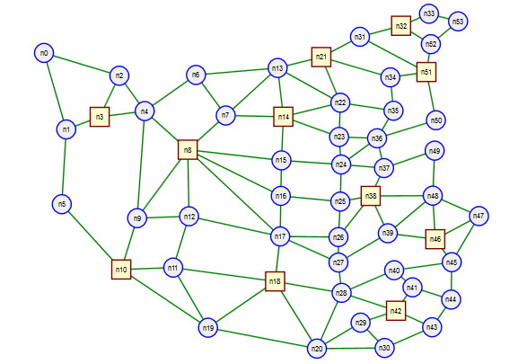
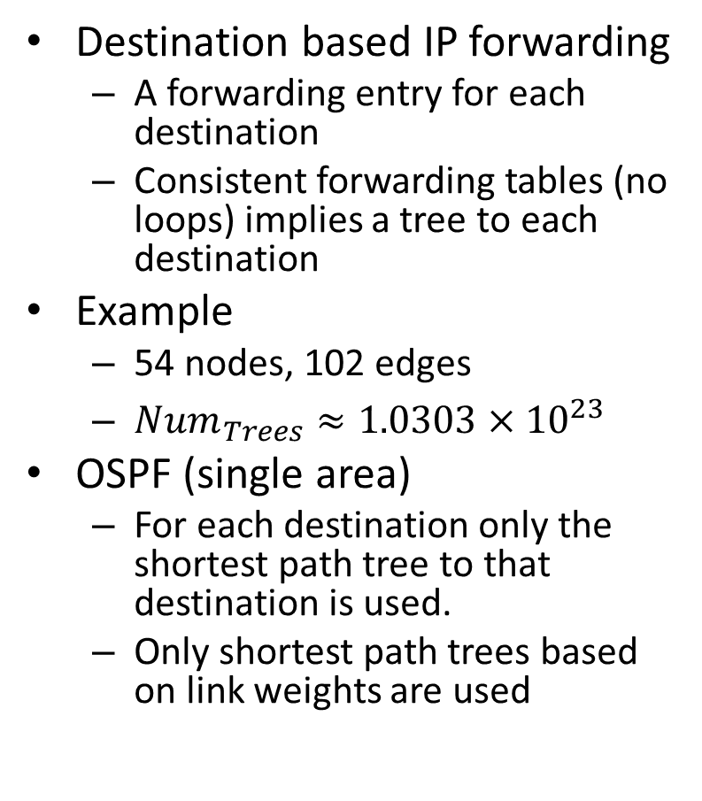
Implications of the Control Plane II
Destination based IP forwarding
  A forwarding entry for each destination
  Consistent forwarding tables (no loops) implies a tree to each destination
Example
  54 nodes, 102 edges
  ${Num}_{Trees}≈1.0303×{10}^{23}$
OSPF (single area)
  For each destination only the shortest path tree to that destination is used.
  Only shortest path trees based on link weights are used

Slide 30
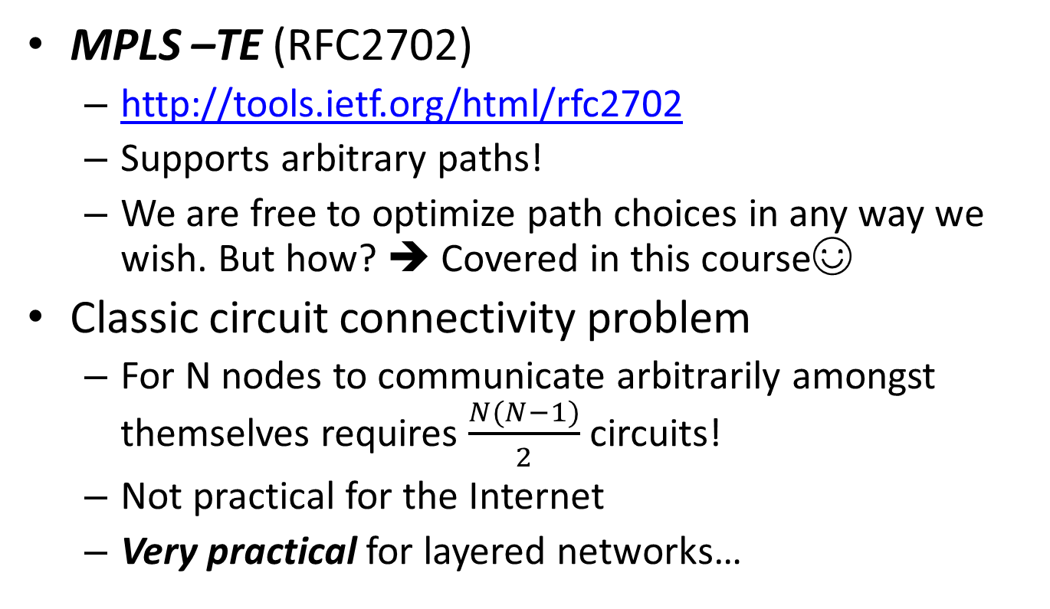
Implications of the Control Plane III
MPLS –TE (RFC2702)
  http://tools.ietf.org/html/rfc2702
  Supports arbitrary paths!
  We are free to optimize path choices in any way we wish. But how? ➔ Covered in this course☺
Classic circuit connectivity problem
  For N nodes to communicate arbitrarily amongst themselves requires $\frac{N(N−1)}{2}$ circuits!
  Not practical for the Internet
  Very practical for layered networks…

