Slide 1
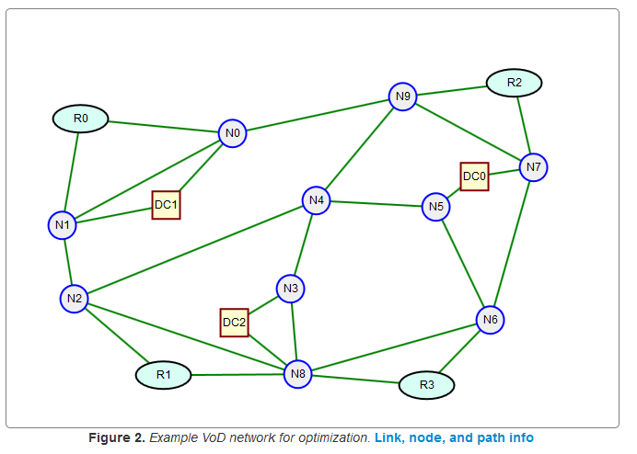
Shortest Path Algorithm Review and the k-shortest path Algorithm
Dr. Greg Bernstein
Grotto Networking
www.grotto-networking.com

Slide 2
Shortest Path Techniques
Approach
  Represent the network by a graph with “weights” or “costs” for links.
Types of Link Weights
  link wt. = link miles => route miles shortest path
  link wt. = 1 => minimum hop count path
  link wt. = ln(p_{i}) , where p_{i} is the probability of failure on a link i, => lowest probability of failure path
  Link wt. = inverse of link bandwidth, crude traffic engineering

Slide 3
The Bellman-Ford Algorithm
Choose the source node, s.
  We will find the shortest path from this node to all other nodes.
  Let w(j, v) be the link weight from node j to node v. Denote the list of previous hop nodes by P_{h}, each node except the source will have one previous hop node from the source.
Initialization
  Label, D₁(s,v), all the non source nodes, v, with their weight to the source and previous hop by the source, if not connected to the source then D₁(s,v) = ∞ and no previous hop.
Repetition Step (updating the labels)
  D_{k}(s,v) = min {over all other nodes j, D_{k-1}(s, j) + w(j,v) }
  Update the previous hop for node v with node j.
  Algorithm converges when D_{k}(s,v) = D_{k-1}(s,v), and takes at most N iterations.
A distributed form of the Bellman-Ford Algorithm is used in RIPv2. See RFC2453 https://tools.ietf.org/html/rfc2453

Slide 4
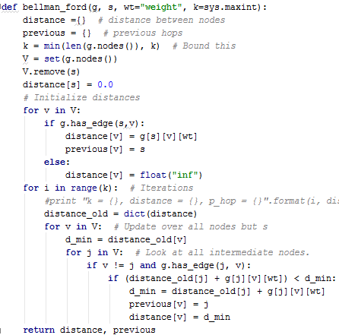
Bellman-Ford in Python
Use a dictionary indexed by nodes for distance and previous hop
Main iteration loop.

Slide 5
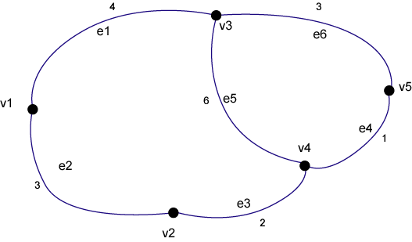
Bellman-Ford Example
  Choose v3 as the source
  Iteration 1: labels = [4, ∞, 0, 6, 3], Ph = [v3, x, v3, v3, v3]
  Iteration 2: labels = [4, 7, 0, 4, 3], Ph = [v3, v1, v3, v5, v3]
  Iteration 3: labels = [4, 6, 0, 4, 3], Ph = [v3, v4, v3, v5, v3]
  Iteration 4: labels = [4, 6, 0, 4, 3], Ph = [v3, v4, v3, v5, v3] Converged!

Slide 6
Where’s the Path and Costs?
What does the label D_{k}(s,v) mean?
  The minimum cost from the source to node v in k steps.
  When the algorithm converges then D_{k}(s,v) is the minimum cost regardless of steps
How do I find the shortest path
  Walk back through the previous hop list to the source.
  Example Ph = [v3, v4, v3, v5, v3] , source is v3
    v1: Path {v1, v3}
    v2: Path {v2, v4, v5, v3}
    v3: Source
    v4: Path {v4, v5, v3}
    v5: Path {v5, v3}

Slide 7
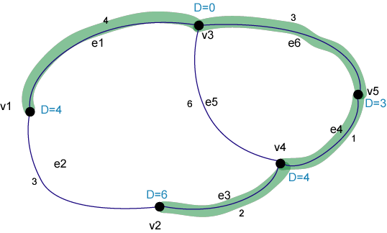
Example Bellman-Ford Results
  Produces a tree of shortest paths from the source.
  Note that this won’t necessarily be a minimum weight spanning tree. This is a different algorithm than that used for spanning trees in bridges.

Slide 8
The Dijkstra’s Algorithm (used in OSPF)
Choose the source node, s.
  We will find the shortest path from this node to all other nodes.
  Let w(j, v) be the link weight from node j to node v. Denote the list of previous hop nodes by P_{h}, each node except the source will have one previous hop node from the source. Let V be the nodes of the graph and T a set of nodes that we construct.
Initialization
  Set T = {s}. D(s,s) = 0, for v ≠ s, D(s, v) = w(s, v).
Repetition Step (while T ≠ V)
  find u ∉ T such that D(s, u) <= D(s, v) for all v ∉ T;
  add the node u to T and update the labels as follows
  for all v ∉ T (updated) if D(s, v) > D(s, u) + w(u, v) then update label D(s, v) and previous hop, i.e., D(s, v) = D(s,u) + w(u,v) and previous hop for node v = u.

Slide 9
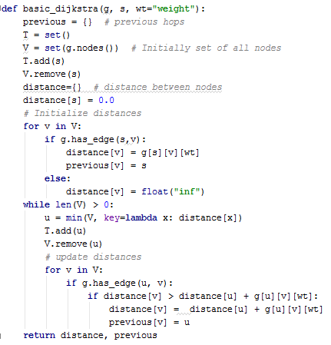
In Python
Use a dictionary indexed by nodes for distance and previous hop
Working set of nodes whose distance is not finished being minimized
Main iteration loop. Assumes there will be a path from source to each node
Finds the node in V with smallest distance to source
Update step for distance and previous hop

Slide 10
Dijkstra Example
  Choose v1 as the source, T = {v1}
  Step 0: labels = [0, 3, 4, ∞, ∞], Ph = [v1, v1, v1, x, x], T = {v1, v2}
  Step 1: labels = [0, 3, 4, 5, ∞], Ph = [v1, v1, v1, v2, x], T={v1,v2, v3}
  Step 2: labels = [0, 3, 4, 5, 7], Ph = [v1, v1, v1, v2, v3], T={v1, v2, v3, v4}
  Iteration 4: labels = [0, 3, 4, 5, 6], Ph = [v1, v1, v1, v2, v4], T={v1, v2, v3, v4, v5} Finished!

Slide 11

Where’s the Path and Costs?
What do the labels D(s,v) mean?
  When we add a node v to the set T then D(s,v) is the minimum cost.
  If we are only interested in the path from s to v then we can stop the algorithm at this point (unlike Bellman-Ford where we had to continue iterating)
How do I find the shortest path?
  Walk back through the previous hop list to the source.
  Example Ph = [v1, v1, v1, v2, v4], source is v1
    v1: source
    v2: Path {v2, v1}
    v3: Path {v3, v1}
    v4: Path {v4, v2, v1}
    v5: Path {v5, v4, v2, v1}
Much easier with Python dictionaries for distance and next hop:

Slide 12
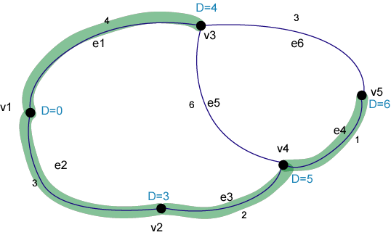
Example Dijkstra Results
  Produces a tree of shortest paths from the source.
  Note that this won’t necessarily be a minimum weight spanning tree. This is a different algorithm than that used for spanning trees in bridges. Bellman-Ford and Dijkstra should give the same results (except for different handling of ties in an implementation).

Slide 13
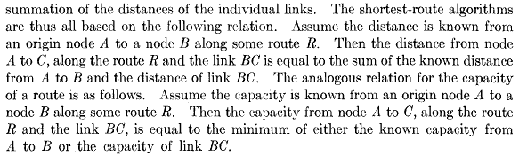
Widest Paths?
What if we are concerned about bandwidth as much as cost, delay, or reliability?
Can we find a method like Bellman-Ford or Dijkstra?
  M. Pollack, “The Maximum Capacity through a Network,” Operations Research, vol. 8, no. 5, pp. 733–736, Sep. 1960.

Slide 14
Widest Path via Dijkstra’s Algorithm
Choose the source node, s.
  We will find the widest path from this node to all other nodes.
  Let c(j, v) be the link capacity from node j to node v. Denote the list of previous hop nodes by P_{h}, each node except the source will have one previous hop node from the source. Let V be the nodes of the graph and T a set of nodes that we construct.
Initialization
  Set T = {s}. C(s,s) = ∞, for v ≠ s, D(s, v) = c(s, v).
Repetition Step (while T ≠ V)
  find u ∉ T such that C(s, u) >= C(s, v) for all v ∉ T;
  add the node u to T and update the labels as follows
  for all v ∉ T (updated) if C(s, v) < min( C(s, u), c(u, v) )then update label C(s, v) and previous hop, i.e., C(s, v) = min(C(s,u), c(u,v)) and previous hop for node v = u.

Slide 15
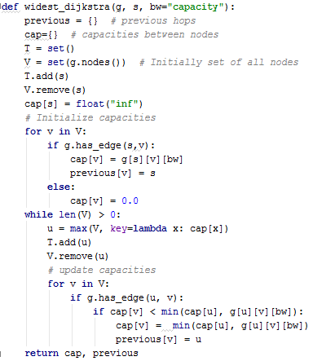
Widest Path via Python
Use dictionaries indexed by nodes for capacity and previous hop
Working set of nodes whose capacity is not finished being maximized
Main iteration loop. Assumes there will be a path from source to each node
Finds the node in V with biggest capacity to source
Update step for capacity and previous hop

Slide 16
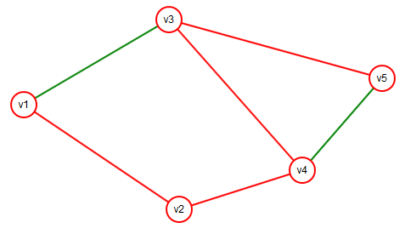
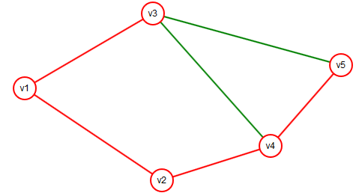
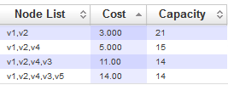
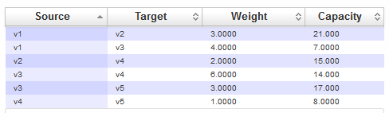
Example Widest Path Results
Shortest Paths from v1 for comparison

Slide 17
K-shortest Paths
We need more path choices!
Only concerned with “loopless paths” in data networks
  Otherwise we’d just be wasting bandwidth resources
References
  https://en.wikipedia.org/wiki/K_shortest_path_routing
  J. Hershberger, M. Maxel, and S. Suri, “Finding the k shortest simple paths: A new algorithm and its implementation,” ACM Trans. Algorithms, vol. 3, no. 4, p. 45, 2007.

Slide 18
Performance of k-shortest paths
Yen 1971
  O(kn(m+n log n))
  https://en.wikipedia.org/wiki/Yen%27s_algorithm
Katoh 1982
  O(k(m + n log n))
We’ll just use my “simplistic” implementation of Yen’s algorithm
  It’s based on section 4.1 (but not optimized) of:
  E. Q. Martins and M. M. Pascoal, “A new implementation of Yen’s ranking loopless paths algorithm,” Quarterly Journal of the Belgian, French and Italian Operations Research Societies, vol. 1, no. 2, pp. 121–133, 2003.
  Available free from: https://estudogeral.sib.uc.pt/jspui/bitstream/10316/7763/1/obra.pdf

Slide 19
K-shortest paths
How does it work?
  Starts with the shortest path
  Then looks at various “detours”
  Complications:
    How to make sure you look at the right set of “detours”
    How to avoid repeating the same “detours”
    How to be space efficient
  Not easy!
    Lucky for us others have done the work to make this efficient ☺

Slide 20
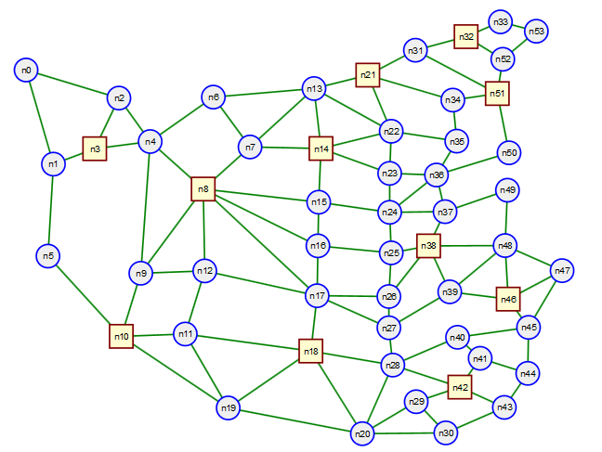
Example Network
Find 20 shortest paths from n3 to n21

Slide 21
Example
[{"capacity":10,"cost":291.9,"nodeList":["n3","n4","n6","n13","n21"]},
{"capacity":10,"cost":316.1,"nodeList":["n3","n4","n8","n7","n13","n21"]},
{"capacity":10,"cost":324.3,"nodeList":["n3","n4","n6","n7","n13","n21"]},
{"capacity":10,"cost":334.4,"nodeList":["n3","n2","n4","n6","n13","n21"]},
{"capacity":10,"cost":343.9,"nodeList":["n3","n4","n8","n7","n14","n13","n21"]},
{"capacity":10,"cost":352.1,"nodeList":["n3","n4","n6","n7","n14","n13","n21"]},
{"capacity":10,"cost":358.7,"nodeList":["n3","n2","n4","n8","n7","n13","n21"]},
{"capacity":10,"cost":366.8,"nodeList":["n3","n2","n4","n6","n7","n13","n21"]},
{"capacity":10,"cost":372.1,"nodeList":["n3","n4","n8","n7","n14","n22","n21"]},
{"capacity":10,"cost":380.2,"nodeList":["n3","n4","n6","n7","n14","n22","n21"]},
{"capacity":10,"cost":386.5"nodeList":["n3","n2","n4","n8","n7","n14","n13","n21"]},
{"capacity":10,"cost":394.6,"nodeList":["n3","n2","n4","n6","n7","n14","n13","n21"]},
{"capacity":10,"cost":395.4,"nodeList":["n3","n4","n8","n7","n6","n13","n21"]},

Slide 22
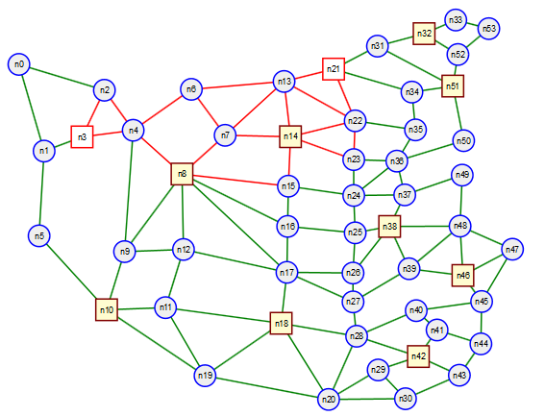
Link use in 20 shortest paths
Find 20 shortest paths from n3 to n21

