Slide 1
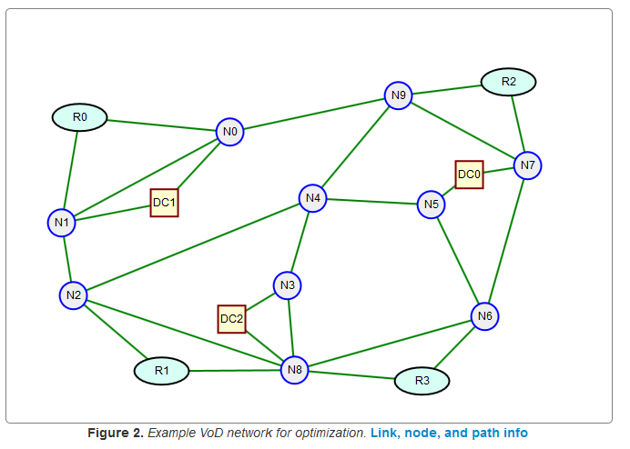
Shortest Path Network Design
B
Dr. Greg Bernstein
Grotto Networking
www.grotto-networking.com

Slide 2
Outline
Technology Specific Path Choice Restrictions
  IP & Ethernet
Shortest Path Based Protocols
  IP: OSPF, IS-IS
  Ethernet: TRILL, Shortest Path Bridging (802.1aq)
Link Weight Optimization Problem
MIP Formulation
Book Readings
  Sections:2.5, 3.1, 7.1.1, 7.2.1

Slide 3
Path Choice Restrictions
The “No Loop Rule”
  No active path between a communications source and sink should ever contain a loop.
Application of this rule to specific data plane and/or control plane results in a set of path choice restrictions
We will investigate the following:
  TDM/WDM Circuits, Virtual Circuits; IP and Ethernet with various control planes including OpenFlow

Slide 4
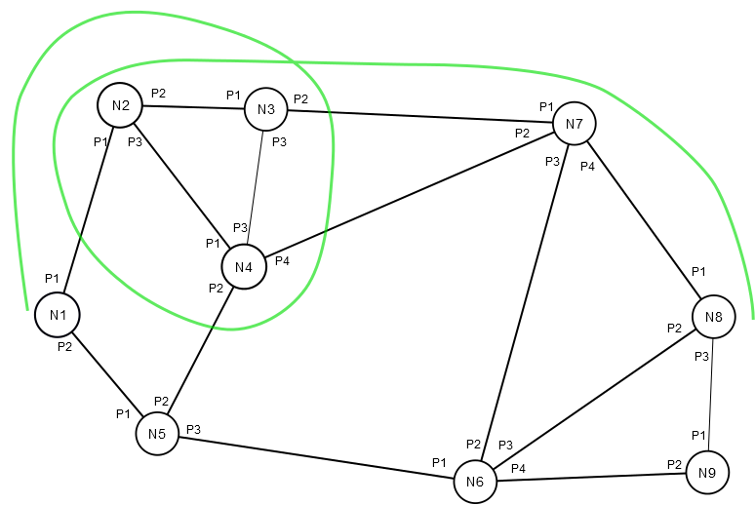
Paths with Loops in TDM Networks?
Could I set up the path [N1, N2, N3, N4, N2, N3, N7, N8]?
What would example cross connect tables look like?

Slide 5
Loops in TDM networks II
Path [N1, N2, N3, N4, N2, N3, N7, N8] X-connect tables
N1
X:X; P1: TS1
N2
P1:TS1; P2: TS3
P3:TS7; P2: TS5
N3
P1:TS3; P3: TS1
P1:TS5; P2: TS2
N4
P3:TS1; P1: TS7
N7
P1:TS2; P4: TS3
N8
P1:TS3; X:X

Slide 6
What’s Wrong with Loops in TDM?
Resources are wasted!
  For at least one link resources are carried twice
  Example [N1, N2, N3, N4, N2, N3, N7, N8]
    Link (N2, N3) carries the same traffic twice
    If this was an G.709 OPU2 signal we would have wasted 10Gbps of capacity on link (N2, N3)
Extremely Easy to Detect & Prevent
  A node shows up twice in the paths node list
  A connection uses the same switch port twice

Slide 7
Loops in Circuit Paths
Could be created with
  TDM, WDM (with wavelength conversion), Virtual Circuits
Almost always prevented by
  Control plane or management plane
In Network Design we only use “k loopless paths” algorithms to generate candidate paths
  Also known as “simple paths”
  Without this restriction it is easier to generate the k shortest paths, but these are not useful for our network design purposes
Loopless
[1]J. Hershberger, M. Maxel, and S. Suri, “Finding the k shortest simple paths: A new algorithm and its implementation,” ACM Trans. Algorithms, vol. 3, no. 4, p. 45, 2007.
[2]D. Eppstein, “Finding the k Shortest Paths,” SIAM J. Comput., vol. 28, no. 2, pp. 652–673, Jan. 1998.
With Loops

Slide 8
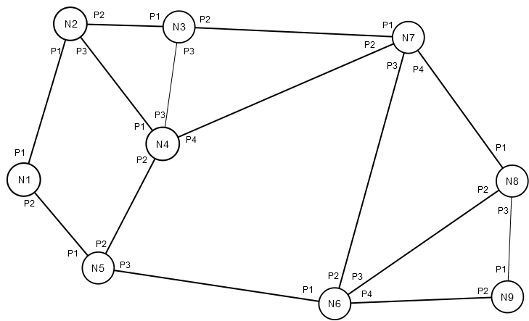
Loops with Datagram Forwarding
Destination Based Forwarding
  Used in IP and Ethernet
  How could a loop arise when sending a packet from N1 to N8?

Slide 9
Loops in Datagram Forwarding
Bad Forwarding tables:
  N1 to N8?
N1 Table
N8: P2
N2 Table
N8: P2
N8
N3 Table
N8: P3
N4 Table
N8: P1
N7 Table
N8: P4

Slide 10
Loops in Datagram Forwarding
Prevention
  IP: make sure “paths” to every destination resulting from routing tables are loop free ➔ form a tree.
  Ethernet (learning bridge control plane): Reduce network to a tree topology, i.e., disable some links (but this throws away bandwidth)
Mitigation
  IP has a Time to Live (TTL) counter that is decremented at each hop
  Ethernet frames do not have a TTL counter

Slide 11
Trees for Paths
A spanning tree for a connected graph contains all the nodes and no loops
  Just “enough” of the links are kept for connectivity
  Can compute the number of spanning trees via Kirchhoff's matrix tree theorem (https://en.wikipedia.org/wiki/Kirchhoff%27s_theorem)
Implications
  Ethernet (learning bridge) must select one tree for network topology (determines all paths)
  IP must select one tree for each destination –N trees total – (determines all paths to the destination)

Slide 12
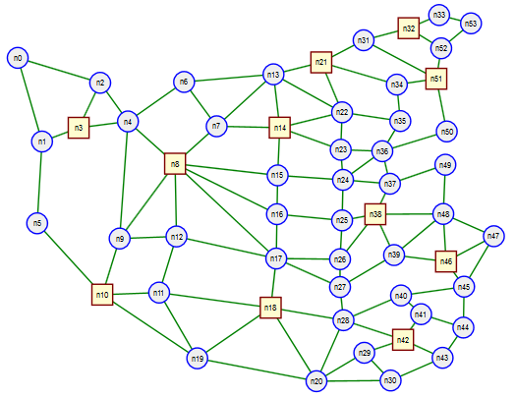
Trees for Paths II
Examples
79 trees
  $${Num}_{Trees}≈1.0303×{10}^{23}$$
L4
L6
N7
N4
N3
L2
L9
L11
L8
L5
N2
L1
N6
L3
L7
N1
N5

Slide 13
Trees for Paths III
Too many trees?
  Want to make a “good” choice so choose shortest path trees
IP Routing
  Open Shortest Path First (OSPF) routing protocol
  IS-IS routing protocol
Ethernet (beyond learning bridge)
  Shortest Path Bridging (IEEE 802.1aq-2012)
  TRILL (Transparent Interconnection of Lots of Links) IETF working group -- http://datatracker.ietf.org/wg/trill/

Slide 14
TRILL RFC5556
Abstract
  Current IEEE 802.1 LANs use spanning tree protocols that have a number of challenges. These protocols need to strictly avoid loops, even temporary ones, during route propagation, because of the lack of header loop detection support. Routing tends not to take full advantage of alternate paths, or even non-overlapping pairwise paths (in the case of spanning trees). This document addresses these concerns and suggests applying modern network-layer routing protocols at the link layer.
J. Touch, R. Perlman, RFC5556, Transparent Interconnection of Lots of Links (TRILL): Problem and Applicability Statement, May 2009

Slide 15
TRILL RFC6325
1.1. Algorhyme V2, by Ray Perlner
  I hope that we shall one day see
  A graph more lovely than a tree.
  A graph to boost efficiency
  While still configuration-free.
  A network where RBridges can
  Route packets to their target LAN.
  The paths they find, to our elation,
  Are least cost paths to destination!
  With packet hop counts we now see,
  The network need not be loop-free!
  RBridges work transparently,
  Without a common spanning tree.
RFC6325, Routing Bridges (RBridges): Base Protocol Specification, July 2011.

Slide 16
RFC3251 – The Best Every Written?
Digression
Abstract
Mostly Pointless Lamp Switching (MPLampS) is an architecture for carrying electricity over IP (with an MPLS control plane). According to our marketing department, MPLampS has the potential to dramatically lower the price, ease the distribution and usage, and improve the manageability of delivering electricity. This document is motivated by such work as SONET/SDH over IP/MPLS (with apologies to the authors). Readers of the previous work have been observed scratching their heads and muttering, "What next?". This document answers that question.
Bala Rajagopalan, RFC3251, Electricity over IP, April 1, 2002.

Slide 17
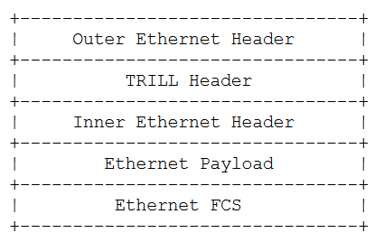
How does TRILL work? I
New Ethertype for TRILL
TRILL frame types
  TRILL Data frames (TRILL encapsulated data frames)
  TRILL control frames
  Other TRILL frames
Still uses Ethernet Frames

Slide 18
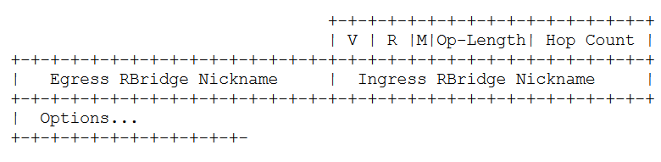
How does TRILL work? II
TRILL Header
  Includes hop count for loop control
Forwarding
  “known destinations” uses shortest path
  “unknown destinations” uses distribution tree and then learns addresses.

Slide 19
IEEE Shortest Path Bridging I
IEEE 802.1aq
  Somewhat difficult to read, better in depth article: https://en.wikipedia.org/wiki/IEEE_802.1aq
  “The technology provides logical Ethernet networks on native Ethernet infrastructures using a link state protocol to advertise both topology and logical network membership. Packets are encapsulated at the edge either in mac-in-mac 802.1ah or tagged 802.1Q/802.1ad frames and transported only to other members of the logical network. Unicast, multicast, and broadcast are supported and all routing is on symmetric shortest paths.”

Slide 20
IEEE Shortest Path Bridging II
IEEE 802.1aq
  https://en.wikipedia.org/wiki/IEEE_802.1aq
  “Shortest path bridging (IEEE 802.1aq) is the replacement for the older Spanning Tree Protocols (IEEE 802.1D STP, IEEE 802.1w RSTP, IEEE 802.1s MSTP) which permitted only a single path toward the root bridge and blocked any redundant paths which could result in a layer 2 loop.”
  “The control plane is based on IS-IS with a small number of extensions defined in RFC 6329.”
Which will win TRILL or SPB? Or will SDN make them both obsolete…

Slide 21
Network Design with Shortest Path Routing
Assume network is in place
Only “knobs” we can adjust are the link weights
  All Shortest Path based protocols provide (require) the setting of link weights
What to optimize for?
  Minimize link congestion, i.e., minimize overall link utilization across the network

Slide 22
Shortest Path Design Problem I
Givens:
  Demands
  Link Capacities
  Network topology
Variables
  Link weights (integers)
  Candidate paths (dependent)
  Link load (dependent)

Slide 23
Shortest Path Design Problem II
Constraints:
  Demands satisfaction
  Link Utilization
  Link Capacity
Objective
  Minimize the maximum utilization over all links

Slide 24
Shortest Path Design Problem III
Simplification
  Introduce supplementary variable r
Constraints:
  Demands satisfaction
  Link Capacity
Objective
  Minimize the maximum utilization over all links

Slide 25
Shortest Path Design Problem IV
Issue
  The previous formulation is not linear. Complicated dependency of shortest paths on link weights.
  Many approaches have been taken to this problem.
  A MIP formulation given in section 7.2.1 of P&M
  This is an “innovative” node link formulation but I have not verified it…
See instead: K. Holmberg and D. Yuan, “Optimization of Internet Protocol network design and routing,” Networks, vol. 43, no. 1, pp. 39–53, Jan. 2004.

