Slide 1
Random Variables and Probabilities
Dr. Greg Bernstein
Grotto Networking
www.grotto-networking.com

Slide 2
Outline
Motivation
Free (Open Source) References
Sample Space, Probability Measures, Random Variables
Discrete Random Variables
Continuous Random Variables
Random variables in Python

Slide 3
Why Probabilistic Models
Don’t have enough information to model situation exactly
Trying to model Random phenomena
  Requests to a video server
  Packet arrivals at a switch output port
Want to know possible outcomes
  What could happen…

Slide 4
Prob/Stat References (free)
Zukerman, “Introduction to Queueing Theory and Stochastic Teletraffic Models”
  http://arxiv.org/abs/1307.2968, July 2013.
  Advanced (suitable for a whole grad course or two)
Grinstead & Snell “Introduction to Probability”
  http://www.clrn.org/search/details.cfm?elrid=8525
  Junior/Senior level treatment
Illowsky & Dean, “Collaborative Statistics”
  http://cnx.org/content/col10522/latest/
  Web based, easy lookups, Freshman/Sophomore level

Slide 5
Sample Space
Definition
  In probability theory, the sample space, S, of an experiment or random trial is the set of all possible outcomes or results of that experiment.
    https://en.wikipedia.org/wiki/Sample_space
Networking examples:
  {Working, Failed} state of an optical link
  {0,1,2,…} the number of requests to a webserver in any given 10 second interval.
  (0,∞] the time between packet arrivals at the input port of an Ethernet switch

Slide 6
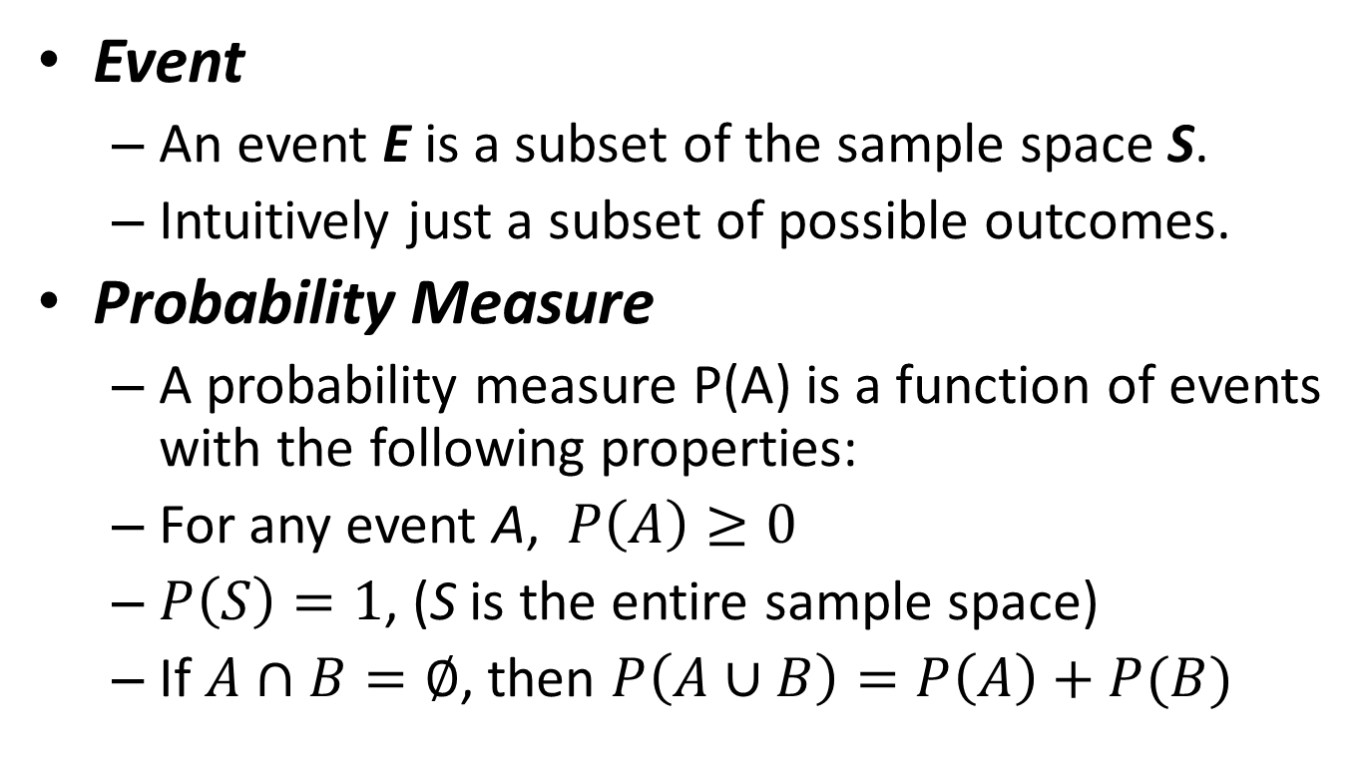
Events and Probabilities
Event
  An event E is a subset of the sample space S.
  Intuitively just a subset of possible outcomes.
Probability Measure
  A probability measure P(A) is a function of events with the following properties:
  For any event A, $P\left(A\right)≥0$
  $P\left(S\right)=1$, (S is the entire sample space)
  If $A∩B=∅$, then $P\left(A∪B\right)=P\left(A\right)+P(B)$
The last condition needs to be extended a bit for infinite sample spaces.

Slide 7
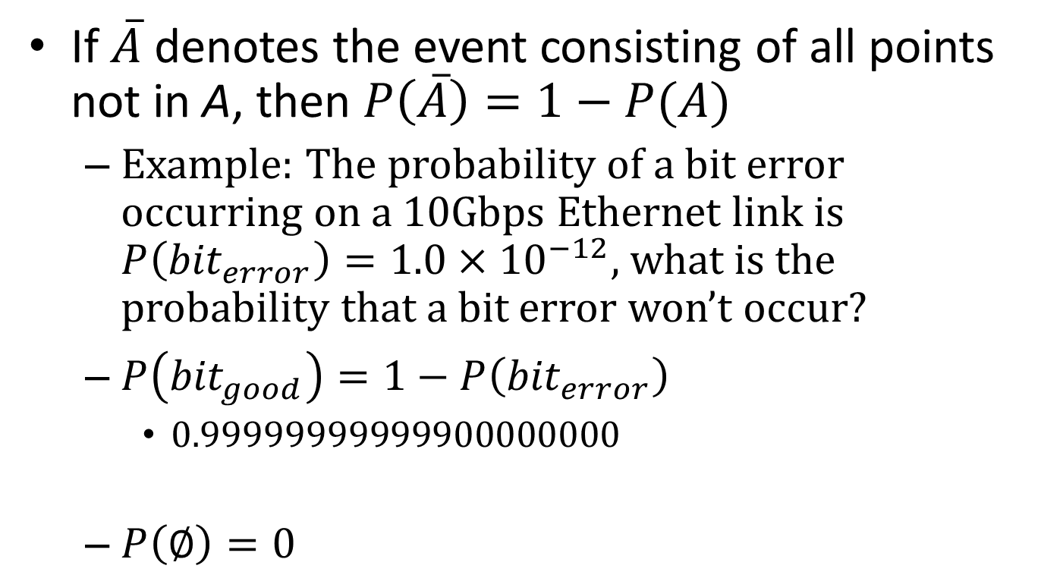
Some consequences
If $\overline{A}$ denotes the event consisting of all points not in A, then $P\left(\overline{A}\right)=1−P(A)$
  Example: The probability of a bit error occurring on a 10Gbps Ethernet link is $P\left({bit}_{error}\right)=1.0×{10}^{−12}$, what is the probability that a bit error won’t occur?
  $P\left({bit}_{good}\right)=1−P\left({bit}_{error}\right)$
    0.99999999999900000000
  $P\left(∅\right)=0$

Slide 8
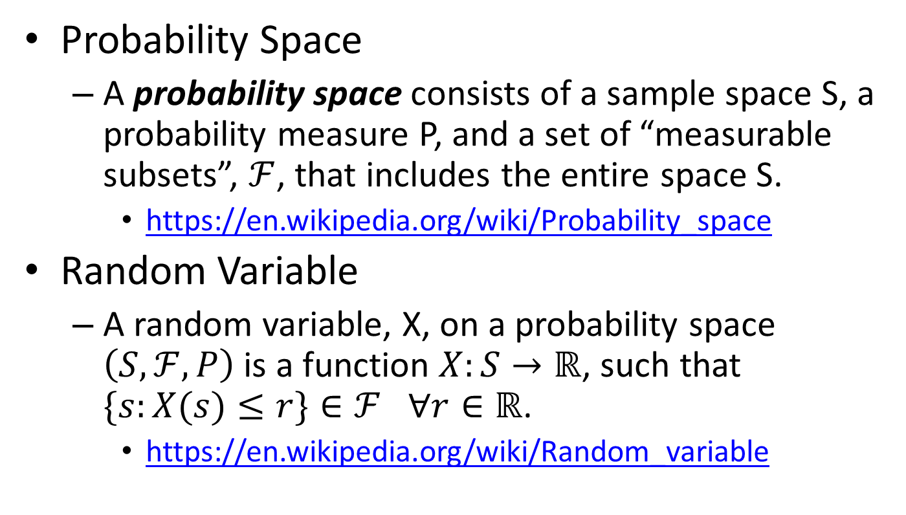
Random Variables
Probability Space
  A probability space consists of a sample space S, a probability measure P, and a set of “measurable subsets”, $ℱ$, that includes the entire space S.
    https://en.wikipedia.org/wiki/Probability_space
Random Variable
  A random variable, X, on a probability space $\left(S,ℱ,P\right)$ is a function $X:S→ℝ$, such that $\{s:X(s)≤r\}∈ℱ$ $∀r∈ℝ$.
    https://en.wikipedia.org/wiki/Random_variable

Slide 9
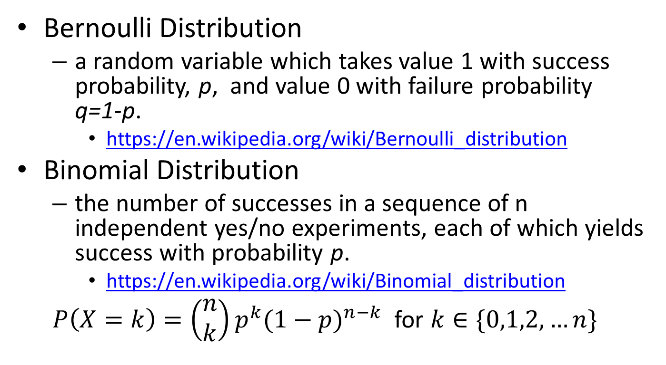
Discrete Distributions
Bernoulli Distribution
  a random variable which takes value 1 with success probability, p, and value 0 with failure probability q=1-p.
    https://en.wikipedia.org/wiki/Bernoulli_distribution
Binomial Distribution
  the number of successes in a sequence of n independent yes/no experiments, each of which yields success with probability p.
    https://en.wikipedia.org/wiki/Binomial_distribution
  $P\left(X=k\right)=\left(\begin{matrix}n \\ k\end{matrix}\right)p^{k}{(1−p)}^{n−k}$ for $k∈\{0,1,2,…n\}$
Just a sum of n independent Bernoulli random variables with the same distribution

Slide 10
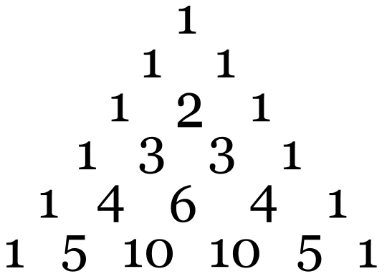
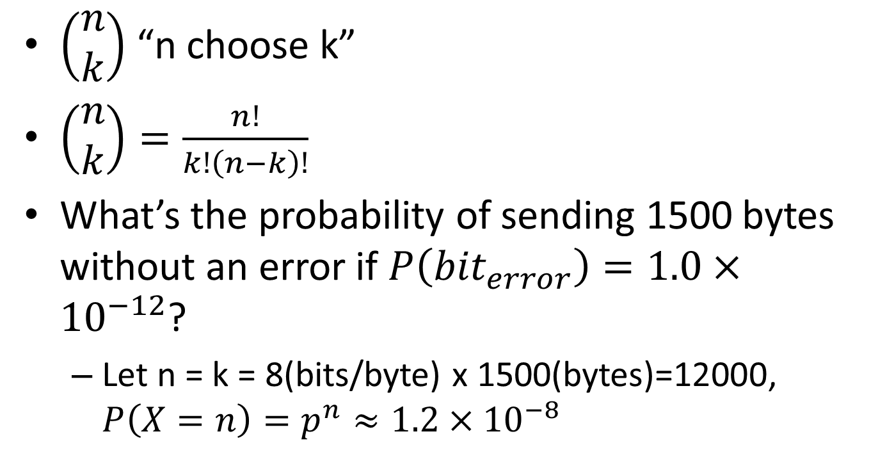
Binomial Coefficients & Distribution
$\left(\begin{matrix}n \\ k\end{matrix}\right)$ “n choose k”
$\left(\begin{matrix}n \\ k\end{matrix}\right)=\frac{n!}{k!\left(n−k\right)!}$
What’s the probability of sending 1500 bytes without an error if $P\left({bit}_{error}\right)=1.0×{10}^{−12}$?
  Let n = k = 8(bits/byte) x 1500(bytes)=12000, $P\left(X=n\right)=p^{n}≈1.2×{10}^{−8}$

Slide 11
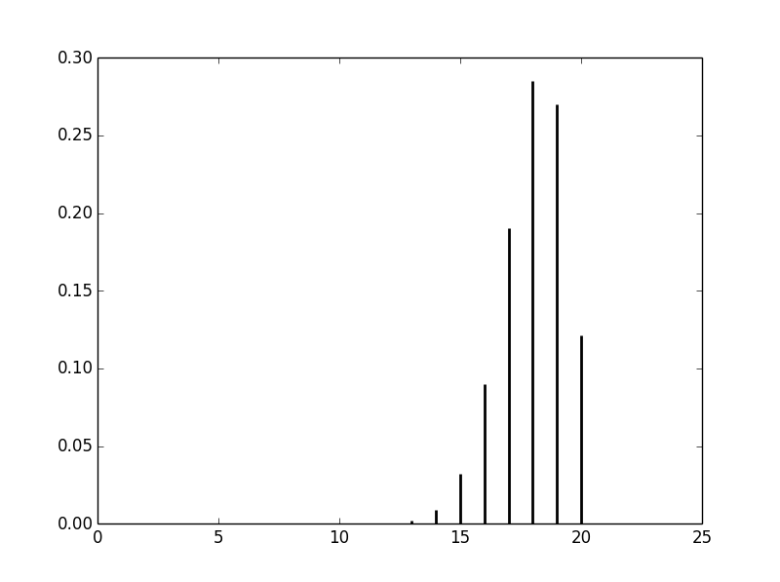
Binomial Distribution
How to get and generate in Python
  Use the additional package SciPy
  import scipy.stats
  help(scipy.stats)
    will give you lots of information including a list of available distributions
  from scipy.stats import binom
    Gets you the binomial distribution
    Can use this to get distribution, mean, variances, and random variates.
    See example in file “BinomialPlot.py”

Slide 12
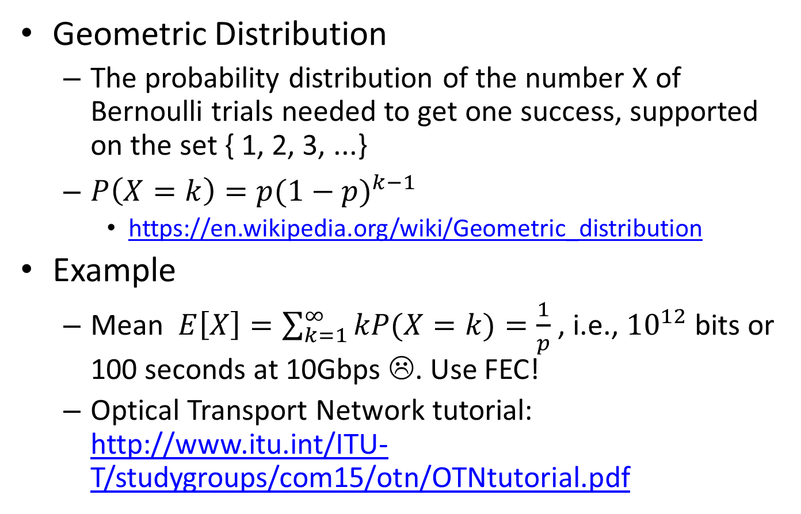
How many bits till a bit Error?
Geometric Distribution
  The probability distribution of the number X of Bernoulli trials needed to get one success, supported on the set { 1, 2, 3, ...}
  $P\left(X=k\right)=p{(1−p)}^{k−1}$
    https://en.wikipedia.org/wiki/Geometric_distribution
Example
  Mean $E\left[X\right]=\sum_{k=1}^{∞}{kP(X=k)}=\frac{1}{p}$ , i.e., ${10}^{12}$ bits or 100 seconds at 10Gbps ☹. Use FEC!
  Optical Transport Network tutorial: http://www.itu.int/ITU-T/studygroups/com15/otn/OTNtutorial.pdf

Slide 13
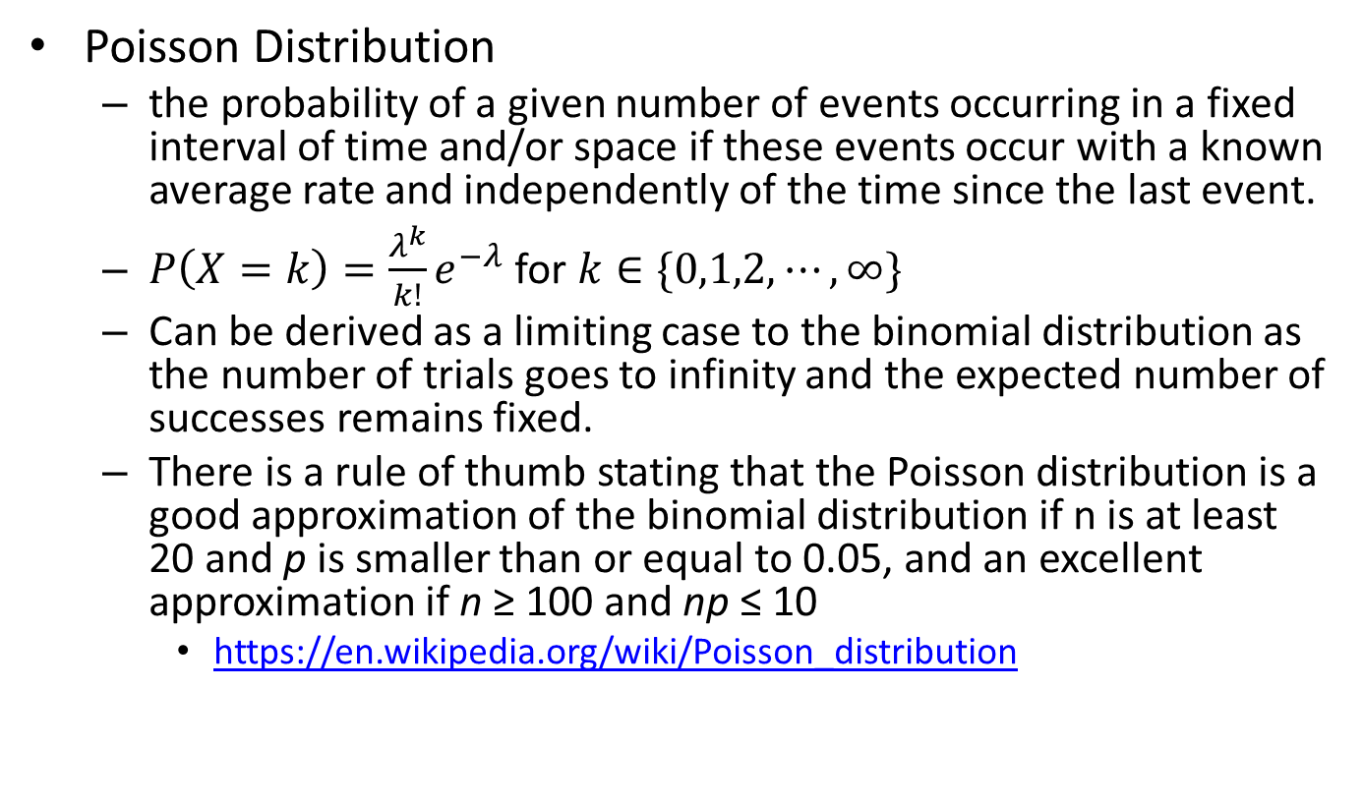
Poisson Distribution
Poisson Distribution
  the probability of a given number of events occurring in a fixed interval of time and/or space if these events occur with a known average rate and independently of the time since the last event.
  $P\left(X=k\right)=\frac{λ^{k}}{k!}e^{−λ}$ for $k∈\{0,1,2,⋯,∞\}$
  Can be derived as a limiting case to the binomial distribution as the number of trials goes to infinity and the expected number of successes remains fixed.
  There is a rule of thumb stating that the Poisson distribution is a good approximation of the binomial distribution if n is at least 20 and p is smaller than or equal to 0.05, and an excellent approximation if n ≥ 100 and np ≤ 10
    https://en.wikipedia.org/wiki/Poisson_distribution

Slide 14
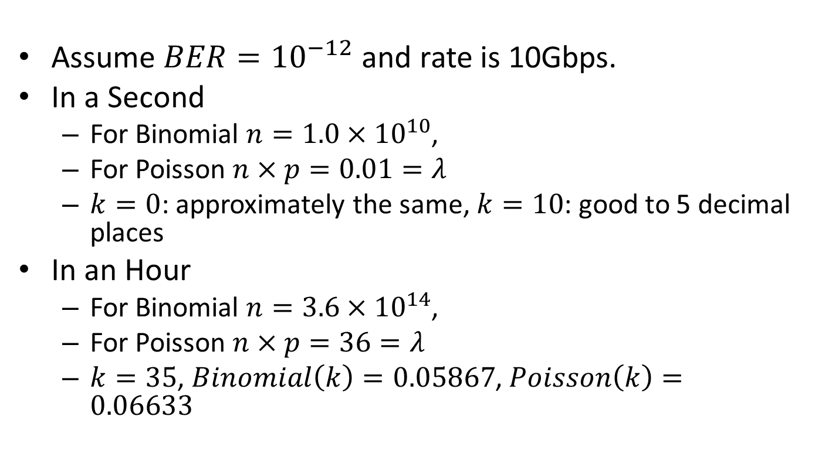
Probability of the Number of Errors in a second and an Hour
Assume $BER={10}^{−12}$ and rate is 10Gbps.
In a Second
  For Binomial $n={1.0×10}^{10}$,
  For Poisson $n×p=0.01=λ$
  $k=0$: approximately the same, $k=10$: good to 5 decimal places
In an Hour
  For Binomial $n={3.6×10}^{14}$,
  For Poisson $n×p=36=λ$
  $k=35$, $Binomial\left(k\right)=0.05867$, $Poisson\left(k\right)=0.06633$
See file: PoissonPlot.py

Slide 15
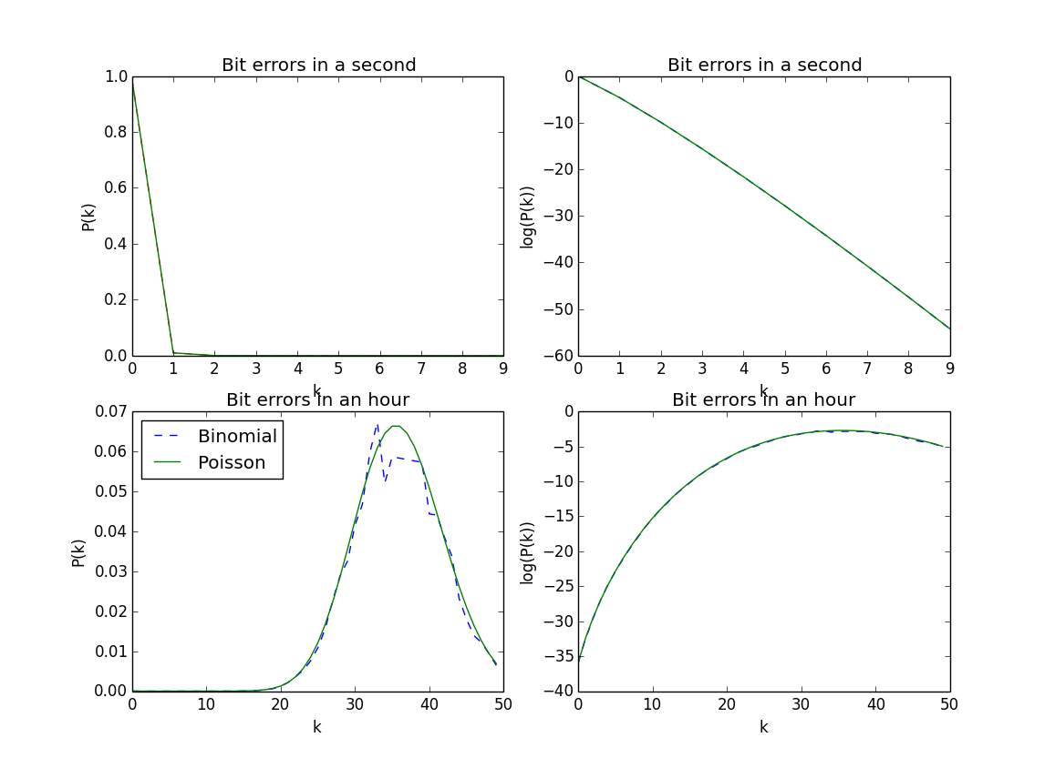
Poisson & Binomial

Slide 16
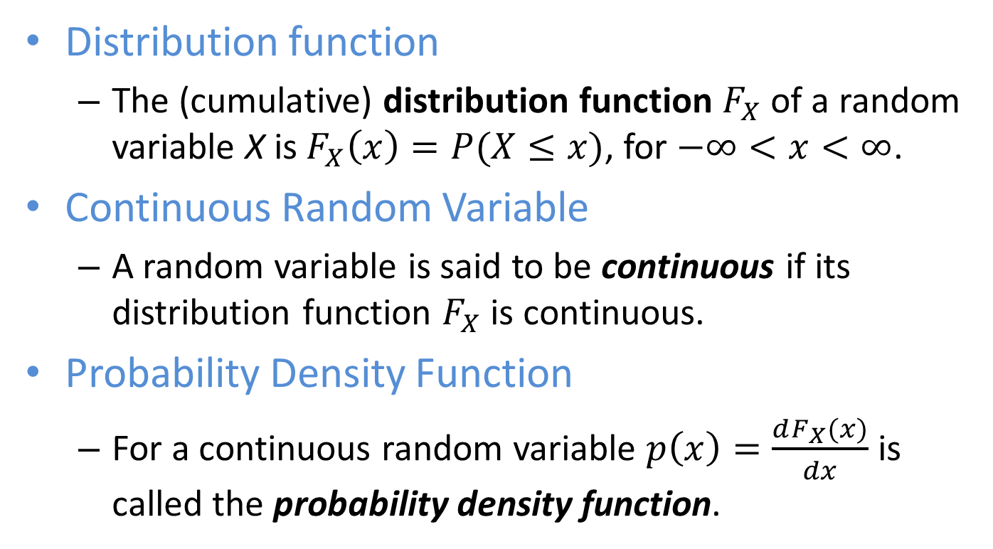
Continuous Random Variables
Distribution function
  The (cumulative) distribution function $F_{X}$ of a random variable X is $F_{X}\left(x\right)=P(X≤x)$, for $−∞<x<∞$.
Continuous Random Variable
  A random variable is said to be continuous if its distribution function $F_{X}$ is continuous.
Probability Density Function
  For a continuous random variable $p\left(x\right)=\frac{dF_{X}(x)}{dx}$ is called the probability density function.

Slide 17
Exponential Distribution I
Modeling
  “The exponential distribution is often concerned with the amount of time until some specific event occurs.”
  “Other examples include the length, in minutes, of long distance business telephone calls, and the amount of time, in months, a car battery lasts.”
  “The exponential distribution is widely used in the field of reliability. Reliability deals with the amount of time a product lasts.”
    http://cnx.org/content/m16816/latest/?collection=col10522/latest

Slide 18
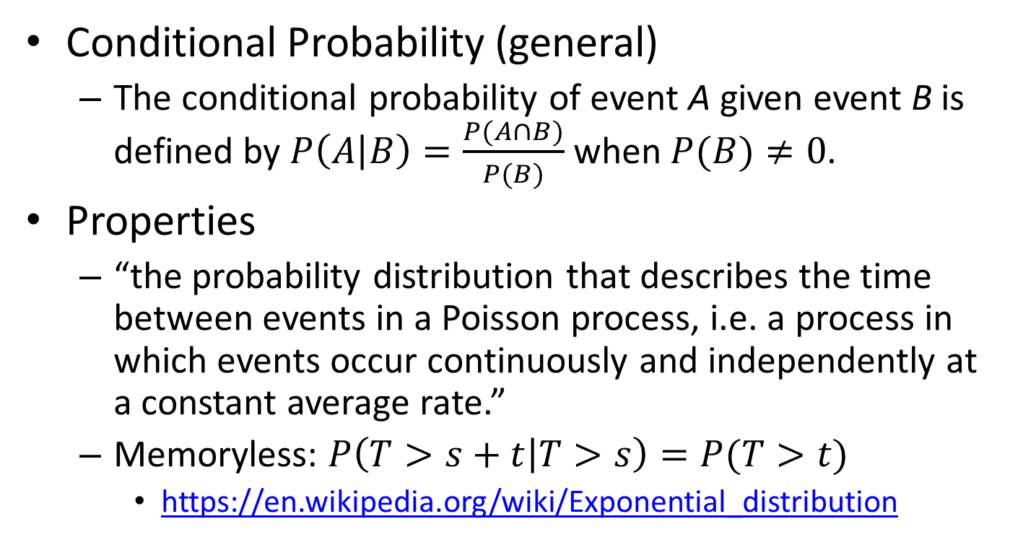
Exponential Distribution II
Conditional Probability (general)
  The conditional probability of event A given event B is defined by $P\left(A | B\right)=\frac{P(A∩B)}{P(B)}$ when $P(B)≠0$.
Properties
  “the probability distribution that describes the time between events in a Poisson process, i.e. a process in which events occur continuously and independently at a constant average rate.”
  Memoryless: $P\left(T>s+t | T>s\right)=P(T>t)$
    https://en.wikipedia.org/wiki/Exponential_distribution

Slide 19
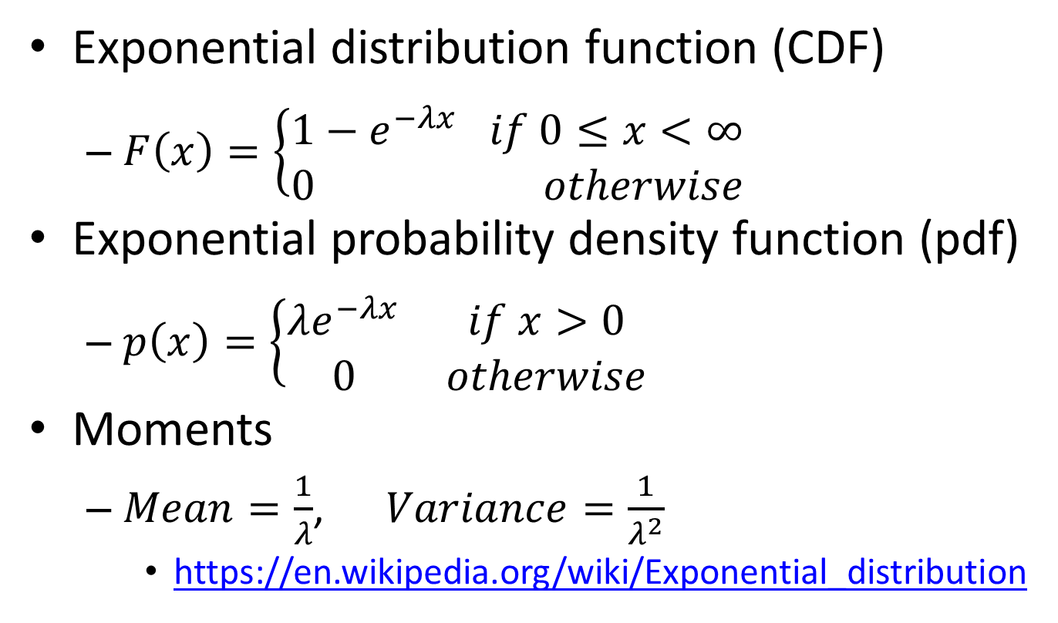
Exponential Distribution III
Exponential distribution function (CDF)
  $F\left(x\right)=\left\{\begin{matrix}1−e^{−λx} if 0≤x<∞ \\ 0 otherwise\end{matrix}\right.$
Exponential probability density function (pdf)
  $p\left(x\right)=\left\{\begin{matrix}λe^{−λx} & if x>0 \\ 0 & otherwise\end{matrix}\right.$
Moments
  $Mean=\frac{1}{λ}$, $Variance=\frac{1}{λ^{2}}$
    https://en.wikipedia.org/wiki/Exponential_distribution

Slide 20
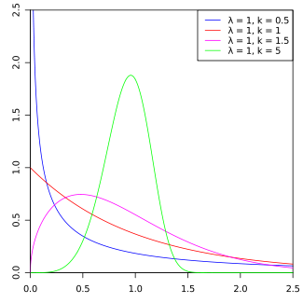
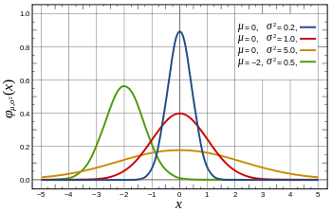
Many more continuous RVs
Uniform
  https://en.wikipedia.org/wiki/Uniform_distribution_%28continuous%29
Weibull
  https://en.wikipedia.org/wiki/Weibull_distribution
  We’ll see this for packet aggregation
Normal
  https://en.wikipedia.org/wiki/Normal_distribution

Slide 21
Random Variables in Python I
Python Standard Library
  import random
Mersenne Twister based
  https://en.wikipedia.org/wiki/Mersenne_Twister
Bits
  random.getrandbits(k)
Discrete
  random.randrange(), random.randint()
Continuous
  random.random() [0.0,1.0), random.uniform(a,b), random.expovariate(lambd), random.normalvariate(mu,sigma) random.weibullvariate(alpha, beta)
And more…

Slide 22
Random Variables in Python II
SciPy
  import scipy.stats
  http://docs.scipy.org/doc/scipy/reference/tutorial/stats.html
Current discrete distributions:
  Bernoulli, Binomial, Boltzmann (Truncated Discrete Exponential), Discrete Laplacian, Geometric, Hypergeometric, Logarithmic (Log-Series, Series), Negative Binomial, Planck (Discrete Exponential), Poisson, Discrete Uniform, Skellam, Zipf
Continuous
  Too many to list here.
  Use help(scipy.stats) to see list or visit online documentation.

