Slide 1
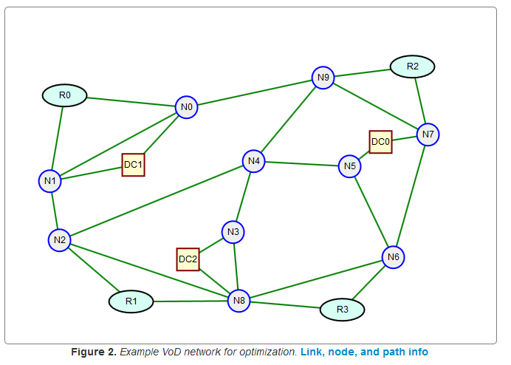
Network Design and Optimization Queueing Theory Overview
Dr. Greg Bernstein
Grotto Networking
www.grotto-networking.com

Slide 2
Outline
Why Queueing Theory?
  Vying for limited resources over time
Standard Model and Notational
  Block diagram: arrivals, waiting area, servers, population, queueing discipline
  Kendall’s notation
Examples
  Single priority IP router output port buffer (delay)
  Limited capacity video streaming server (blocking)
  TDM/WDM path request
Stochastic Processes
Formulas and Results for some key Systems:
  M/M/1 Basic queueing model
  M/M/1/k Finite Buffer for output port
  M/M/m/m m resources available – blocking or denial of service
How to handle more general cases
  Approximations
  Simulations

Slide 3
References
Zukerman, “Introduction to Queueing Theory and Stochastic Teletraffic Models”
  http://arxiv.org/abs/1307.2968, July 2013.
  Advanced (suitable for a whole grad course or two)
  I’ll denote this by “Zukerman”
  We’ll be picking and choosing a small fraction of the material, note that we don’t have time to go through the derivations. We will, however, verify some results via Discrete Event Simulation in Python.
Wikipedia…

Slide 4
Our Motivation for using Queueing Theory
Interested in utilization of limited system resources over time
Quality of Service (QoS) received by system users can be dependent on
  Waiting time to get service
  Total time in system
  Immediate availability of system resources
We are dealing with some kind of uncertainty in the system
  Random packet arrival times, Random service requests, random packet sizes, random resource use times, etc…

Slide 5
General “System”
Waiting space, the queue
One or more servers with random or deterministic processing times
Arrival process for stuff entering the system (random or deterministic)
.
.
.
Queueing Discipline
Population that generates requests, packets or other stuff that needs to use the systems resources
.
.
.

Slide 6
Kendall’s Notation
Used to indicate the type of queueing model
  Zukerman section 3.1
  https://en.wikipedia.org/wiki/Kendall%27s_notation
A/S/c/K/N/D
  A denotes the time between arrivals (arrival process)
  S The service time distribution
  c the number of servers
  K the capacity of the system (including those in service)
  N the size of the population of jobs to be served
  D and queueing discipline
  When the final three parameters are not specified (e.g. M/M/1 queue), it is assumed K = ∞, N = ∞ and D = FIFO.

Slide 7
Example I
Output Port on an IP router
  General random IP packet arrivals
  Constant bit rate output port, but random packet length leads to General random service times
  Each “port” acts as a server (so one server)
  Large but finite output buffer size
  Assume FIFO and infinite population
  Model: G/G/1/N queueing system
Quantities of Interest
  Packet delay: average, variables, probabilities
  Packet loss probabilities (due to queue overflow)

Slide 8
Example II
Access to a cell base station from handset
  Fixed number of available access slots (frequency and time slots) “servers”
  No waiting: call dropped (on handover) or connection blocked.
  General random arrival process. What would influence this?
  General random service time. What would influence this?
Model: G/G/m/m
  Where m is the total number of available timeslot*frequencies (servers) and there is only m “spaces” in the system for customers.
  Interested in call dropping and blocking statistics

Slide 9
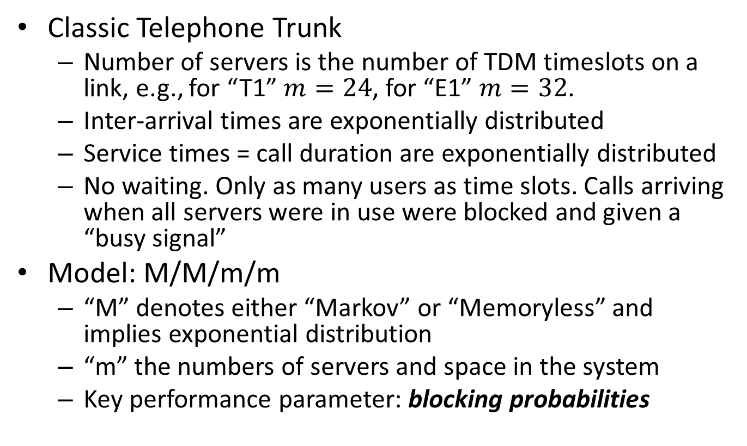
Example III
Classic Telephone Trunk
  Number of servers is the number of TDM timeslots on a link, e.g., for “T1” $m=24$, for “E1” $m=32$.
  Inter-arrival times are exponentially distributed
  Service times = call duration are exponentially distributed
  No waiting. Only as many users as time slots. Calls arriving when all servers were in use were blocked and given a “busy signal”
Model: M/M/m/m
  “M” denotes either “Markov” or “Memoryless” and implies exponential distribution
  “m” the numbers of servers and space in the system
  Key performance parameter: blocking probabilities

Slide 10
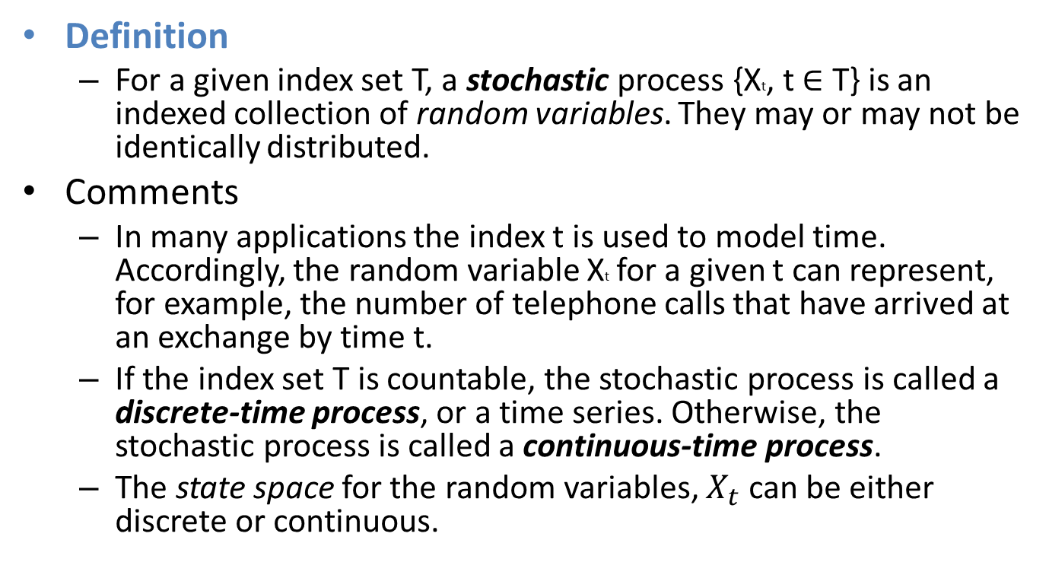
Stochastic Processes
Definition
  For a given index set T, a stochastic process {Xt, t ∈ T} is an indexed collection of random variables. They may or may not be identically distributed.
Comments
  In many applications the index t is used to model time. Accordingly, the random variable Xt for a given t can represent, for example, the number of telephone calls that have arrived at an exchange by time t.
  If the index set T is countable, the stochastic process is called a discrete-time process, or a time series. Otherwise, the stochastic process is called a continuous-time process.
  The state space for the random variables, $X_{t}$ can be either discrete or continuous.
Zukerman section 2.1

Slide 11
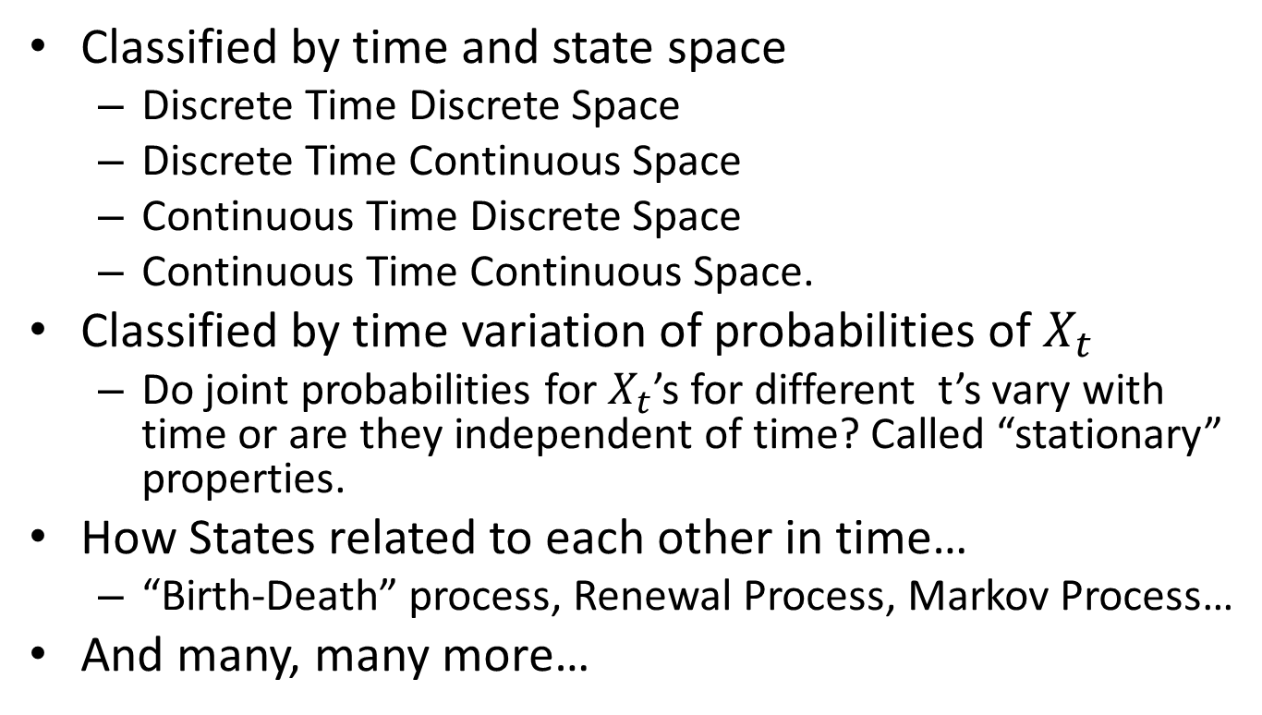
Types of Stochastic Processes
Classified by time and state space
  Discrete Time Discrete Space
  Discrete Time Continuous Space
  Continuous Time Discrete Space
  Continuous Time Continuous Space.
Classified by time variation of probabilities of $X_{t}$
  Do joint probabilities for $X_{t}$’s for different t’s vary with time or are they independent of time? Called “stationary” properties.
How States related to each other in time…
  “Birth-Death” process, Renewal Process, Markov Process…
And many, many more…
Zukerman section 2.1

Slide 12
Counting Process
Definition
  A point process can be defined by its counting process {N(t), t ≥ 0}, where N(t) is the number of arrivals with [0, t). A counting process {N(t)} has the following properties:
    N(t) ≥ 0,
    N(t) is integer,
    if s > t, then N(s) ≥ N(t) and N(s) − N(t) is the number of occurrences within (t, s].
Comment
  Note that N(t) is not an independent process because for example, if t2 > t1 then N(t2) is dependent on the number of arrivals in [0, t1), namely, N(t1).
Zukerman section 2.2

Slide 13
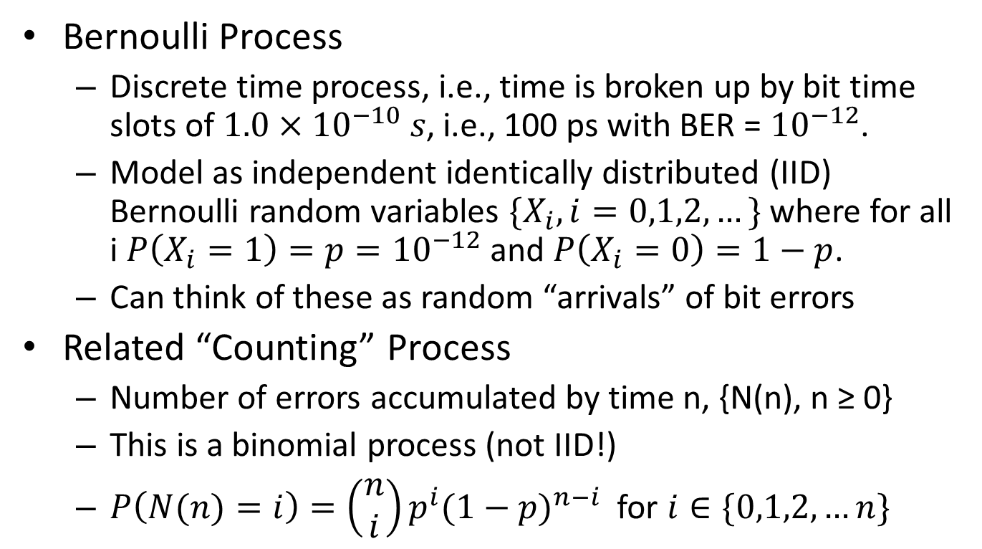
Example: Bit Error on 10Gbps link
Bernoulli Process
  Discrete time process, i.e., time is broken up by bit time slots of $1.0×{10}^{−10} s$, i.e., 100 ps with BER = ${10}^{−12}$.
  Model as independent identically distributed (IID) Bernoulli random variables $\{X_{i}, i=0,1,2,…\}$ where for all i $P\left(X_{i}=1\right)=p={10}^{−12}$ and $P\left(X_{i}=0\right)=1−p$.
  Can think of these as random “arrivals” of bit errors
Related “Counting” Process
  Number of errors accumulated by time n, {N(n), n ≥ 0}
  This is a binomial process (not IID!)
  $P\left(N(n)=i\right)=\left(\begin{matrix}n \\ i\end{matrix}\right)p^{i}{(1−p)}^{n−i}$ for $i∈\{0,1,2,…n\}$
Zukerman section 2.2.1

Slide 14
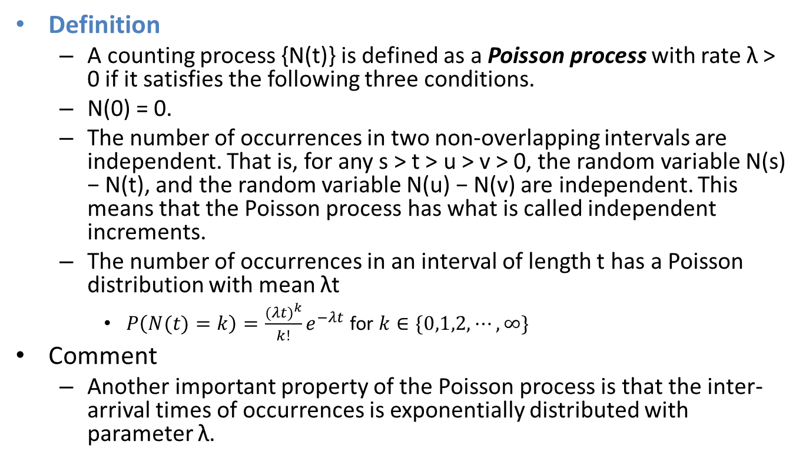
Poisson Process
Definition
  A counting process {N(t)} is defined as a Poisson process with rate λ > 0 if it satisfies the following three conditions.
  N(0) = 0.
  The number of occurrences in two non-overlapping intervals are independent. That is, for any s > t > u > v > 0, the random variable N(s) − N(t), and the random variable N(u) − N(v) are independent. This means that the Poisson process has what is called independent increments.
  The number of occurrences in an interval of length t has a Poisson distribution with mean λt
    $P\left(N(t)=k\right)=\frac{{(λt)}^{k}}{k!}e^{−λt}$ for $k∈\{0,1,2,⋯,∞\}$
Comment
  Another important property of the Poisson process is that the inter-arrival times of occurrences is exponentially distributed with parameter λ.
Zukerman section 2.2.2

Slide 15
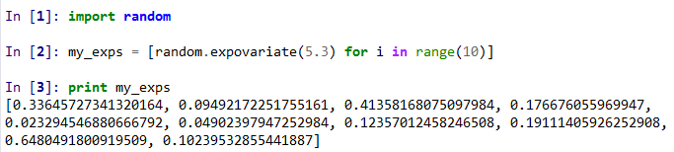
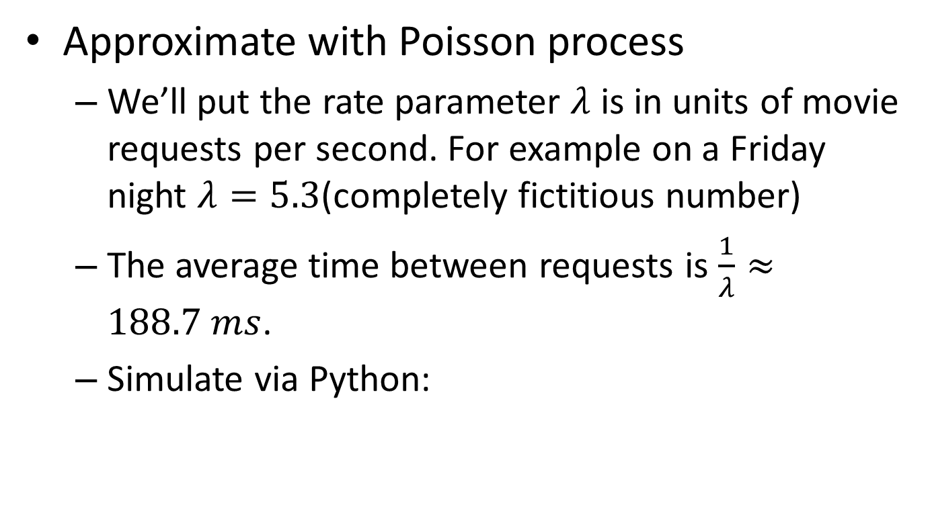
Movie requests to a video server
Approximate with Poisson process
  We’ll put the rate parameter $λ$ is in units of movie requests per second. For example on a Friday night $λ=5.3$(completely fictitious number)
  The average time between requests is $\frac{1}{λ}≈188.7 ms$.
  Simulate via Python:

Slide 16

M/M/1 Queue Definition
Formal Definition
  An M/M/1 queue is a stochastic process whose state space is the set {0,1,2,3,...} where the value corresponds to the number of customers in the system, including any currently in service.
  Arrivals occur at rate λ according to a Poisson process and move the process from state i to i + 1.
  Service times have an exponential distribution with parameter μ in the M/M/1 queue.
  FIFO queueing discipline; infinite buffer size.
    https://en.wikipedia.org/wiki/M/M/1_queue
Arrivals
Departures

Slide 17
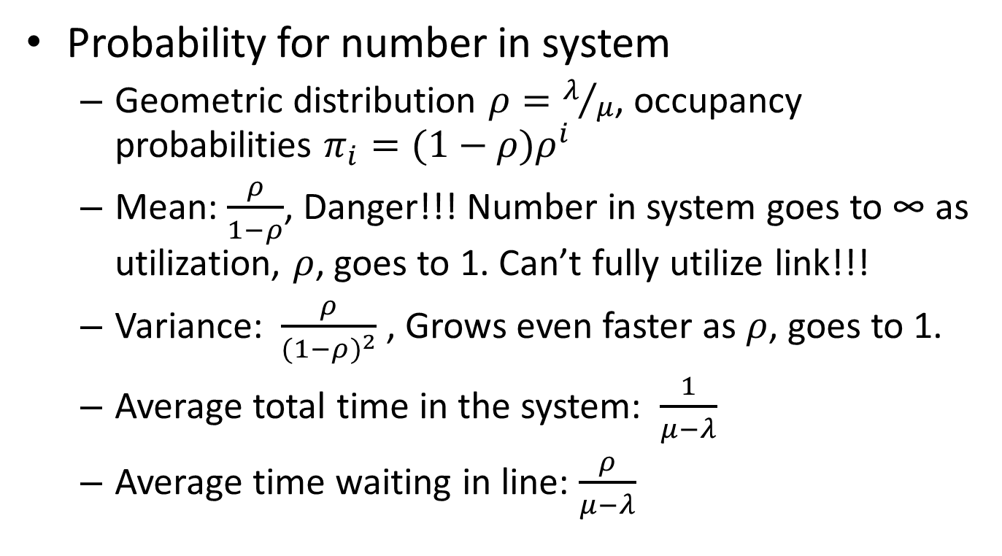
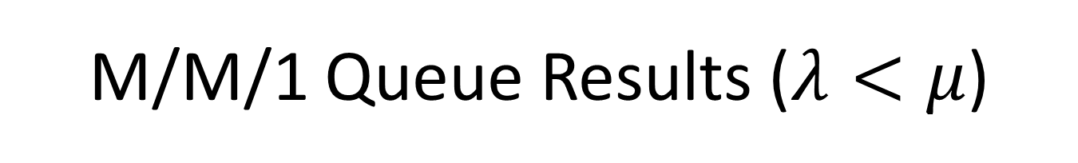
M/M/1 Queue Results ($λ<μ$)
Probability for number in system
  Geometric distribution $ρ=λ/μ$, occupancy probabilities $π_{i}=(1−ρ)ρ^{i}$
  Mean: $\frac{ρ}{1−ρ}$, Danger!!! Number in system goes to ∞ as utilization, $ρ$, goes to 1. Can’t fully utilize link!!!
  Variance: $\frac{ρ}{{(1−ρ)}^{2}}$ , Grows even faster as $ρ$, goes to 1.
  Average total time in the system: $\frac{1}{μ−λ}$
  Average time waiting in line: $\frac{ρ}{μ−λ}$

Slide 18
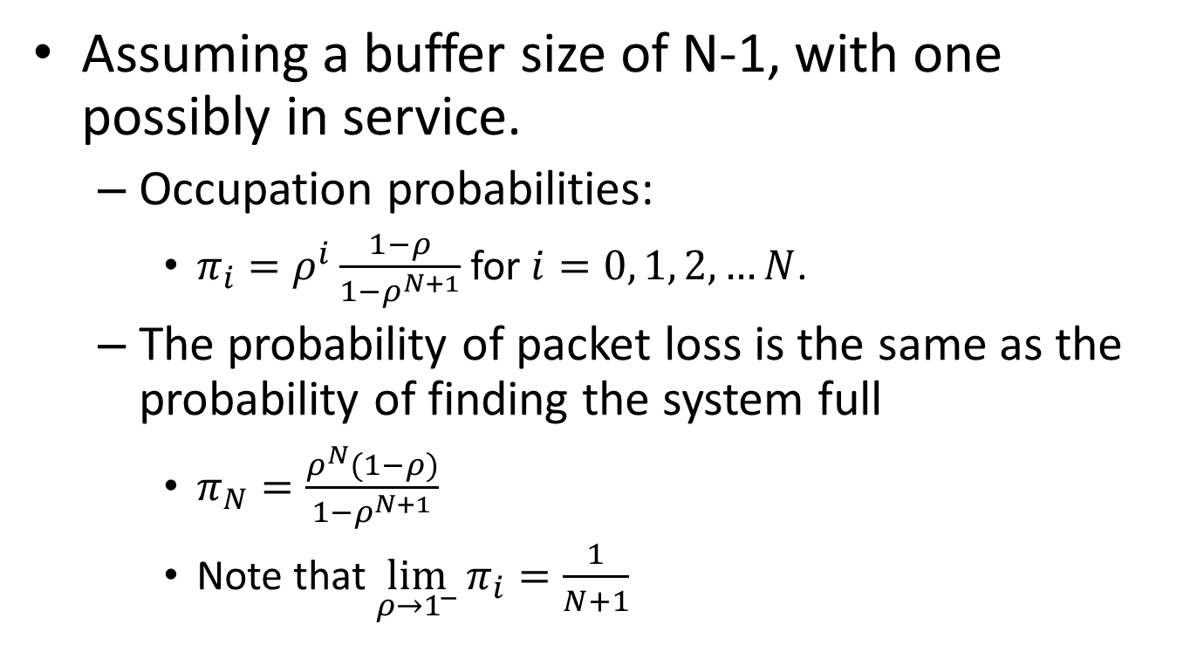
M/M/1/N Finite buffers and loss
Assuming a buffer size of N-1, with one possibly in service.
  Occupation probabilities:
    $π_{i}=ρ^{i}\frac{1−ρ}{1−ρ^{N+1}}$ for $i=0, 1, 2, …N$.
  The probability of packet loss is the same as the probability of finding the system full
    $π_{N}=\frac{ρ^{N}(1−ρ)}{1−ρ^{N+1}}$
    Note that $\lim_{ρ→1^{−}}{π_{i}}=\frac{1}{N+1}$

Slide 19
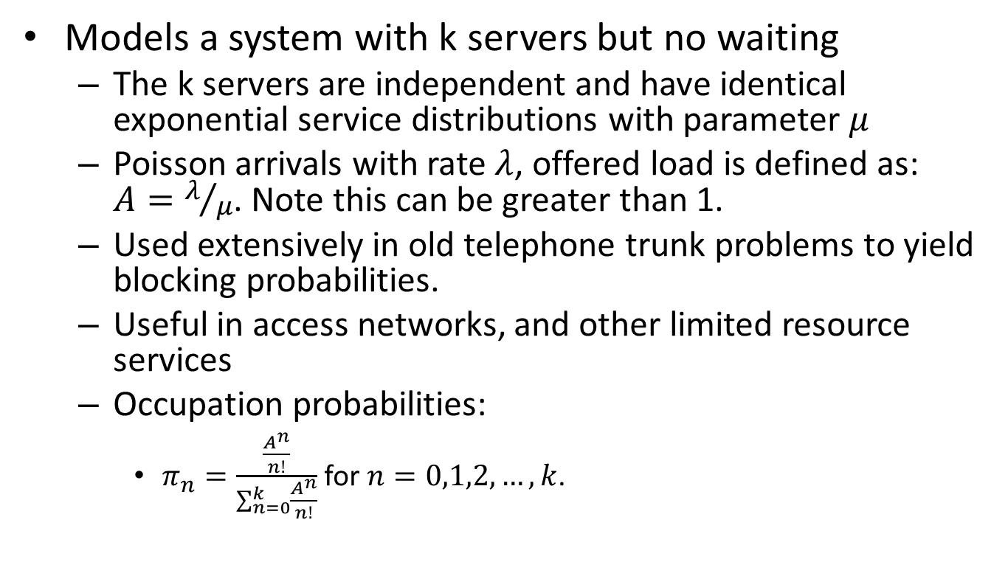
M/M/k/k Queue
Models a system with k servers but no waiting
  The k servers are independent and have identical exponential service distributions with parameter $μ$
  Poisson arrivals with rate $λ$, offered load is defined as: $A=λ/μ$. Note this can be greater than 1.
  Used extensively in old telephone trunk problems to yield blocking probabilities.
  Useful in access networks, and other limited resource services
  Occupation probabilities:
    $π_{n}=\frac{\frac{A^{n}}{n!}}{\sum_{n=0}^{k}{\frac{A^{n}}{n!}}}$ for $n=0,1,2, …,k$.

Slide 20
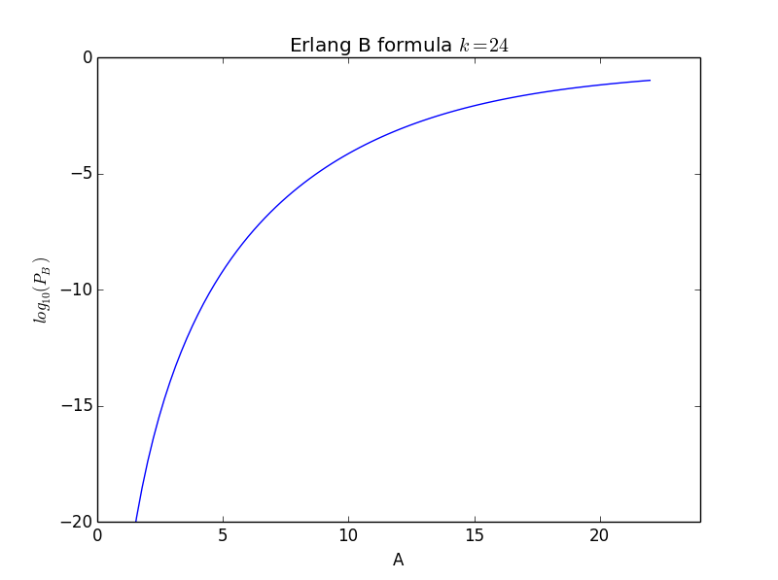
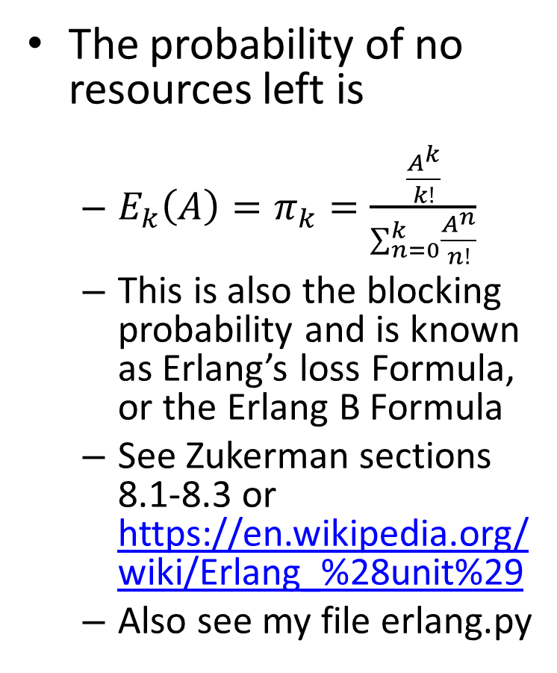
M/M/k/k Queue: Blocking
The probability of no resources left is
  ${E_{k}\left(A\right)=π}_{k}=\frac{\frac{A^{k}}{k!}}{\sum_{n=0}^{k}{\frac{A^{n}}{n!}}}$
  This is also the blocking probability and is known as Erlang’s loss Formula, or the Erlang B Formula
  See Zukerman sections 8.1-8.3 or https://en.wikipedia.org/wiki/Erlang_%28unit%29
  Also see my file erlang.py

Slide 21
Practicalities
Arrival processes
  When is exponential inter-arrival times a good approximation? When not?
Service times
  Is exponential service time accurate for packet switch output queue service time?
Simple formulas don’t generally exist so we use:
  Approximations/limits
    Where do we find these?
  Simulations
    Simple models like M/M/1, M/M/1/N, M/M/k/k very useful in checking simulations and understanding convergence time!
    But what to use in simulations?

Slide 22
How to Shop for Results I
Literature Search
  Google, Google Scholar, ACM Digital Library, IEEE Explore
Evaluate and Filter by
  Title (needs to sound somewhat relevant)
  Abstract
    Main way for you to evaluate whether you spend any more time reading the paper.

Slide 23
How to Shop for Results II
Other considerations before reviewing rest of paper
  Journal or conference “quality”
  Author or Author institution “reputation”
  Specificity of result
If appropriate go to “Introduction”
  Should provide a terse context/background on result
  Should discuss related work
    Can be a good source of more relevant papers via the reference list.

Slide 24
How to Shop for Results III
Check Reference List
  Too few may indicate a problem with paper. Though some journals have strict limits on numbers.
Read the “Conclusion”
  Should spell out what they accomplished.
If all the previous check out
  Read the “body” of the paper
  This may involve extra work such as looking up concepts and such which you may be unfamiliar

Slide 25
Current Literature Example
M. A. Arfeen, K. Pawlikowski, D. McNickle, and A. Willig, “The role of the Weibull distribution in Internet traffic modeling,” in Teletraffic Congress (ITC), 2013 25th International, 2013, pp. 1–8.

Slide 26
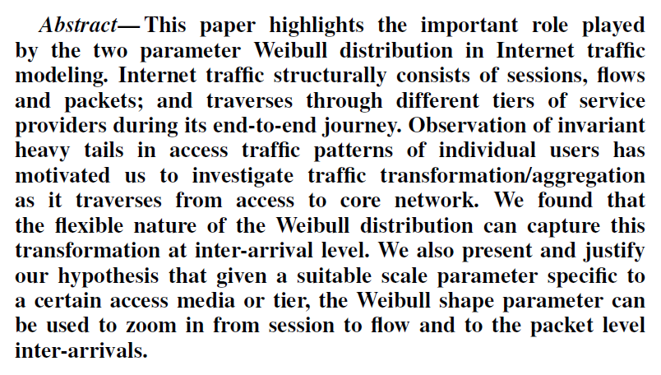
Review Abstract
New concepts: Weibull distribution; sessions, flows, and packet inter-arrival times; Heavy tail; access through core models.

Slide 27
Paper Sections
Introduction
Related Work
Theory
Problem Statement and Challenges
Description of Data Set
Access to Core Traffic Transformation
Sessions to Flows to Packets
Conclusion
References
Introductory material including key concepts (long range dependence), related work, theoretical background, detailed problem statement
Provides a nice overview of advanced notions: Burstiness, Pareto and Weibull distributions, long tails, self similarity, limit theorems…
Main body of paper

