Slide 1
Network Design and Optimization Python Introduction
Dr. Greg Bernstein
Grotto Networking
www.grotto-networking.com

Slide 2
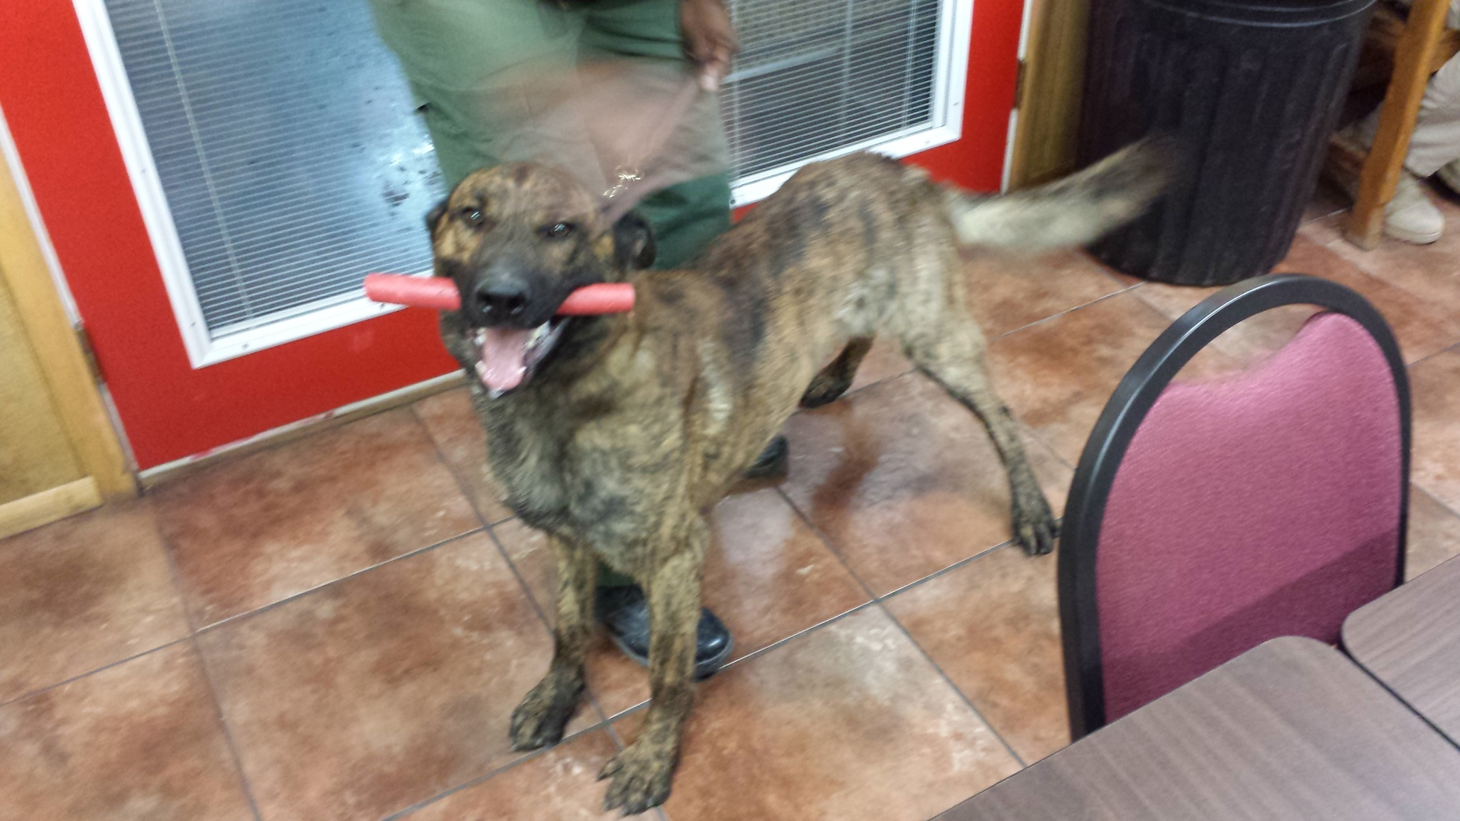
Python: The Working Dog of Programming Languages
Lucy with her “reward” chew toy after finding me hiding in a closet during testing.

Slide 3
Why Python?
Works well with Others (languages)
Relatively easy access to vast open source numerical and scientific libraries
Interactive and Object Oriented
Quick for testing out new ideas
Good for more complicated stuff too
Well used in Data Communication, Scientific, and Web Development communities
OpenStack, Mininet, PoX (cloud & SDN)
Numpy, SciPy, NetworkX, Pandas, Astropy, Sage (Math & Science)
Flask, Django, Pyramid, Tornado (Web)
Open Source!

Slide 4
Bare bones or a Distribution?
You can get Language and Standard Library
directly from https://www.python.org/
Then add external libraries
Issue: this can get a bit tricky on Windows and Macs
For ease of getting started there are scientific "Python distributions" available for no cost via the web. We will use Python version 2.7 due to its compatibility with numerical packages such as Numpy, Matplotlib, SciPy, NetworkX, SimPy, etc...
Anaconda (Windows, Mac, Linux) https://store.continuum.io/cshop/anaconda/
Python(x,y) (Windows) https://code.google.com/p/pythonxy/
Enthought Canopy Express https://www.enthought.com/products/epd/free/

Slide 5
Getting Started Resources
Python Tutorial
http://docs.python.org/2/tutorial/index.html
Building Skills in Python
Free PDF, Aimed at experienced programmers, Recommended
http://www.itmaybeahack.com/book/python-2.6/latex/BuildingSkillsinPython.pdf
Lectures on Scientific Computing with Python
http://nbviewer.ipython.org/github/jrjohansson/scientific-python-lectures/tree/master/
Uses IPython notebooks. Covers basics, numpy, matplotlib, and more…
Code Academy
http://www.codecademy.com/tracks/python

Slide 6
Editors and IDEs I Use
Geany Editor
http://www.geany.org/
Recognizes Python classes, Functions, variables; syntax highlighting, zoom; Cross platform: Linux, Windows, Mac
Notepad++
http://notepad-plus-plus.org/
Fast, Windows only, syntax highlighting, zoom, doesn’t recognize Python functions, classes, variables
PyCharm (full IDE)
http://www.jetbrains.com/pycharm/
Free and professional editions
Your favorites?

Slide 7
Python Shells
Plain Python shell
Can just type “python” at a command prompt to start and interactive shell
IPython http://ipython.org/
A much improved command line shell
Great Qt based graphical shell (I use this all the time)
Full on Browser based notebook interface. Include nice text, code, and graphics together.
Included with Anaconda, PythonXY, and Enthought distributions and available separately

Slide 8
Other Tools I Use
Google Python Style Guide
http://google-styleguide.googlecode.com/svn/trunk/pyguide.html
Version Control: Git
I’ve got a slide deck on using Git locally for single person projects.
Documentation Generators (Python)?
Doxygen
Originally aimed at C++, But can now do python, but in a C++ kind of way. Easy to use.
Sphinx
Used for much Python documentation. A bit tougher to use but very pretty documentation.

Slide 9
External Python Libraries
Numpy (http://www.numpy.org/)
SciPy (http://www.scipy.org/)
Matplotlib (http://matplotlib.org/)
SimPy (http://simpy.readthedocs.org/en/latest/)
NetworkX (http://networkx.github.io/)
PuLP (https://code.google.com/p/pulp-or/)
https://pythonhosted.org/PuLP/ Documentation
Flask (http://flask.pocoo.org/)
Almost all included with Anaconda, PythonXY, or Enthought distributions

Slide 10
Network Visualization in the Web Era
Common GUI Problems
Non-portable
Graphics library lock-in
Lack of Support
Alternative: Web based GUI’s and Visualization
Raw technologies: HTML5, CSS, SVG, JavaScript
Powerful JavaScript libraries: D3.js, jQuery, etc…
Data sharing: JSON, XML
Downside: learning curve…

Slide 11
Our R&D Environment I
Network Editor/Viewer Web Application
http://www.grotto-networking.com/GraphEdit.html
Import and export network related entities such as graph, paths, demands, etc.. Via JSON files
JSON parser from Python standard library
Web Browser
Running “Single Page” JavaScript Application
Graph JSON
Path JSON
Our network design and optimization algorithms
Path JSON
Open Source Solvers and Libraries as needed
Path JSON
Tree JSON
DemandJSON

Slide 12
Our R&D Environment II
Network Editor/Viewer Web Application
Next step beyond http://www.grotto-networking.com/GraphEdit.html
Exchange network related entities via AJAX (or WebSockets)
Web Browser
Running “Single Page” JavaScript Application
RESTful Web Service
AJAX RESTful service requests, i.e., GET, POST, PUT,…
Exchanging JSON data
Simple Python WebServer (Flask)
Our network design and optimization algorithms
Open Source Solvers and Libraries as needed
This is what I use on my machine

Slide 13
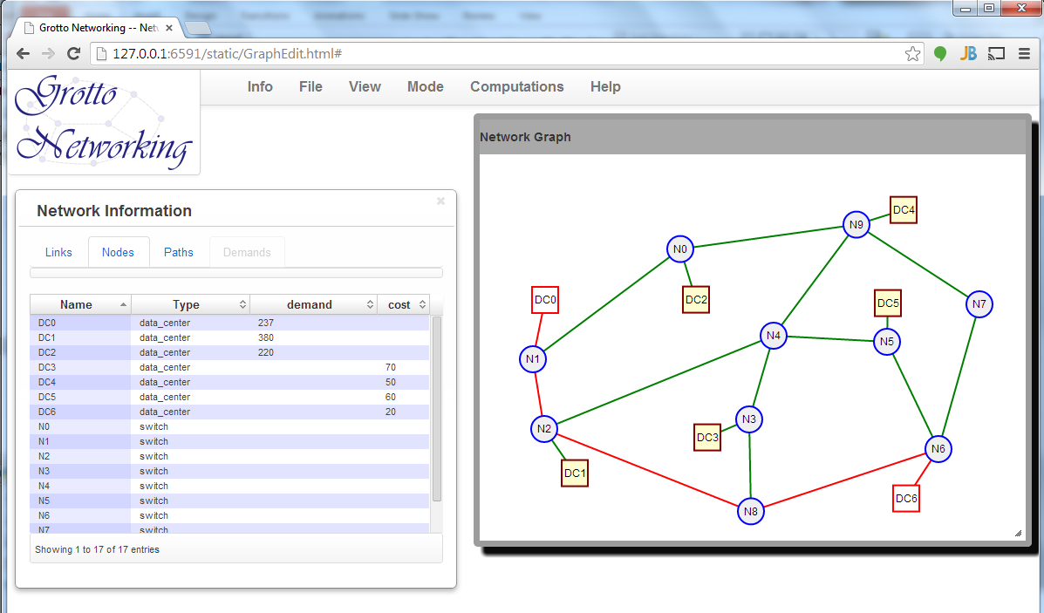
Example of R&D Environment II

