Slide 1
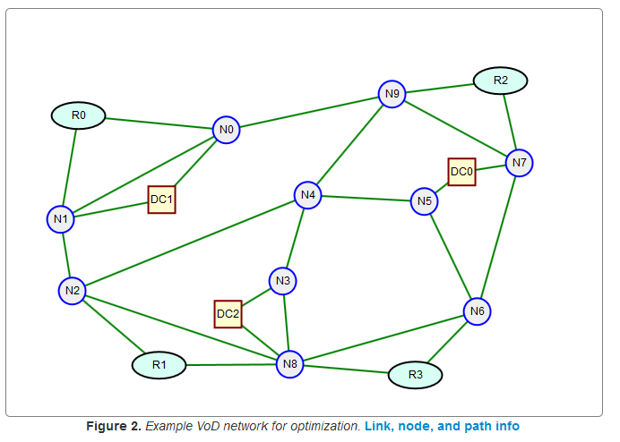
Multi-Layer Network Design II
B
Dr. Greg Bernstein
Grotto Networking
www.grotto-networking.com

Slide 2
Outline
Two layer allocation problems
  Link-Path, Single Path Allocation
  Examples
Two layer dimensioning problems
Book Readings
  Section 2.9, Section 12.1 (skip or skim 12.1.5)

Slide 3
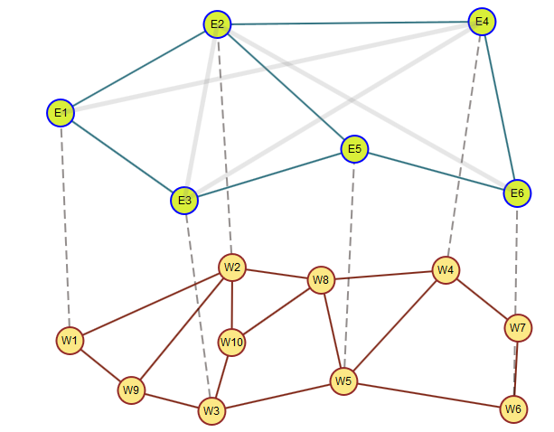
Two layer capacity allocation Problem
Example Ethernet over WDM
  Ethernet demands: {('E1', 'E4'): 23, ('E2', 'E3'): 18, ('E2', 'E6'): 19, ('E3', 'E4'): 17}
  WDM link capacities: 40Gbps

Slide 4

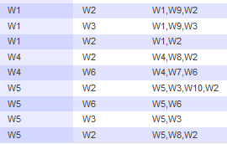
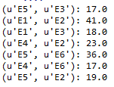
Example Solutions
Optimized objective = 33785.36
Upper layer selected paths:
Lower layer selected paths:
Upper layer link capacities:
Splitting over two different lower layer paths

Slide 5
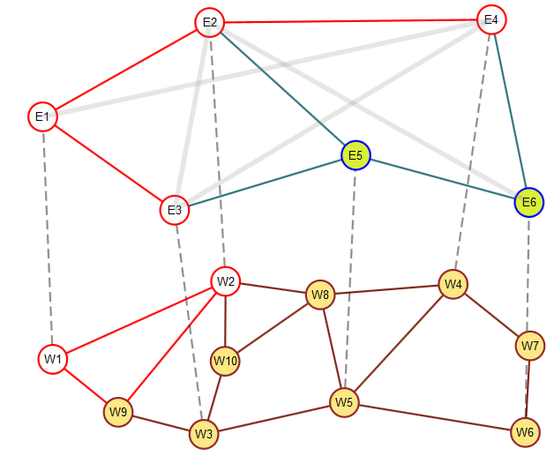
Example Solutions II
Two upper layer paths contribute to the load on link (E1, E2)
Demand on (E1, E2) needs to be split over two different paths [W1, W2] and [W1, W9, W2]

Slide 6
Two Layer SPA Formulation I
Upper Layer
Indices
  Demands
  Links
  Candidate paths
Constants
  Volume of demand d
  Link in path indicator
Variables
  Flow allocation
  Link capacity

Slide 7
Two Layer SPA Formulation II
Upper Layer
Demand Constraints
Link Capacity Constraints

Slide 8
Two Layer SPA Formulation III
Lower Layer
Indices
  Links (lower)
  Candidate paths (lower)
Constants
  Link Capacity (lower)
  Link in path indicator (lower)
  Link cost (lower)
Variables
  Flow allocation (lower)
  Path Selection indicator (lower, binary)

Slide 9
Two Layer CA Formulation IV
Lower Layer
Demand Constraints
Link Capacity Constraints
Path Selection Constraints
Objective
  minimize

Slide 10
Variable reduction?
Do we need both and ?
  Can’t we just use as follows:
  Second inequality has two variables multiplied by each other and hence is a non-linear constraint, but we need an linear MIP formulation

Slide 11
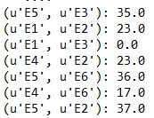
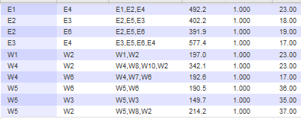
Example SPA Solution I
Optimized objective = 35696.34 (previous: 33785.36)
Upper layer link capacities:
Upper and Lower layer selected paths:

Slide 12
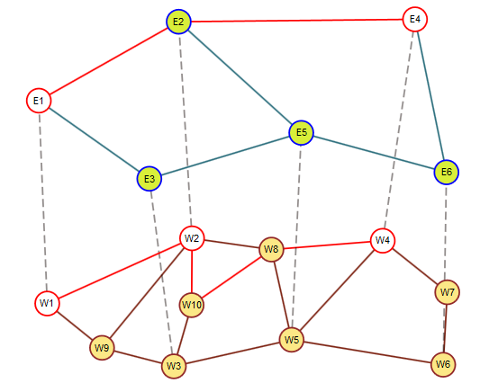
Example SPA Solution II
Upper layer path: [E1, E2, E4]
Lower layer paths implementing upper layer links:
(E1, E2): [W1, W2]
(E2, E4): [W2, W10, W8, W4]

Slide 13
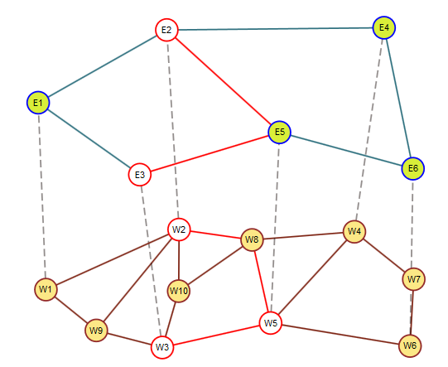
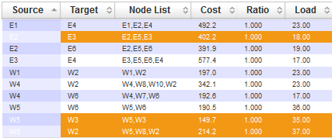
Example SPA Solution III
Upper layer path: [E2, E5, E3]
Lower layer paths implementing upper layer links:
(E3, E5): [W3, W5]
(E2, E5): [W2, W8, W5]

Slide 14
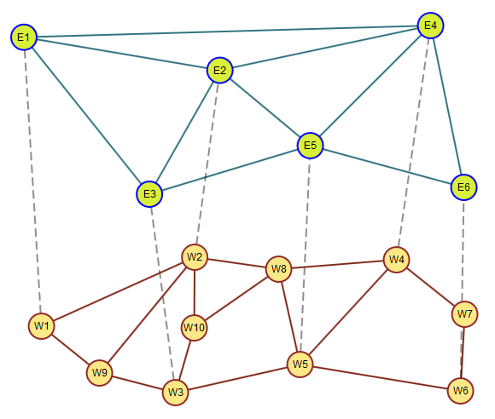
Dimensioning Problems
Looking to size links at both upper and lower layers
  Start simple then deal with modular sizing

Slide 15
Two Layer Dimensioning Formulation I
Upper Layer
Indices
  Demands
  Links
  Candidate paths
Constants
  Volume of demand d
  Link in path indicator
  Cost of upper layer links
Variables
  Flow allocation (continuous)
  Link capacity (continous)
In CA problems we only cared about lower layer costs. Why would we care here? What values might be assigned?

Slide 16
Two Layer Dimensioning Formulation II
Upper Layer
Demand Constraints
Link Capacity Constraints

Slide 17
Two Layer Dimensioning Formulation III
Lower Layer
Indices
  Links (lower)
  Candidate paths (lower)
Constants
  Link in path indicator (lower)
  Link cost (lower)
Variables
  Flow allocation (continuous)
  Link Capacity (continuous)

Slide 18
Two Layer Dimensioning Formulation IV
Lower Layer
Demand Constraints
Link Capacity Constraints
Objective (multi-layer)
  minimize

Slide 19
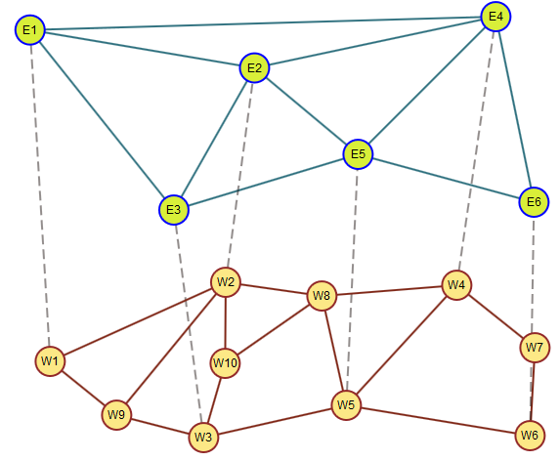
Multi-layer Dim Example Ia
Ethernet over WDM
  Initially continuous variables for link capacities

Slide 20
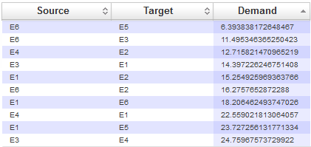
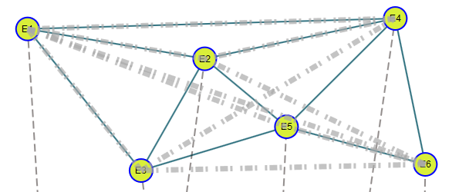
Multi-layer Dim Example Ib
Demands
  Upper layer only
  Randomly generated

Slide 21
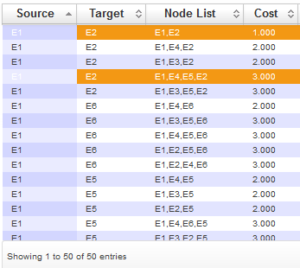
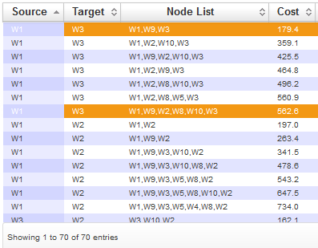
Multi-layer Dim Example Ic
Candidate path generation (k-shortest paths alg)
  Upper layer link costs = 1 (why would this be reasonable?)
  Lower layer link costs based on distance
Example best and worst paths
Upper Layer
Lower Layer

Slide 22
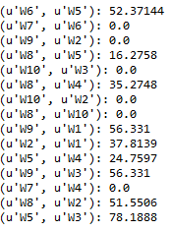
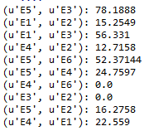
Multi-layer Dim Example Id
Link Size Solutions
Upper Layer
Lower Layer
Dimensioning problem objective = 55,526.56

Slide 23
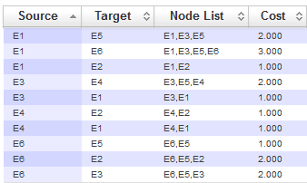
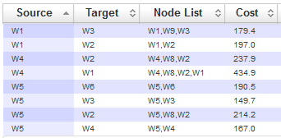
Multi-layer Dim Example Ie
Solution Paths
Upper Layer
Lower Layer

Slide 24
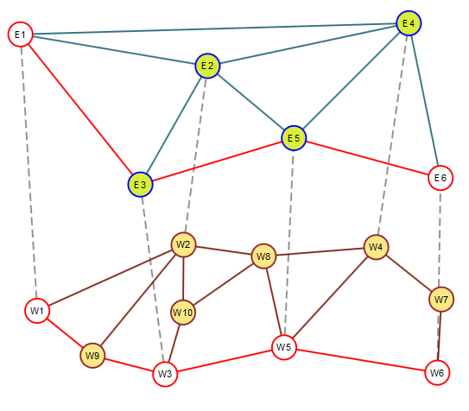
Multi-layer Dim Example If
Solution Paths
  Realizing demand (E1, E6): 18.2
Upper Layer
Lower Layer

Slide 25
Multi-Layer Dimensioning Modular
But links don’t come in continuous sizes!
  Let M be the size of the capacity for the upper layer links
  Let N be the size of the capacity for the lower layer links
  Use a mix of continuous and integer variables in the formulation

Slide 26
Two Layer Dimensioning Formulation I
Upper Layer
Indices
  Demands
  Links
  Candidate paths
Constants
  Volume of demand d
  Link in path indicator
  Cost of upper layer links
  Upper layer module size M
Variables
  Flow allocation (continuous)
  Link capacity (integer)

Slide 27
Two Layer Dimensioning Formulation II
Upper Layer
Demand Constraints
Link Capacity Constraints
Module size times the integer link capacity

Slide 28
Two Layer Dimensioning Formulation III
Lower Layer
Indices
  Links (lower)
  Candidate paths (lower)
Constants
  Link in path indicator (lower)
  Link cost (lower)
  Link Modular Capacity N
Variables
  Flow allocation (integer)
  Link Capacity (integer)

Slide 29
Two Layer Dimensioning Formulation IV
Lower Layer
Demand Constraints
Link Capacity Constraints
Objective (multi-layer)
  minimize
Slightly different cost function than text so we can compare to previous results.

Slide 30
Modular Dimensioning Example 2a
Technology Stack
  10Gbps Ethernet over WDM
  Each wavelength supports 40Gbps of traffic
    Could use G.709 OTU3, OTU3e2
    Or SONET OC-768/ SDH STM-256
In formulation
  M=10
  N=40

Slide 31
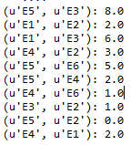
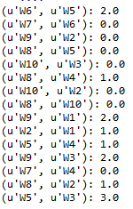
Multi-layer Mod Dim Example 2b
Link Size Solutions
Upper Layer
Lower Layer
Do these link sizes seem correct? Why or Why not?
Dimensioning problem objective = 71,930.81

Slide 32
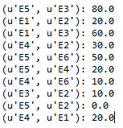
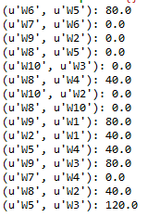
Multi-layer Mod Dim Example 2b
Scaled Link Size Solutions
  Need to multiply by modular factors M and N
Upper Layer
Lower Layer

Slide 33
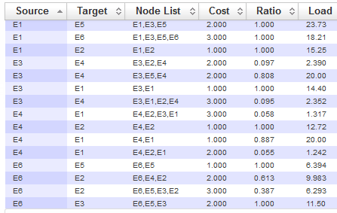
Multi-layer Mod Dim Example 2c
Upper Layer Solution Paths
Path Splitting!

Slide 34
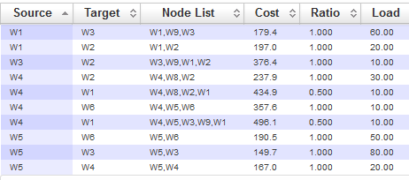
Multi-layer Mod Dim Example 2d
Lower Layer Solution Paths
Path Splitting!

Slide 35
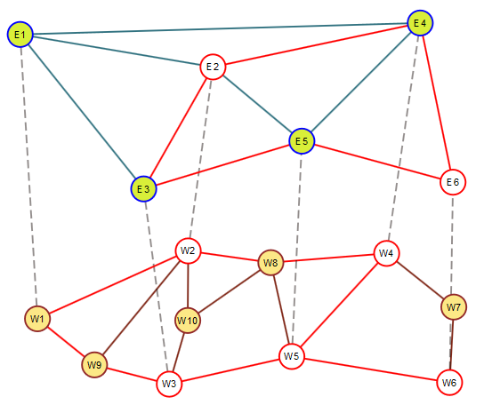
Multi-layer Mod Dim Example 2e
Demand (E2, E6) realization
  Via multiple upper and lower layer paths
Assuming aggregate flows between nodes and Ethernet LAG technology is it okay to split:
Upper layer paths?
Lower layer paths?

