Slide 1
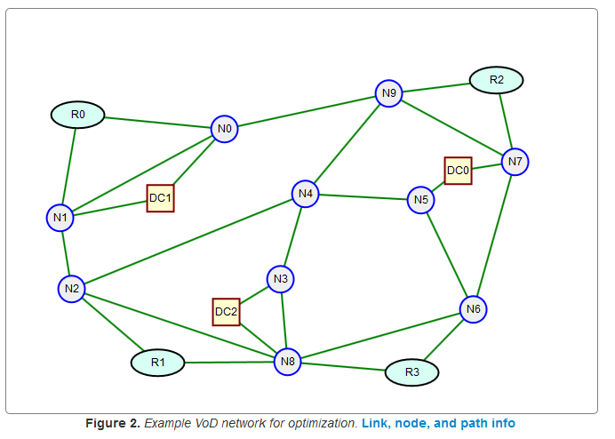
Multi-Layer Network Design
B
Dr. Greg Bernstein
Grotto Networking
www.grotto-networking.com

Slide 2
Outline
How we stack network layers
  Concept of Adaptation
  Technologies and Examples
Two layer dimensioning problems
  Link-Path, Node Link Formulations
  Continuous, Modular, Single Path Allocation
  Examples
Two layer allocation problems
  Link-Path, Node Link Formulations
  Continuous, Modular, Single Path Allocation
  Examples
Book Readings
  Section 2.9, Section 12.1 (skip or skim 12.1.5)

Slide 3
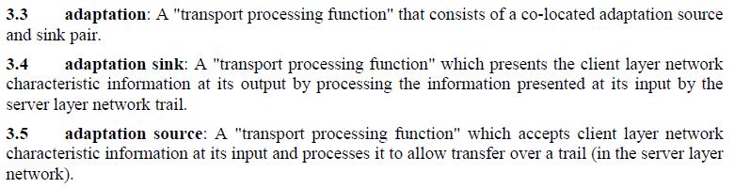
The Adaptation concept
How do we put “stuff” inside other “stuff”?
  Packets within Packets?
  Packets within bit streams (TDM channels)?
  Bit streams within bit streams?
  Bit streams within Packets?
Definition from ITU-T G.805

Slide 4
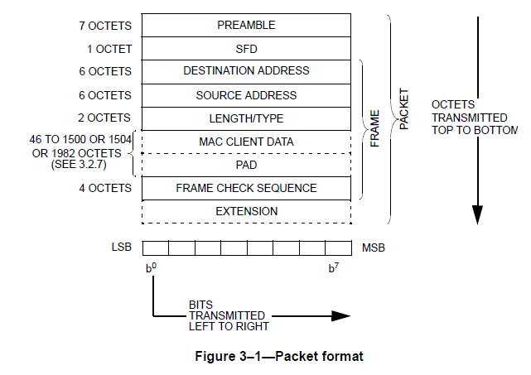
Example: “Stuff” over Ethernet
Ethernet’s Type field used to indicate what is being carried
  Also see https://en.wikipedia.org/wiki/EtherType for general info
Some “famous” current EtherTypes (hex):
0800 IPv4
0806 ARP
22F3 TRILL
8847 MPLS
86DD IPv6
Tells us what is being carried by the Ethernet “frame”
From IEEE 802.3 section 1, 2012

Slide 5
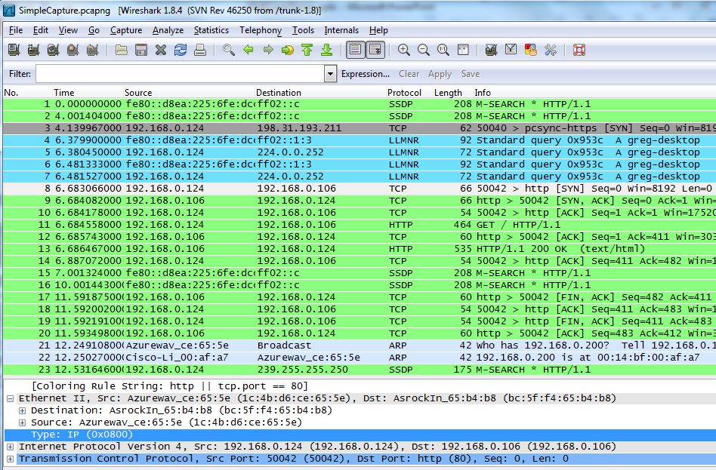
“Stuff” over Ethernet
Type field always included in packet traces…

Slide 6
Packets over TDM
Via Point to Point Protocol (PPP)
  PPP over SONET/SDH, http://tools.ietf.org/html/rfc2615
  PPP in HDLC-like Framing, http://tools.ietf.org/html/rfc1662
Via Generic Framing Procedure
  G.7041 (10/2008)
Ethernet direct into G.709
  G.709 (12/2009)
Legacy & Proprietary Approaches
  Indirectly via ATM or Frame Relay
  Many “pre-standard” vendor specific implementations.

Slide 7
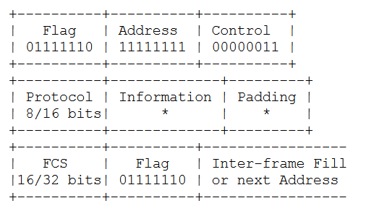
Packet over SONET (POS)
Really RFC2615 and RFC1662
  Uses a special “flag” to denote the start of the information
    This needs to be “escaped” via bit or byte stuffing techniques.

Slide 8
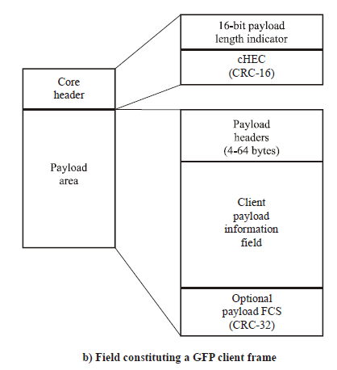
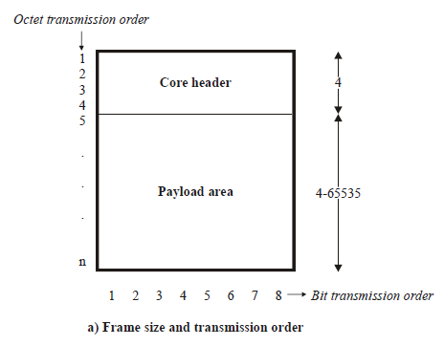
GFP over SDH or G.709
No manipulation of user data
  Uses payload length indicator and core header error check (cHEC) to track payload (packet) boundaries.

Slide 9
Common Multi-Layer Combinations
IP over something
  Why not just IP?
IP over MPLS over something
  Why not just IP over MPLS?
Ethernet over WDM
  Metro and Long haul
Ethernet over TDM
  WAN
TDM over WDM
  WAN

Slide 10
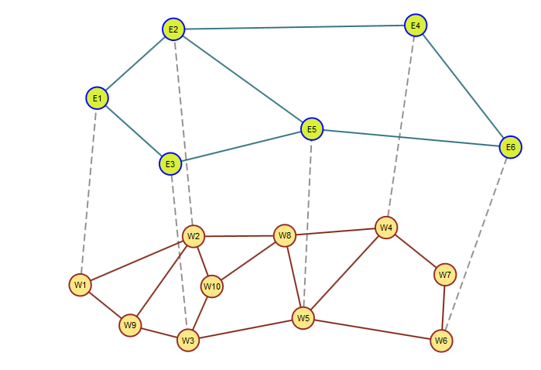
Modeling Multi-Layer Networks I
Upper layer “links” implemented via lower layer paths
  Link (E1,E3) could be implemented via paths [W1, W9, W3], [W1,W2, W10, W3],etc..
Ethernet Layer Network
Adaptation “links” between associated layer nodes
WDM Layer Network

Slide 11
Modeling Multi-Layer Networks II
Each Upper layer Node must be associated with one lower layer node (adaptation “links”)
Ethernet Layer Network
Adaptation “links” between associated layer nodes
WDM Layer Network

Slide 12
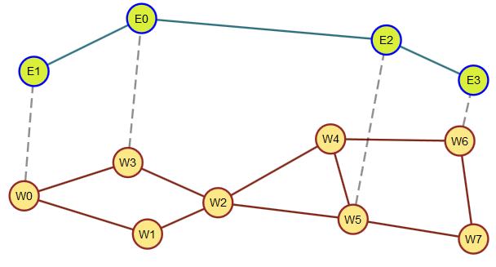
Modeling Multi-Layer Networks III
Simplifying assumptions
  Will assume a “uniform” technology mix. In real networks technology mix would change at the edges.
  We won’t model adaptation related constraints.
    These could always be added later

Slide 13
Multi Layer Problem Formulation
Key Ideas
  Can initially think of each network layer as a separate optimization problem
  Problems become coupled as upper layer “links” become lower layer “demands”
Same variety of problem types as before
  Capacitated Allocation
  Dimensioning
  Various constraints such as single path allocation, modular dimensioning, etc…

Slide 14
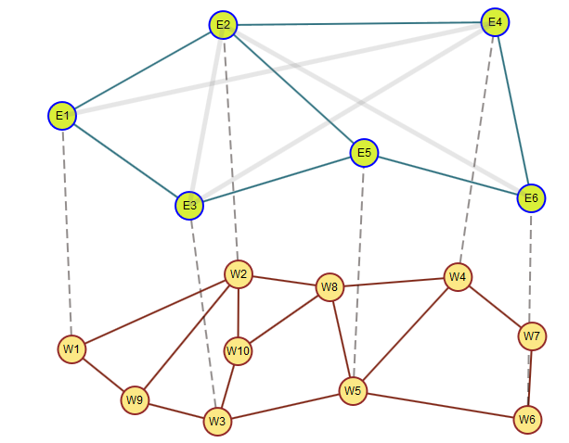
Two layer capacity allocation Problem
Example Ethernet over WDM
  Ethernet demands: {('E1', 'E4'): 23, ('E2', 'E3'): 18, ('E2', 'E6'): 19, ('E3', 'E4'): 17}
  WDM link capacities: 40Gbps

Slide 15
Two Layer CA Formulation I
Upper Layer
Indices
  Demands
  Links
  Candidate paths
Constants
  Volume of demand d
  Link in path indicator
Variables
  Flow allocation
  Link capacity

Slide 16
Two Layer CA Formulation II
Upper Layer
Demand Constraints
Link Capacity Constraints
  Hmm, this looks more like a dimensioning problem
    We’ll use the upper layer link capacities as the lower layer “demands”

Slide 17
Two Layer CA Formulation III
Lower Layer
Indices
  Links (lower)
  Candidate paths (lower)
Constants
  Link Capacity (lower)
  Link in path indicator (lower)
  Link cost (lower)
Variables
  Flow allocation (lower)

Slide 18
Two Layer CA Formulation IV
Lower Layer
Demand Constraints
Link Capacity Constraints
Objective
  minimize

Slide 19
Implementation
Givens
  A two layer network
  A set of upper layer demands
Need
  Separate upper and lower layer networks
  Candidate paths for upper and lower layer networks
  Mapping between upper layer links and lower layer demands

Slide 20
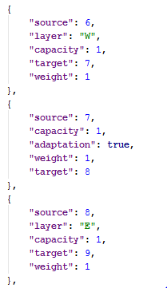
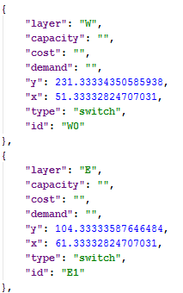
Multi-Layer Network JSON
Nodes (assigned to a single layer)
Layer Links (similar)
Adaptation Links (between layers)
Example edges:
Example nodes:
Still using a graph model with nodes and edges but we add more attributes to the nodes and edges to enable multi-layer network models

Slide 21
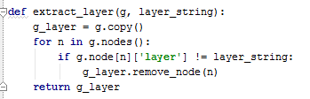

Obtaining Layer Subnetworks
Python/NetworkX make this easy
  Make a copy of the network
  Remove all nodes that are not in the layer of interest
Usage:

Slide 22


Mapping between Upper and Lower Layers
Using “adaptation” edges
  Here we create a Python dictionary mapping upper layer nodes to lower layer nodes by following adaptation links.
  We use this mapping to turn upper layer links into lower layer demands
This code returns a Python dictionary of attributes for link e
Example use: generating some “dummy” lower layer demands that will be used to feed a candidate path generating function.

Slide 23
Generating Candidate Paths I
Utility function for candidate path generation
  gen_cand_paths(g, demands, n)
    Generates n paths per demand pair. Returns a dictionary indexed by demand node pair whose value is a list of paths (each path a node list)
Upper Layer network
Lower Layer network

Slide 24
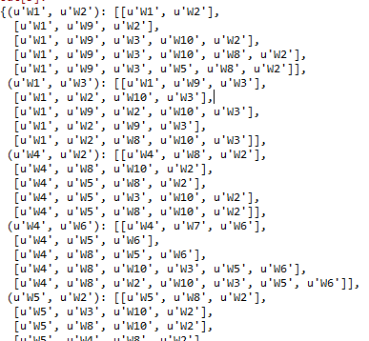
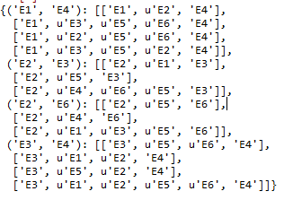
Generating Candidate Paths II
Upper and lower candidate paths:

Slide 25



Creating Multi-Layer LP Variables

Slide 26
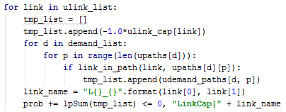
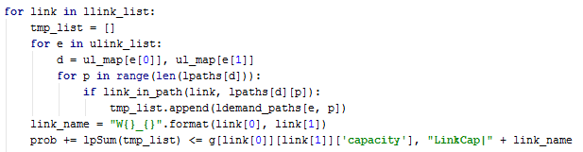
Constraints Implementation I

Slide 27
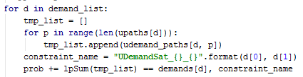
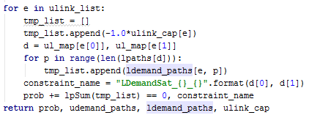
Constraints Implementation II

Slide 28

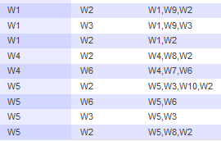
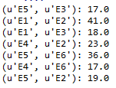
Example Solutions
Upper layer selected paths:
Lower layer selected paths:
Upper layer link capacities:
Splitting over two different lower layer paths

Slide 29
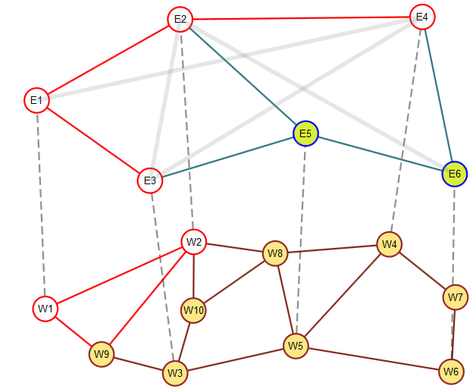
Example Solutions II
Two upper layer paths contribute to the load on link (E1, E2)
Demand on (E1, E2) needs to be split over two different paths [W1, W2] and [W1, W9, W2]

