Slide 1
LPs and MIPs background and solution approaches
Dr. Greg Bernstein
Grotto Networking
www.grotto-networking.com

Slide 2
Outline
LP problem formulations
A variety of different forms
Convex Sets and Functions
LP problems have both
Linear Programming
Polytopes and the Simplex Method
Mixed Integer Programming
Branch and Bound

Slide 3
LP and MIP References
P & M Sections 5.1.1, 5.1.2, 5.1.3, 5.2.1, 5.2.2
LINEAR PROGRAMMING: A Concise Introduction, Thomas S. Ferguson
http://www.math.ucla.edu/~tom/LP.pdf
Well written and to the point
Wikipedia
https://en.wikipedia.org/wiki/Linear_programming
Combinatorial Optimization, Algorithms and Complexity
Christos Papadimitriou & Kenneth Steiglitz, Dover
Good more advanced book, inexpensive. Referenced as P&S in these slides.

Slide 4
General Linear Program I
Indices
$j=1,2,…,n$ for the variables
$i=1,2,…,m$ for the constraints
Constants
$a_{ij}$ coefficient for variable j in constraint i
$b_{i}$ right-hand side of constraint i
$c_{j}$ cost coefficient of variable j
Variables
$x_{j}≥0$
Objective
Minimize $z=\sum_{j}{c_{j}x_{j}}$
Constraints
$\sum_{j}{a_{ij}x_{i}≤b_{i}}$ for $i=1,2,…,m$

Slide 5
General Linear Program II
Matrix/Vector form
Minimize $z=c^{T}x$
Subject to $Ax≤b$
Or even more tersely:
$\min_{x}\left\{c^{T}x:Ax≤b\right\}$

Slide 6
Other Forms
“Standard Form”
Minimize $z=c^{T}x$
Subject to $Ax=b$
How do we:
Deal with “relaxed Variables”, i.e., variables that can be positive or negative
Go from inequality constraints to equality constraints and vice-versa

Slide 7
LP Form conversion
Equality constraints in terms of inequalities
$\sum_{j}{a_{ij}x_{i}=b_{i}}$ is equivalent to
$\sum_{j}{a_{ij}x_{i}≤b_{i}}$ and $−\sum_{j}{a_{ij}x_{i}≤{−b}_{i}}$
Inequality constraints in terms of equality constraint
Add a slack variable, $\sum_{j}{a_{ij}x_{i}≤b_{i}}$ is equivalent to $\sum_{j}{a_{ij}x_{i}+s_{i}=b_{i}}$ where $s_{i}≥0$
An unconstrained variable $x_{i}⋚0$
Can be written as the difference of two constrained variables $x_{i}=x^{+}−x^{−}$

Slide 8
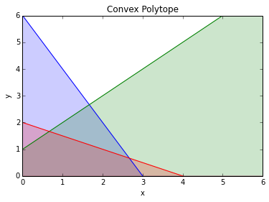
Convex Sets
Intuition
A set is convex if for any two points in the set the line connecting those points is also in the set.
Definition
A set S is convex if given any $x,y∈S$ then the set $\{αx+\left(1−α\right)y\}$ is contained in S for all $0≤α≤1$.

Slide 9
Optimizing over Convex Sets
Convex Function (P&S)
A function f:$S⊂ℝ^{n}→ℝ^{1}$is called convex if $f\left(λx+\left(1−λ\right)y\right)≤λf\left(x\right)+\left(1−λ\right)f(y)$ for $0≤λ≤1$, S a convex set, and $x,y∈S$.
Theorem (1.2 of P&S)
If f is a convex function and the feasible set, F, is convex then the minimization problem of f over F has the property that every local minimum on a Euclidean neighborhood is also a global minimum.

Slide 10
Convex Sets II
Proposition
The set $S=\left\{Ax≤b\right\}$ is convex.
Prove it!
Definition
The set $S=\left\{Ax≤b\right\}$ is called a (convex) polytope.
A bounded polytope is called a polyhedron

Slide 11
Extreme Points
Definition
A feasible point x is called an extreme point if it cannot be express as a finite convex linear combination $x=\sum_{k=1}^{K}{α_{k}}x^{k}$ of other feasible points $x^{k}$ where $∝_{k}≥0$ and $\sum_{k=1}^{K}{α_{k}}=1$.
Extreme points of a polytope are called vertices.
Theorem 5.1 (P&M)
If an LP problem has a bounded global minimum and the solution polytope contains at least one vertex, then the optimal solution set also contains at least one vertex.
Implication: Look for optimum at the polytope vertices!

Slide 12
How to find vertices of Polytope
Start with Standard form for feasible set
$Ax=b$, $x≥0$
Assume the m rows of A are linearly independent and x has dimension m.
Definition
A basis of A is a linearly independent collection of the columns of $ℬ=\{A_{j_{1}},A_{j_{2}}$,…, $A_{j_{m}}$}.
Choose a basis and use it to form a matrix B
Set all components of x not corresponding to a column in B to zero
Let $x_{j_{k}}$equal the kth component of $B^{−1}b$
This will be called a basic solution, it may not be feasible.

Slide 13
Example
Inequality system
Add slack variables to get equality constraints
Look at 3 x 5 matrix representing this system
(5 choose 3) = 10 potential “basis”

Slide 14
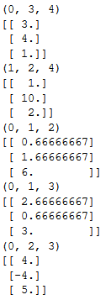
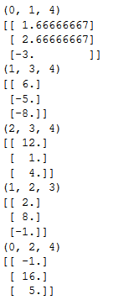
Example (cont.)
Not all basic solutions are feasible!
These five are not feasible. Why?

Slide 15
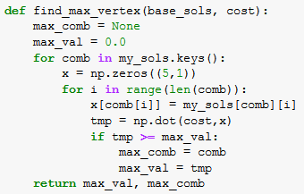
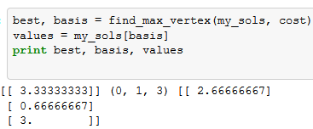
Example (cont.)
Compute cost at all feasible solutions
Take minimum

Slide 16
Number of Potential Polytope Vertices
Simplest Node Link Capacitated Allocation Problem
3 nodes, 6 links, 6 demands
36 link flow variables (6 links, 6 demands)
6 Link capacity constraints: add in 6 slack variables
Node conservation (balance) constraints: 18 (3 nodes, 6 demands)
Total 42 variables, 24 constraints ➔42 choose 24 potential vertices to be examined = 353,697,121,050
Can’t just iterate over all polytope vertices

Slide 17
Simplex Method
To solve
$\min_{x}\left\{c^{T}x:Ax≤b\right\}$
Find a basic feasible solution (BFS)
There are some common tricks to speed this up
From that initial BFS
Use the cost vector information to efficiently take us to another improved BFS (or stop if we are optimal).
Works very well in practice
See P&M section 5.1.3

Slide 18
Linear programming (LP) I
Many optimization problems can be formulated exactly or approximately as LP problems. LP problems are also used in the solution of many much harder optimization problems
Some well known LP Software
lp_solve (http://lpsolve.sourceforge.net/5.5/)
CLP (https://projects.coin-or.org/Clp) Part of the COIN-OR project
GLPK (GNU Linear Programming Kit)
CPLEX (now part of IBM, commercial)

Slide 19
Linear programming (LP) II
Optimization Specific Languages
AMPL -- A Modeling Language for Mathematical Programming (http://www.ampl.com/)
GNU MathProg modeling language, which is a subset of the AMPL language
Well known LP file formats
“The CPLEX LP file format provides a facility for entering a problem in a natural, algebraic LP formulation from the keyboard.” To read this type of file with lp_solve IDE rename to use an .lpt extension.
“MPS is an old format, so it is set up as though you were using punch cards. Fields start in column 2, 5, 15, 25, 40 and 50. Sections of an MPS file are marked by so-called header cards, which are distinguished by their starting in column 1. Although it is typical to use upper-case throughout the file (like I said, MPS has long historical roots), many MPS-readers will accept mixed-case for anything except the header cards, and some allow mixed-case anywhere.”
From http://lpsolve.sourceforge.net/5.5/

Slide 20
Theoretical Issues
Simplex Method is not a Polynomial Time Algorithms (P&S section 8.6)
Theorem
For every d >1 there is an LP with 2d equations and 3d variables such that the simplex method may take $2^{d}−1$ iterations to find the optimum.
More Theory
In 1979 is was proven that a particular method for solving LPs was polynomial. However in practice the simplex method is much faster.
In 1984 a new approach with polynomial time bounds was developed and appears competitive with the simplex method.
Practice
Simplex and other solver types appear, some may be better than others on particular problems.
Field continues to advance

Slide 21
Mixed Integer Programming (MIP)
Modular Dimensioning Problems
Real and integer values
Capacitated Allocation Problems
With “no-splitting” constraint leads to binary {0, 1} variables.
We know that these are NP-Complete
We’ve seen that they can be solved
How?

Slide 22
Branch and Bound
Idea
Use a “smart” divide and conquer strategy.
We’ll divide up the Feasible set into disjoint pieces
We’ll break the feasible set in pieces at integer boundaries of the variables
Issue we can get a lot of pieces…
We initially solve a “relaxed” LP version of the MIP on a such a subset. Three possible results
Relaxed solution is infeasible on the subset
Relaxed solution has an solution that isn’t as good as current best integer solution
Relaxed solution has a solution that is better than current best

Slide 23
Example Problem
MIP:
Maximize $8x_{1}+11x_{2}+6x_{3}+4x_{4}$
Subject to: $5x_{1}+7x_{2}+4x_{3}+3x_{4}≤14$
With $x_{i}∈\{0,1\}$ (binary)
Relaxed LP:
Maximize $8x_{1}+11x_{2}+6x_{3}+4x_{4}$
Subject to: $5x_{1}+7x_{2}+4x_{3}+3x_{4}≤14$
With ${0≤x}_{i}≤1$ (continuous and bounded)
Example from http://mat.gsia.cmu.edu/orclass/integer/node13.html

Slide 24
Relaxed LP and MIP: Feasibility
What does the feasibility of the Relaxed LP tell us about the feasibility of the MIP?
Nothing! The MIP could be either feasible or infeasible.
Why? The MIP is a more constrained problem than the Relaxed LP.
What does would the infeasibility of the Relaxed LP tell us about the infeasibility of the MIP?
The MIP is infeasible!

Slide 25
Relaxed LP and MIP: Optimality
What is the relationship between the best (maximum) value of the objective for
${Objective}_{relaxed LP}≥{Objective}_{MIP}$
Why?
The MIP is a more constrained problem than the Relaxed LP.
How can we use this in a divide and conquer strategy?
Can use it to (relatively) quickly evaluate whether a particular partition of the feasible set needs to be “searched”.

Slide 26
Relaxed LP and MIP: Optimality II
What does the optimality of the Relaxed LP on a subset of the feasible set relative to the best current solution of the MIP tell us?
If the relaxed solution on a subset of the feasible solution is not as good as the current best MIP solution then we don’t need to consider this subset any further, since no MIP solution on this subset can be as good as the LP solution.
B&B Terminology: we say a node/branch/subset has been fathomed if the above condition holds. In a sense we understand what the best that subset can offer and we don’t need to deal with it (further partitioning) any longer.

Slide 27
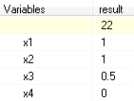
B&B Example Part 1
Relaxed LP:
Maximize $8x_{1}+11x_{2}+6x_{3}+4x_{4}$
Subject to: $5x_{1}+7x_{2}+4x_{3}+3x_{4}≤14$
With ${0≤x}_{i}≤1$ (continuous and bounded)
Solution is not an integer (see $x_{3}$):

Slide 28
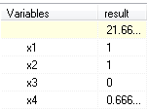
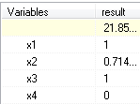
B&B Example Part 2
Maximize $8x_{1}+11x_{2}+6x_{3}+4x_{4}$
Subject to: $5x_{1}+7x_{2}+4x_{3}+3x_{4}≤14$
With ${0≤x}_{1},x_{2},x_{4}≤1$
Split feasible set into two pieces one with $x_{3}=0$ and one with $x_{3}=1$
Solution is not an integer:
X3=0
X3=1
Which one to try next?

Slide 29
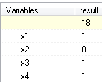
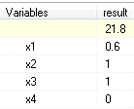
B&B Example Part 3
Second Branching
Maximize $8x_{1}+11x_{2}+6x_{3}+4x_{4}$
Subject to: $5x_{1}+7x_{2}+4x_{3}+3x_{4}≤14$
With ${0≤x}_{1},x_{4}≤1$, $x_{3}=1$
Split chosen subset of feasible set into two pieces one with $x_{2}=0$ and one with $x_{2}=1$
X2=1
X2=0
Integer Solution
(Best so far)

Slide 30
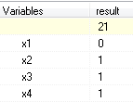
B&B Example Part 4
Third Branching
Maximize $8x_{1}+11x_{2}+6x_{3}+4x_{4}$
Subject to: $5x_{1}+7x_{2}+4x_{3}+3x_{4}≤14$
With $0≤x_{4}≤1$, $x_{3}=1$, $x_{2}=1$
Split chosen subset of feasible set into two pieces one with $x_{1}=0$ and one with $x_{1}=1$
X1=1
X1=0
Integer Solution
(Best so far)

Slide 31
B&B Example Part 5
Branching Tree:
X3=0
X3=1
X1=0
X1=1
Integer Solution
(Best so far)
Integer Solution
(Best )

Slide 32
Understanding B&B Solver Behavior
lp_solve open source MIP solver
Modular Dimensioning Node Link Formulation
Chinese Network (directed) 204 links, 54 nodes
1224 variables, 474 constraints
204 integer (not binary) variables
$$gap=\frac{MIPSolution−RelaxedSolution}{RelaxedSolution}$$

Slide 33
Understanding B&B Solver Behavior
Modular Dimensioning Node Link Formulation
Chinese Network (directed) 204 links, 54 nodes
1224 variables, 474 constraints
204 integer (not binary) variables

Slide 34
Websites and Such
Introduction to Integer Linear Programming
http://wpweb2.tepper.cmu.edu/fmargot/introILP.html
A Tutorial on Integer Programming
http://mat.gsia.cmu.edu/orclass/integer/integer.html
MINLP Collaboration Site (CMU-IBM)
http://minlp.org/index.php

