Slide 1
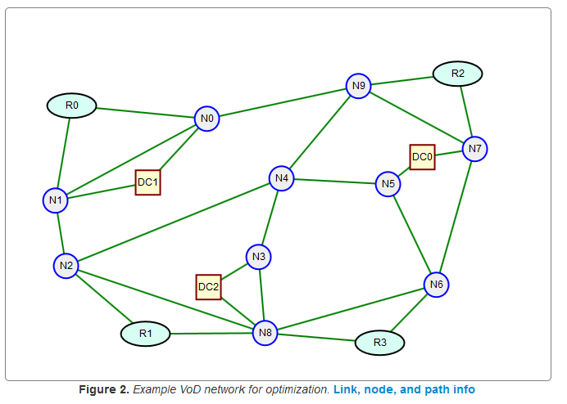
Network Dimensioning Problems: Where to put the capacity and how much…
B
Dr. Greg Bernstein
Grotto Networking
www.grotto-networking.com

Slide 2
Outline
Basic Dimensioning Problem
  From constraints to variables
  Link Path Formulation
  Node Link Formulation
  Comments
Shortest Paths (separate slide deck)
Technology Realities and examples
  Ethernet LAGs, SONET/SDH, G.709
Modular Links
  Shortest Path allocation rule doesn’t apply
  Theoretical difficulty of MIPs

Slide 3
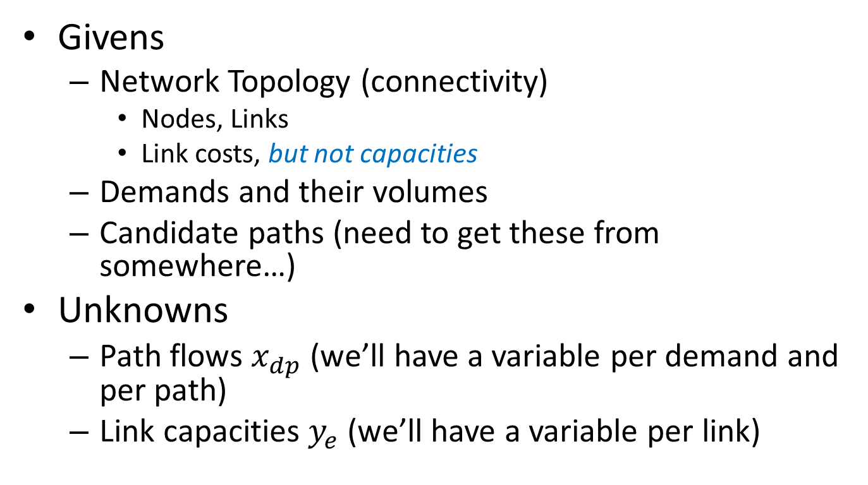
Basic Dimensioning Problem:
Link-Path Formulation
Givens
  Network Topology (connectivity)
    Nodes, Links
    Link costs, but not capacities
  Demands and their volumes
  Candidate paths (need to get these from somewhere…)
Unknowns
  Path flows $x_{dp}$ (we’ll have a variable per demand and per path)
  Link capacities $y_{e}$ (we’ll have a variable per link)

Slide 4
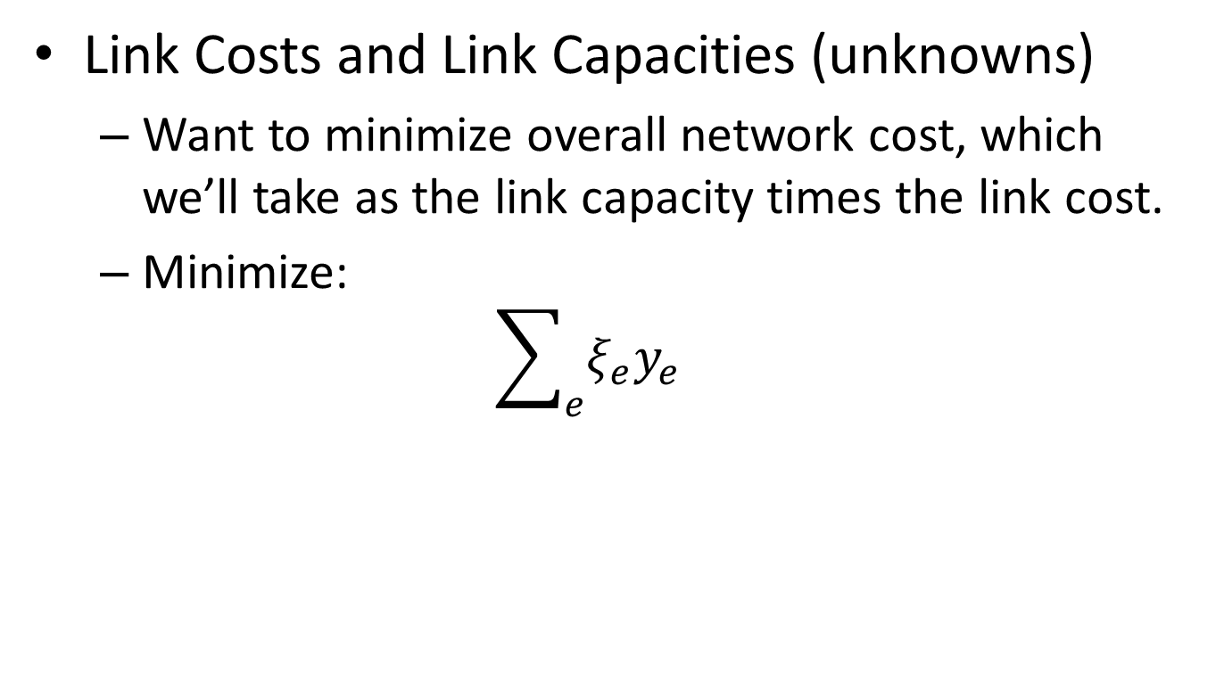
Cost Function
Link Costs and Link Capacities (unknowns)
  Want to minimize overall network cost, which we’ll take as the link capacity times the link cost.
  Minimize:
  $$\sum_{e}{ξ_{e}y_{e}}$$

Slide 5
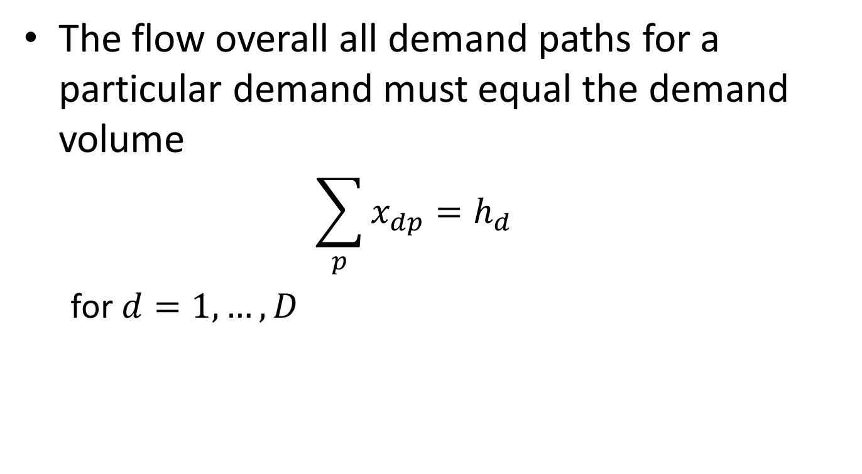
Demand Constraints
The flow overall all demand paths for a particular demand must equal the demand volume
  $$\sum_{p}{x_{dp}=h_{d}}$$
  for $d=1,…,D$

Slide 6
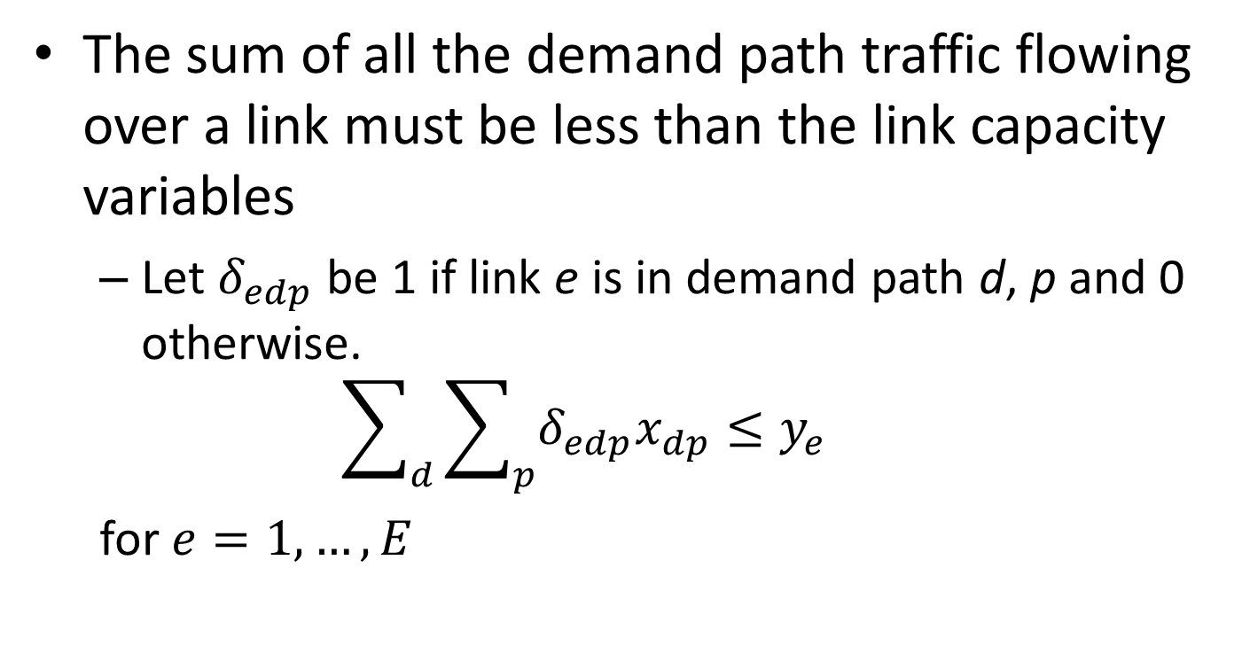
Link Capacity Constraints
The sum of all the demand path traffic flowing over a link must be less than the link capacity variables
  Let $δ_{edp}$ be 1 if link e is in demand path d, p and 0 otherwise.
  $$\sum_{d}{\sum_{p}{δ_{edp}x_{dp}≤y_{e}}}$$
  for $e=1,…,E$

Slide 7
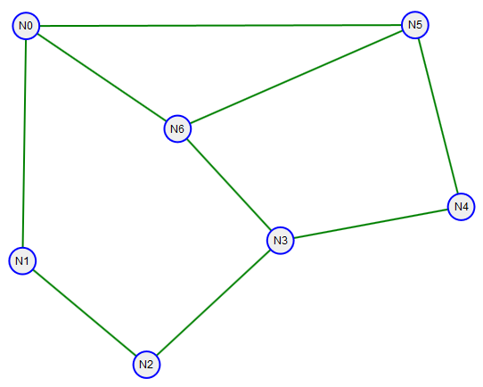
Dimensioning Link-Path Example
  7 nodes, 9 links, 5 demands, 3 candidate paths per demand
  demands = {("N0", "N3"): 25, ("N2", "N3"): 29, ("N1", "N6"): 25, ("N3", "N5"): 31, ("N0", "N2"): 16}
  Candidate_paths = {('N2', 'N3'): [['N2', 'N3'], ['N2', u'N1', u'N0', u'N6', 'N3'], ['N2', u'N1', u'N0', u'N5', u'N4', 'N3']], ('N0', 'N3'): [['N0', u'N6', 'N3'], ['N0', u'N1', u'N2', 'N3'], ['N0', u'N5', u'N4', 'N3']], ('N1', 'N6'): [['N1', u'N0', 'N6'], ['N1', u'N2', u'N3', 'N6'], ['N1', u'N0', u'N5', 'N6']], ('N0', 'N2'): [['N0', u'N1', 'N2'], ['N0', u'N6', u'N3', 'N2'], ['N0', u'N5', u'N4', u'N3', 'N2']], ('N3', 'N5'): [['N3', u'N4', 'N5'], ['N3', u'N6', 'N5'], ['N3', u'N6', u'N0', 'N5']]}
  15 Path demand variables, 9 link capacity variables

Slide 8
Dimensioning Link-Path Example
  Minimize
  OBJ: y_N0_N1 + y_N0_N5 + y_N0_N6 + y_N1_N2 + y_N2_N3 + y_N3_N4 + y_N3_N6 + y_N4_N5 + y_N5_N6
  Subject To
  DemandSat_N0_N2: xDN0_N2P_0 + xDN0_N2P_1 + xDN0_N2P_2 = 16
  DemandSat_N0_N3: xDN0_N3P_0 + xDN0_N3P_1 + xDN0_N3P_2 = 25
  DemandSat_N1_N6: xDN1_N6P_0 + xDN1_N6P_1 + xDN1_N6P_2 = 25
  DemandSat_N2_N3: xDN2_N3P_0 + xDN2_N3P_1 + xDN2_N3P_2 = 29
  DemandSat_N3_N5: xDN3_N5P_0 + xDN3_N5P_1 + xDN3_N5P_2 = 31
  LinkCap|LN0_N1: xDN0_N2P_0 + xDN0_N3P_1 + xDN1_N6P_0 + xDN1_N6P_2 + xDN2_N3P_1 + xDN2_N3P_2 - y_N0_N1 <= 0
  LinkCap|LN0_N5: xDN0_N2P_2 + xDN0_N3P_2 + xDN1_N6P_2 + xDN2_N3P_2 + xDN3_N5P_2 - y_N0_N5 <= 0
  LinkCap|LN0_N6: xDN0_N2P_1 + xDN0_N3P_0 + xDN1_N6P_0 + xDN2_N3P_1 + xDN3_N5P_2 - y_N0_N6 <= 0
  LinkCap|LN1_N2: xDN0_N2P_0 + xDN0_N3P_1 + xDN1_N6P_1 + xDN2_N3P_1 + xDN2_N3P_2 - y_N1_N2 <= 0
  LinkCap|LN2_N3: xDN0_N2P_1 + xDN0_N2P_2 + xDN0_N3P_1 + xDN1_N6P_1 + xDN2_N3P_0 - y_N2_N3 <= 0
  LinkCap|LN3_N4: xDN0_N2P_2 + xDN0_N3P_2 + xDN2_N3P_2 + xDN3_N5P_0 - y_N3_N4 <= 0
  LinkCap|LN3_N6: xDN0_N2P_1 + xDN0_N3P_0 + xDN1_N6P_1 + xDN2_N3P_1 + xDN3_N5P_1 + xDN3_N5P_2 - y_N3_N6 <= 0
  LinkCap|LN4_N5: xDN0_N2P_2 + xDN0_N3P_2 + xDN2_N3P_2 + xDN3_N5P_0 - y_N4_N5 <= 0
  LinkCap|LN5_N6: xDN1_N6P_2 + xDN3_N5P_1 - y_N5_N6 <= 0
Solution:
y_N0_N1 = 41.0
y_N0_N5 = 0.0
y_N0_N6 = 50.0
y_N1_N2 = 16.0
y_N2_N3 = 29.0
y_N3_N4 = 0.0
y_N3_N6 = 56.0
y_N4_N5 = 0.0
y_N5_N6 = 31.0

Slide 9
Dimensioning Link-Path Example
  Demand path variable solution:
  xDN0_N2P_0 = 16.0
  xDN0_N2P_1 = 0.0
  xDN0_N2P_2 = 0.0
  xDN0_N3P_0 = 25.0
  xDN0_N3P_1 = 0.0
  xDN0_N3P_2 = 0.0
  xDN1_N6P_0 = 25.0
  xDN1_N6P_1 = 0.0
  xDN1_N6P_2 = 0.0
  xDN2_N3P_0 = 29.0
  xDN2_N3P_1 = 0.0
  xDN2_N3P_2 = 0.0
  xDN3_N5P_0 = 0.0
  xDN3_N5P_1 = 31.0 ????
  xDN3_N5P_2 = 0.0
Observations:
It seems like P0 path is used for most demands. Why?
For the (N3, N5) demand the P1 path is used? How could this happen?

Slide 10
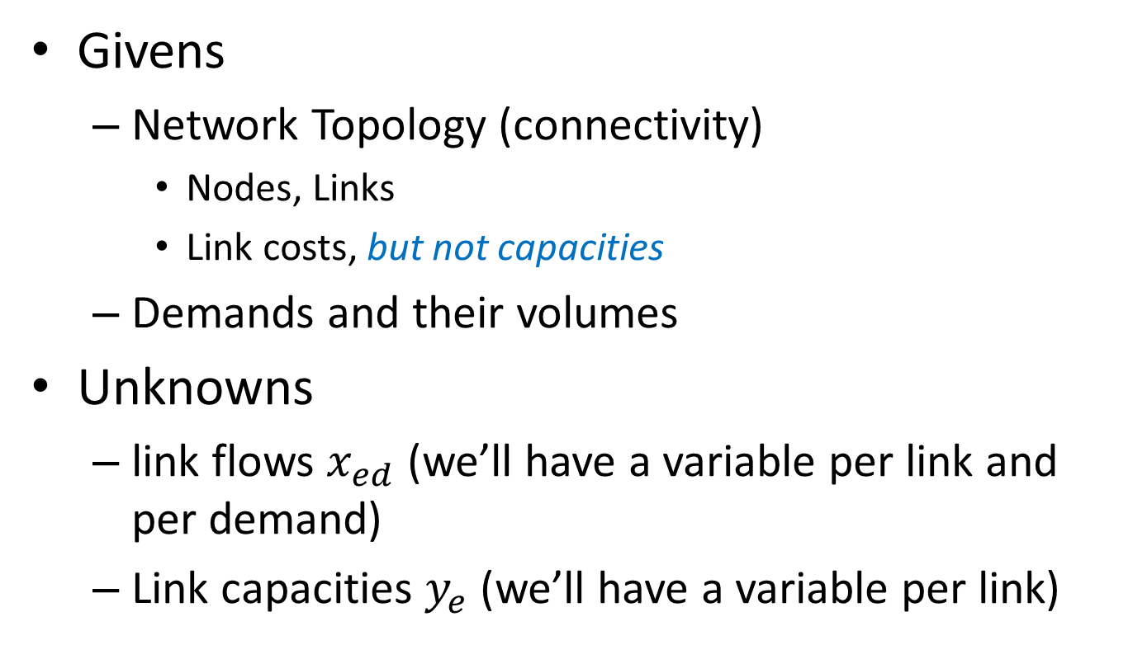
Basic Dimensioning Problem:
Node-Link Formulation
Givens
  Network Topology (connectivity)
    Nodes, Links
    Link costs, but not capacities
  Demands and their volumes
Unknowns
  link flows $x_{ed}$ (we’ll have a variable per link and per demand)
  Link capacities $y_{e}$ (we’ll have a variable per link)

Slide 11
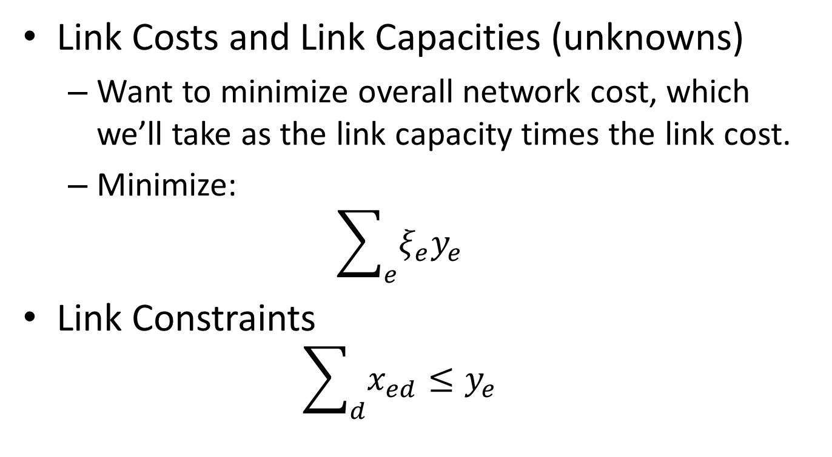
Cost Function & Link Constraints
Link Costs and Link Capacities (unknowns)
  Want to minimize overall network cost, which we’ll take as the link capacity times the link cost.
  Minimize:
  $$\sum_{e}{ξ_{e}y_{e}}$$
Link Constraints
  $$\sum_{d}{x_{ed}}≤y_{e}$$

Slide 12
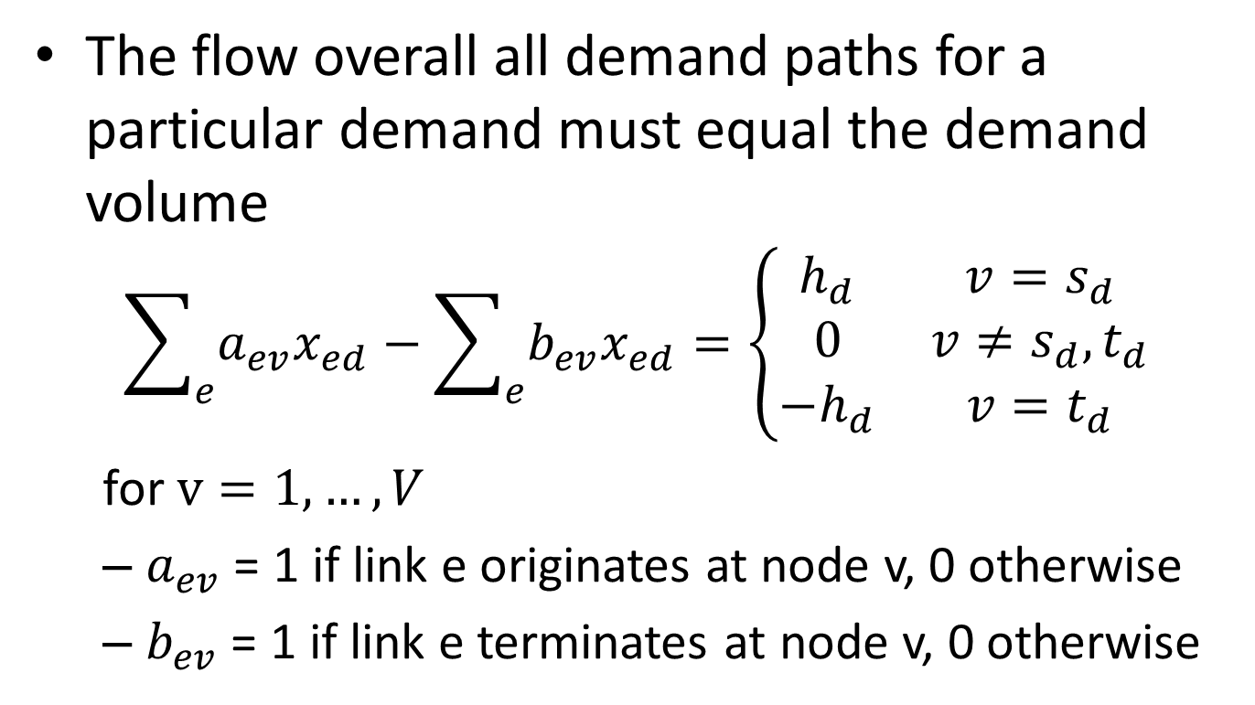
Node Conservation Constraints
The flow overall all demand paths for a particular demand must equal the demand volume
  $$\sum_{e}{a_{ev}x_{ed}}−\sum_{e}{b_{ev}x_{ed}}=\left\{\begin{matrix}h_{d} & v=s_{d} \\ 0 & v≠s_{d},t_{d} \\ −h_{d} & v=t_{d}\end{matrix}\right.$$
  for $v=1,…,V$
  $a_{ev}$ = 1 if link e originates at node v, 0 otherwise
  $b_{ev}$ = 1 if link e terminates at node v, 0 otherwise

Slide 13
Dimensioning Node-Link Example
  7 nodes, 18 (directed) links, 5 demands (directed)
  90 link-demand variables
  See file: basicDimNodeLinkEx.lpt

Slide 14
Dimensioning Node-Link Example
Organized by demands
  xLN0_N1_DN0_N2 = 16.0
  xLN1_N2_DN0_N2 = 16.0
  xLN1_N0_DN1_N6 = 25.0
  xLN0_N6_DN1_N6 = 25.0
  xLN0_N6_DN0_N3 = 25.0
  xLN6_N3_DN0_N3 = 25.0
  xLN2_N3_DN2_N3 = 29.0
  xLN3_N4_DN3_N5 = 31.0
  xLN4_N5_DN3_N5 = 31.0
Do you see a pattern?
  Is there a simple rule that we could have used rather than solving all these equations?
Solution
  y_N0_N1 = 16.0
  y_N0_N6 = 50.0
  y_N1_N0 = 25.0
  y_N1_N2 = 16.0
  y_N2_N3 = 29.0
  y_N3_N4 = 31.0
  y_N4_N5 = 31.0
  y_N6_N3 = 25.0

Slide 15
Comments
Basic (Linear & Continuous) Dimensioning Problem
  Shortest Path Allocation Rule
  In the link-path formulation allocate all flow to the shortest path for a particular demand, use these to come up with the link capacities.
  In the node-link formulation allocate link flow for a demand based on the network’s shortest path between the nodes of the demand pair.
  No LP Solution is necessary.
  How do we get the paths? See Shortest Path slides.

Slide 16
Technical Realities
Links come in fixed sizes! You can’t get a 2.3Gbps Ethernet link :-<
Ethernet
  10Mbps, 100Mbps, 1Gbps, 10Gbps, 100Gbps
SONET (Synchronous Optical NETwork)
  STS-1 (50Mbps), STS-3 (155Mbps), STS-12 (622Mbps), STS-48 (2.5Gbps), STS-192 (10Gbps), STS-768 (40Gbps)
  OC-3, OC-12, OC-48, OC-192, OC-768 (OC = optical carrier)
SDH (Synchronous Digital Hierarchy)
  STM-1, STM-4, STM-16, STM-64, STM-256
G.709 (Optical Transport Network)
  OTU1 (2.5Gbps), OTU2 (10Gbps), OTU3(40Gbps), OTU4(100Gbps)

Slide 17
Link Aggregation
General Notion
  https://en.wikipedia.org/wiki/Link_aggregation
Ethernet
  Link Aggregation Groups (single hop)
  IEEE standard 802.1AX-2008
    Read sections 1, 5.1.2, 5.1.3, 5.2.1
Virtual Concatenation (SONET, SDH, G.709)
  Included in G.707 and G.709, Link Capacity Adjustment Scheme (LCAS) in G.7042
  G. Bernstein, D. Caviglia, R. Rabbat, and H. Van Helvoort, “VCAT-LCAS in a clamshell,” IEEE Communications Magazine, vol. 44, no. 5, pp. 34–36, May 2006.

Slide 18
Multiplexing Hierarchies
SONET/SDH
  Basic frame structure: 9 rows x 90 columns, repeating every 125uS
  Two levels of TDM multiplexing
  SONET/SDH very similar except for terminology
G.709
  One level of optical multiplexing, one level of TDM multiplexing
  Basic frame structure 4 rows x 4080 columns (frame rates vary)

Slide 19
SONET STS-1 Structure
Rate = 90 bytes x 9 rows x 64kbps = 51.84Mbps

Slide 20
SONET/SDH Equivalence
SONET | SDH
Synchronous Transport Signal 3N (STS-3N) | Synchronous Transport Module N (STM-N)
SONET Section | Regenerator Section (RS)
SONET Line | Multiplex Section (MS)
STS Group (not really a SONET term) | Administrative Unit Group (AUG)
STS Channel (not really a SONET term) | Administrative Unit 3 (AU-3)
STS-3c Channel (not really a SONET term) | Administrative Unit 4 (AU-4)
STS-1 Path (i.e., STS SPE but without the fixed stuff in columns) | Virtual Container 3 (VC-3)
STS-3c Path (i.e., STS-3c SPE) | Virtual Container 4 (VC-4)
No SONET equivalent | Tributary Unit Group 3 (TUG-3)
No SONET equivalent | Tributary Unit 3 (TU-3)
VT Group | Tributary Unit Group 2 (TUG-2)
VT-1.5 Channel (not really a SOET term) | Tributary Unit 11 (TU-11)
VT-2 Channel (not really a SONET term) | Tributary Unit 12 (TU-12)
VT-3 Channel (not really a SONET term) | No SDH equivalent
VT-6 Channel (not really a SONET term) | Tributary Unit 2 (TU-2)
VT-1.5 Path | Virtual Container 11 (VC-11)
VT-2 Path | Virtual Container 12 (VC-12)
VT-3 Path | No SDH equivalent
VT-6 Path | Virtual Container 2 (VC-2)
VT1.5 payload capacity | Container 11 (C-11)
VT2 payload capacity | Container 12 (C-12)
VT3 payload capacity | No SDH equivalent
VT6 payload capacity | Container 2 (C-2)
STS-1 payload capacity | Container 3 (C-3)
STS-3c payload capacity | Container 4 (C-4)
STS-Nc SPE N>3 | VC-4-Xc (X=N/3)

Slide 21
STS-N and STM-N Signals
SONET N=3, 12, 48, 192, 768
SDN N = 1, 4, 16, 64, 256

Slide 22
Finer granularity multiplexing
  Bit rate of a VT1.5/VC-11: 27 bytes every 125us ➔ 1.728Mbps, What would you use this for?
  Bit rate of a VT2/VC-12: 36 bytes every 125us ➔2.304Mbps, What would you use this for?

Slide 23
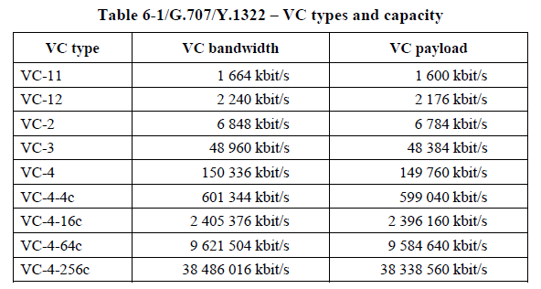
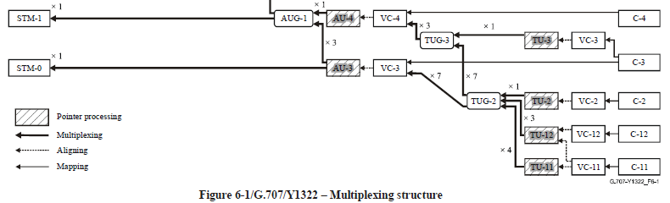
Lower order virtual containers
Finer granularity multiplexing for T1 and E1 signals
  28 T1s in an STM-0
  21 E1s in an STM-0

Slide 24
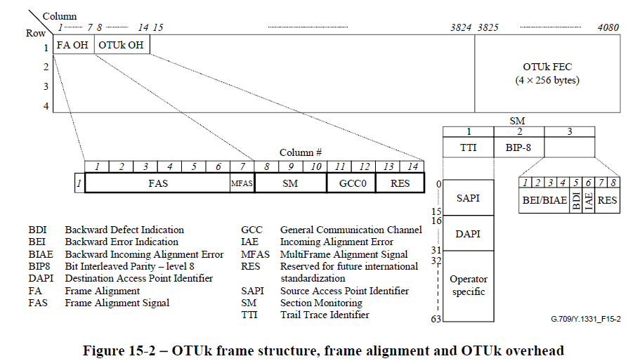
G.709 TDM Signal Structure
Note only 14 bytes of overhead per 4x3824=15296, less than 0.1%

Slide 25
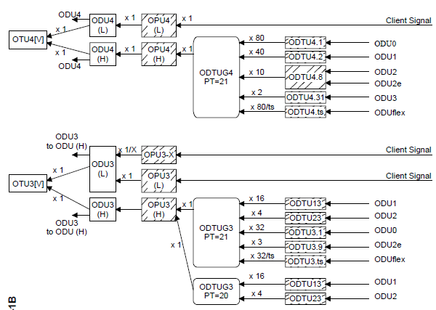
G.709 Multiplexing Hierarchy (partial)

Slide 26
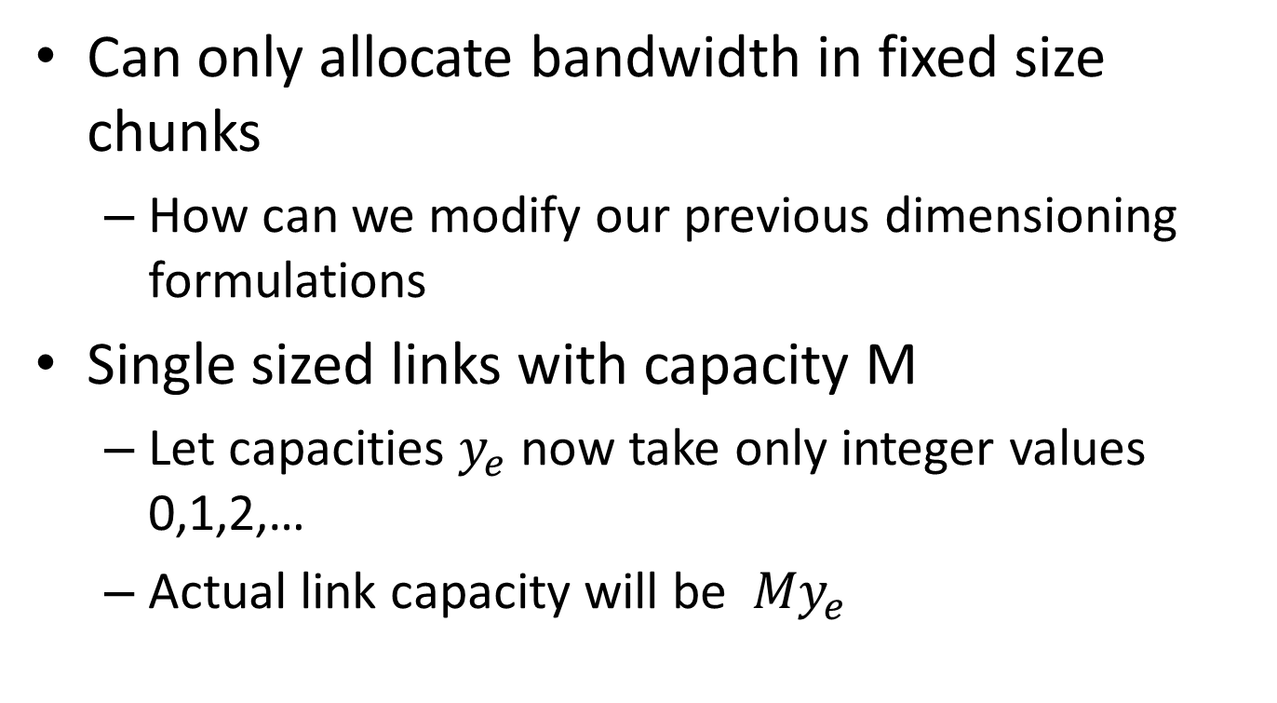
Modular Dimensioning Problems
Can only allocate bandwidth in fixed size chunks
  How can we modify our previous dimensioning formulations
Single sized links with capacity M
  Let capacities $y_{e}$ now take only integer values 0,1,2,…
  Actual link capacity will be ${My}_{e}$

Slide 27
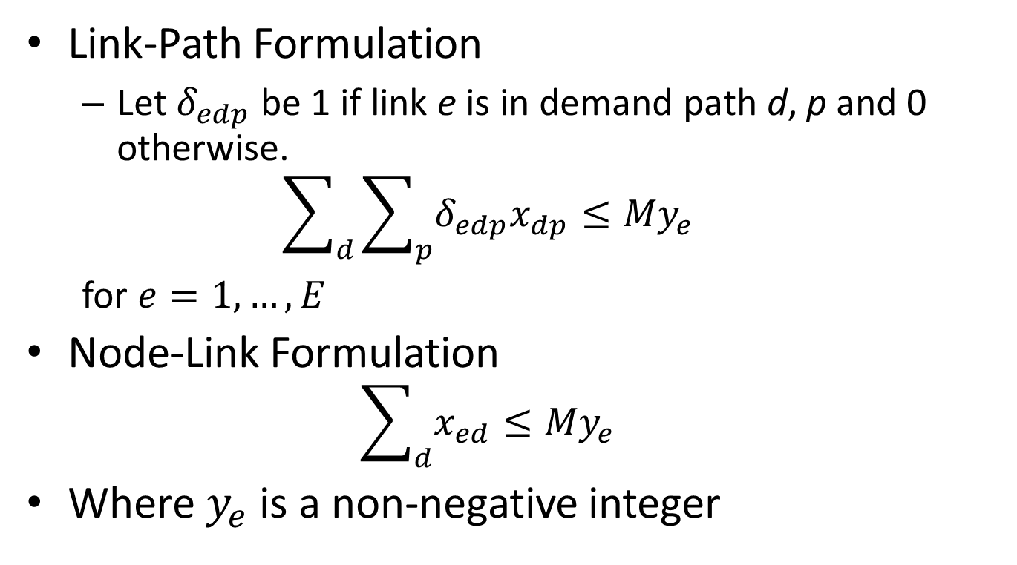
Link Capacity Constraints
Link-Path Formulation
  Let $δ_{edp}$ be 1 if link e is in demand path d, p and 0 otherwise.
  $$\sum_{d}{\sum_{p}{δ_{edp}x_{dp}≤{My}_{e}}}$$
  for $e=1,…,E$
Node-Link Formulation
  $$\sum_{d}{x_{ed}}≤{My}_{e}$$
Where $y_{e}$ is a non-negative integer

Slide 28
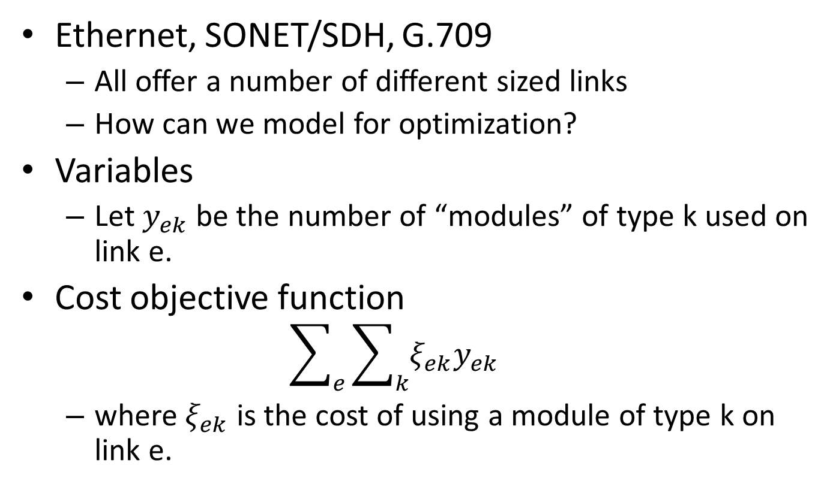
More than one speed link?
Ethernet, SONET/SDH, G.709
  All offer a number of different sized links
  How can we model for optimization?
Variables
  Let $y_{ek}$ be the number of “modules” of type k used on link e.
Cost objective function
  $$\sum_{e}{\sum_{k}{ξ_{ek}y_{ek}}}$$
  where $ξ_{ek}$ is the cost of using a module of type k on link e.

Slide 29
Bad News…
Proposition 4.3 (P&M page 126)
  The Dimensioning problem with modular links is NP complete.
Appendix B of P&M reviews Complexity Theory
  In essence our slightly modified dimensioning problem went from a simple shortest path algorithm guaranteed a low order polynomial in network size to something potentially exponential

Slide 30
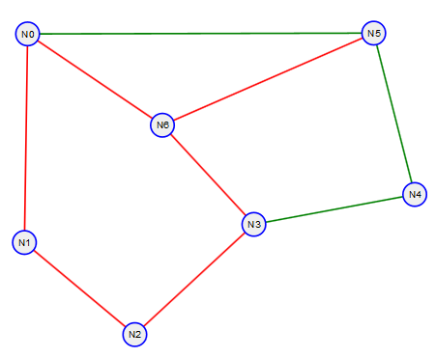
Example Link Path
Use the sample network and demands but limit to 40Gbps link sizes
  Demands = {('N0', 'N2'): 16, ('N0', 'N3'): 25, ('N1', 'N6'): 25, ('N2', 'N3'): 29, ('N3', 'N5'): 31}
Unrestricted Solution:
y_N0_N1 = 41.0
y_N0_N5 = 0.0
y_N0_N6 = 50.0
y_N1_N2 = 16.0
y_N2_N3 = 29.0
y_N3_N4 = 0.0
y_N3_N6 = 56.0
y_N4_N5 = 0.0
y_N5_N6 = 31.0
Total cost = 223
Modular (M = 40)Solution:
y_N0_N1 = 1.0
y_N0_N5 = 0.0
y_N0_N6 = 1.0
y_N1_N2 = 1.0
y_N2_N3 = 1.0
y_N3_N4 = 0.0
y_N3_N6 = 2.0
y_N4_N5 = 0.0
y_N5_N6 = 1.0
Total cost = 280
2

Slide 31
Example Link Path
Paths Taken
  Demands = {('N0', 'N2'): 16, ('N0', 'N3'): 25, ('N1', 'N6'): 25, ('N2', 'N3'): 29, ('N3', 'N5'): 31}
Unrestricted Solution paths:
  xDN0_N2P_0 = 16.0
  xDN0_N3P_0 = 25.0
  xDN1_N6P_0 = 25.0
  xDN2_N3P_0 = 29.0
  xDN3_N5P_1 = 31.0
Modular (M = 40)Solution:
xDN0_N2P_0 = 16.0
xDN0_N3P_0 = 25.0
xDN1_N6P_0 = 15.0
xDN1_N6P_1 = 10.0
xDN2_N3P_0 = 29.0
xDN3_N5P_1 = 31.0
2

Slide 32
Modular Node Link Example I
(M = 40) Node-Link Solution (directed network):
y_N0_N1 = 1.0
y_N0_N6 = 1.0
y_N1_N0 = 1.0
y_N1_N2 = 1.0
y_N2_N1 = 1.0
y_N2_N3 = 1.0
y_N3_N2 = 1.0
y_N3_N6 = 2.0
y_N4_N3 = 1.0
y_N5_N4 = 1.0
y_N6_N0 = 1.0
y_N6_N3 = 1.0
y_N6_N5 = 1.0
Total cost = 560
We didn’t put any requirements for
  Symmetric links
  Symmetric path assignments
into out equations so we didn’t get them in our solutions!

Slide 33
Large Node-Link Example
Chinese Network
  Demands <n3, n51>, <n8, n21>, <n6, n23>, <n4, n22>, <n7, n36>, 1Gpbs each
  Modularity of links 10Gbps
Problem size:
  Network with 204 directed links, 54 nodes, 5 Demand pairs
  Link Flow Variables: 1020
  Link Capacity Variables: 204
  Node flow conservation constraints: 270
  Link capacity constraints: 204

Slide 34
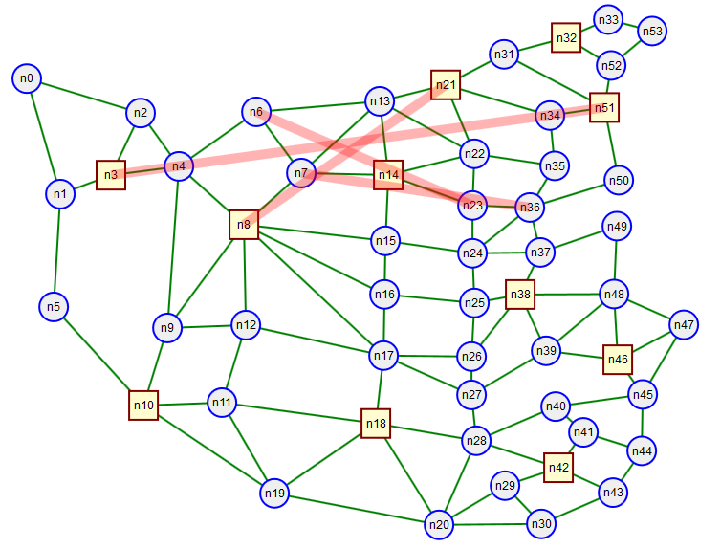
Network and Demands

Slide 35
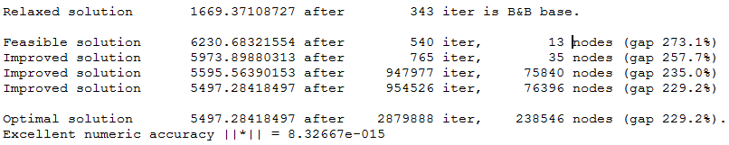
Results I
With CBC called via Python
  Windows Laptop with Intel I5 processor: After 1 minute 7 seconds, Total cost 5497.28, declared optimal. (CBC is from COIN-OR)
  Linux Desktop with Intel I7 processor: 38.9 seconds.
With lp_solve called separately
  Windows Lapt top with Intel I5 processor: After 7 minutes 44 seconds, Total cost 5497.28, declared optimal. (lp_solve is older code)
From lp_solve
Look at iteration count to declare optimal from finding feasible and improved solutions

Slide 36
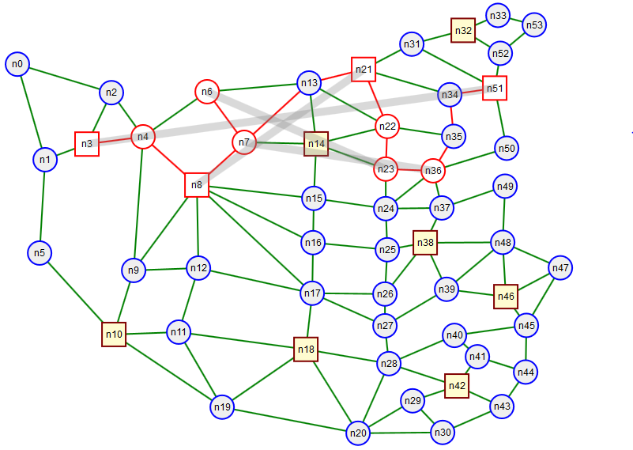
Results II
Links used: [y_n13_n21, y_n21_n22, y_n22_n23, y_n23_n36, y_n3_n4, y_n34_n51, y_n35_n34, y_n36_n35, y_n4_n8, y_n6_n7, y_n7_n13, y_n8_n7] ➔ 12 links

