Slide 1
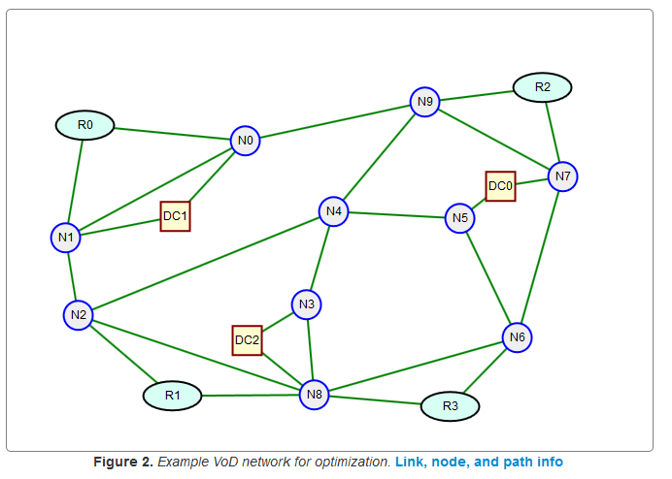
Network Design and Optimization
Introduction
Dr. Greg Bernstein
Grotto Networking
www.grotto-networking.com

Slide 2
Outline
Who we are…
The Context for Network Design & Analysis
What we will cover this quarter
Class mechanics

Slide 3
Who am I?
Part time lecturer
  Networking, C++, OO Programing
Consultant
  Standards work at IETF, ITU-T, and OIF
  GMPLS, WSON, PCE, MPLS
  Book author, journal publications, patents…
Part time hacker
  Python, JavaScript, C++, HTML5, CSS, etc…
Industry experience
  Former director of software development at an acquired startup whose products are deployed in core networks around the world. Radio, IP, ATM, MPLS, GMPLS, SONET/SDH, WDM…
  Lots of “optical plumbing” stuff ☺
Academics
  B.S., M.S., Ph.D. University of California Berkeley

Slide 4
Who are you?
Industry experience?
  How many years?
  Networking experience? What technologies?
Programming languages
  Python, Java, C++, JavaScript, HTML5, CSS?
Math
  Linear algebra?, calculus, more?
Statistics
  Probability?, Stochastic processes?, queueing theory?

Slide 5
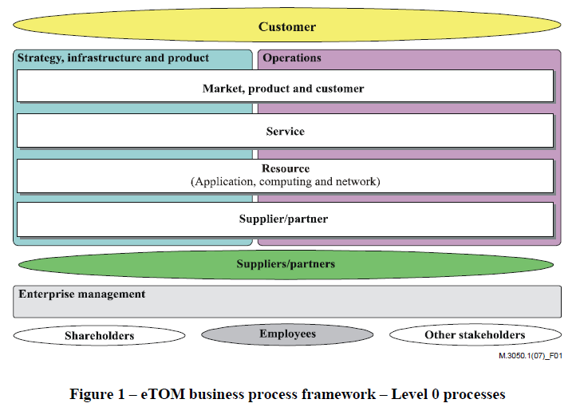
Network analysis and design Context I
Where do we fit in?
  Telecom Operations Map from ITU-T M.3050.1 (2007)

Slide 6
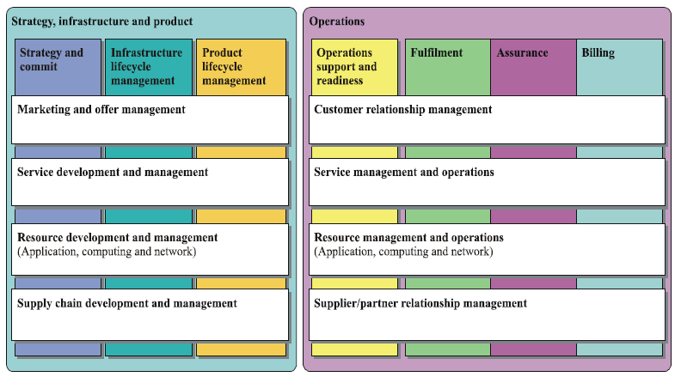
Network analysis and design Context II
Where do we fit in?
  Telecom Operations Map from ITU-T M.3050.1 (2007)
We are here

Slide 7
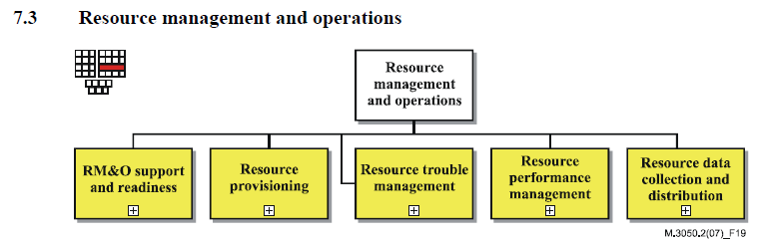
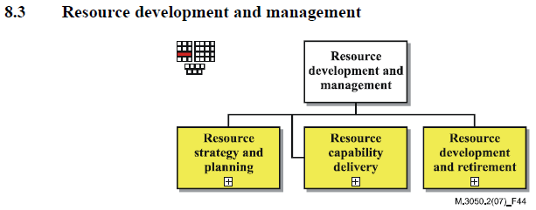
Network analysis and design Context III
Where do we fit in?
  Telecom Operations Map from ITU-T M.3050.2 (2007)

Slide 8
Network Analysis
What can we get from a given network
  Throughput, QoS, reliability
What if Analysis?
  Changing traffic patterns?
  Changing statistical properties?
  Disaster Planning and Restoration
Performance Analysis

Slide 9
Network Design
Green Field
  Starting from “nothing” (rare)
Incremental Build out
  Network enhancements for new services, changing traffic and usage patterns
Overlay Design
  Design or redesign of layer in a multi-layer network, including “application overlays” such as CDNs.
Optimization
  How can performance or throughput improvements

Slide 10
Network Environments and Technologies
Environments:
  Data Center; Including HPC, extremely large multi-building
  WAN (Wide Area Network)
  MAN (Metropolitan Area Network)
  Enterprise (from the home to Fortune 500 companies)
Technologies:
  IP, MPLS
  Ethernet, SDN (OpenFlow)
  TDM (G.709, SONET/SDH),
  WDM, WSON, ULH (ultra long haul), UHC (ultra high capacity)

Slide 11
Course Mechanics I
Objectives:
  Understand essential network design and analysis concepts and algorithms and their relative strengths and weaknesses.
Prerequisite:
  An Upper division (Junior/Senior level) Networking class
Required Text:
  M. Pioro and D. Medhi, Routing, Flow, and Capacity Design in Communication and Computer Networks. Elsevier, 2004.
  Supplementary reading materials from the computing and networking literature will be assigned.

Slide 12
Programming in Python
Python is a very flexible language that is relatively easy to get started with and has much support in the scientific, cloud computing and engineering communities.
We will be using several common additional engineering and scientific packages with Python.
For ease of getting started there are scientific "Python distributions" available for no cost via the web. We will use Python version 2.7 due to its compatibility with numerical packages such as Numpy, Matplotlib, SciPy, NetworkX, SimPy, etc...
  Anaconda (Windows, Mac, Linux) https://store.continuum.io/cshop/anaconda/
  Python(x,y) (Windows) https://code.google.com/p/pythonxy/
  Enthought Canopy Express https://www.enthought.com/products/epd/free/

Slide 13
Math in this Course
We will be describing our networks in a form suitable for “optimization” ➔ mathematically
We will be working with a large number of variables and constraints
  We’ll use an essential minimum of mathematical notation to do this in a efficient way.
  We will actually generate the equations via software.
  We’ll use open source software to solve these equations
We will use a fair number of mathematical results and algorithms
  Most will be from Open Source libraries
  Some algorithms are taken from the literature and implemented by me ☺
  We will not have time to prove these results ☹
Ask Questions on unfamiliar notation or terms!!!

Slide 14
Topics for this Quarter
A bit of Queueing Theory
  Review of Random Variables, Waiting times, Blocking probabilities
Discrete Event Simulation
  How do performance evaluation tools such as Comnet, Omnet++, NS2 work? What are they good and not good for…
Formulation of Network Design Problems
  General techniques, Technology specifics
  Automation of equation generation from network description
Solution of Network Design Problems
  Just scratching the surface; use of open source solvers
  Processing results, visualizing results
Network Measurements
  For demand and statistic determination
Using Python to assist all the above and web tools for visualization, e.g., D3.js (http://d3js.org/)

